Slide 1
Arterial Blood Gas (ABG)
Veronica Chandre
PPT-20007-C1 Rev 1
INTERNAL USE ONLY

Slide 2
Agenda
Clinical Review
Product Overview
Clinical Selling
Competition
INTERNAL USE ONLY

Slide 3
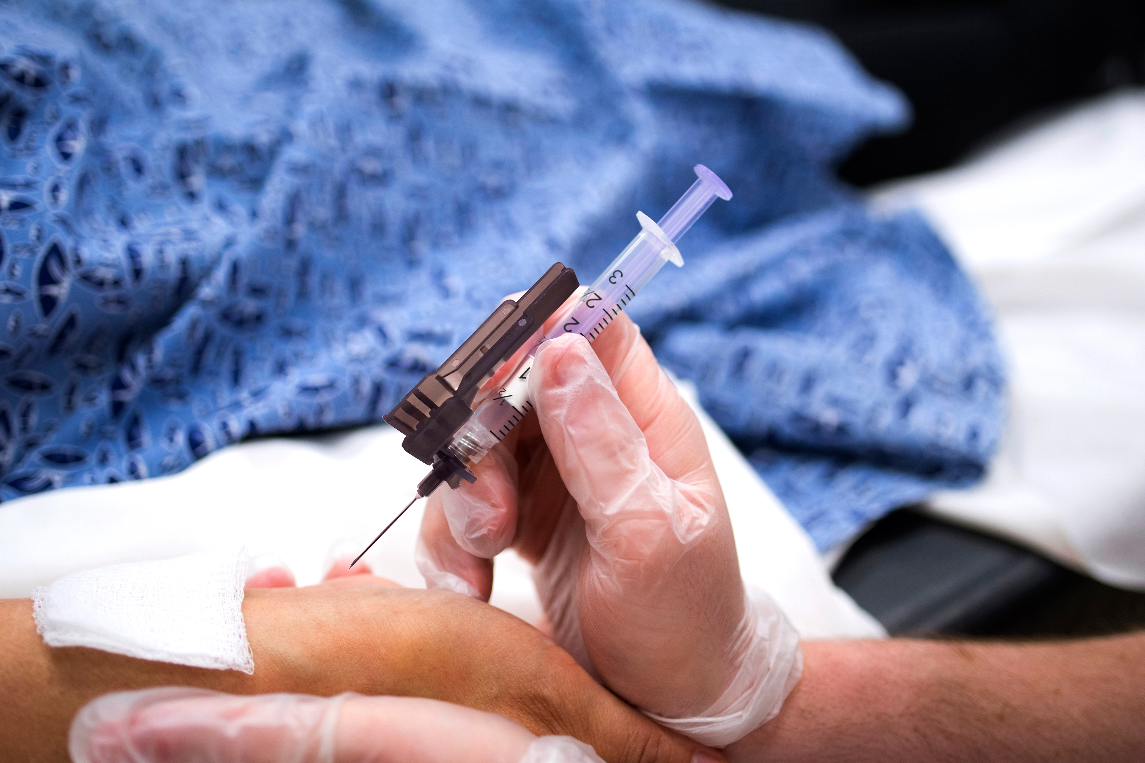
Clinical Review
INTERNAL USE ONLY

Slide 4
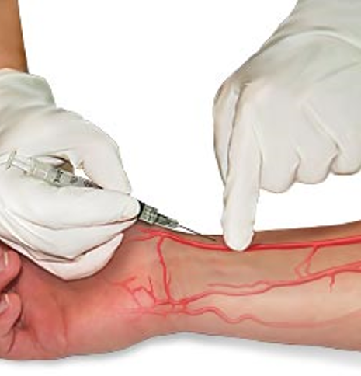
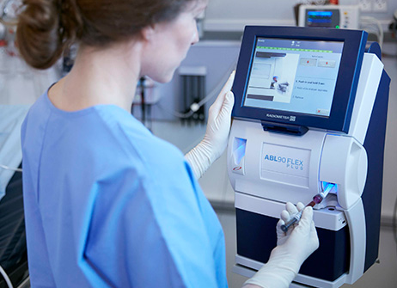
What is an ABG?
  When a patient’s respiratory or metabolic system is in question, an ABG analysis is typically the first test ordered by the physician.
  Arterial blood reacts quickly to changes in the lungs
  Gives clues about how well the lungs, heart, and kidneys are working
  To obtain an ABG analysis, blood is drawn from an artery and placed in an analyzer that determines the chemical makeup of the sample
INTERNAL USE ONLY

Slide 5
Importance of Analyzing ABGs
A provider may ask for an arterial blood gas test to check:
  Severe breathing and lung problems
    Ventilator management
    Surgical patients
    Chronic obstructive pulmonary disease (COPD)
  Oxygen requirement
  Acid-base balance to determine
    Kidney failure
    A severe infection
    Specific toxic ingestions
    Complications of diabetes (DKA)
  Patient condition during overdose, shock, trauma, or other emergency conditions
  State of mother/child during delivery
INTERNAL USE ONLY

Slide 6
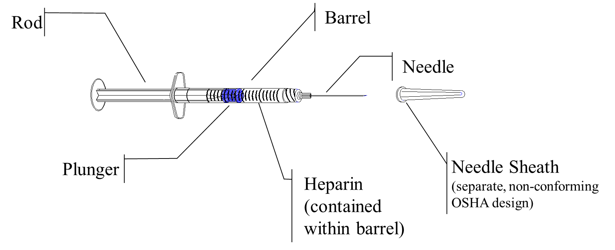
Standard Syringe
Rod
Barrel
Needle
Plunger
Needle Sheath (separate, non-conforming OSHA design)
Heparin
(contained within barrel)
INTERNAL USE ONLY

Slide 7
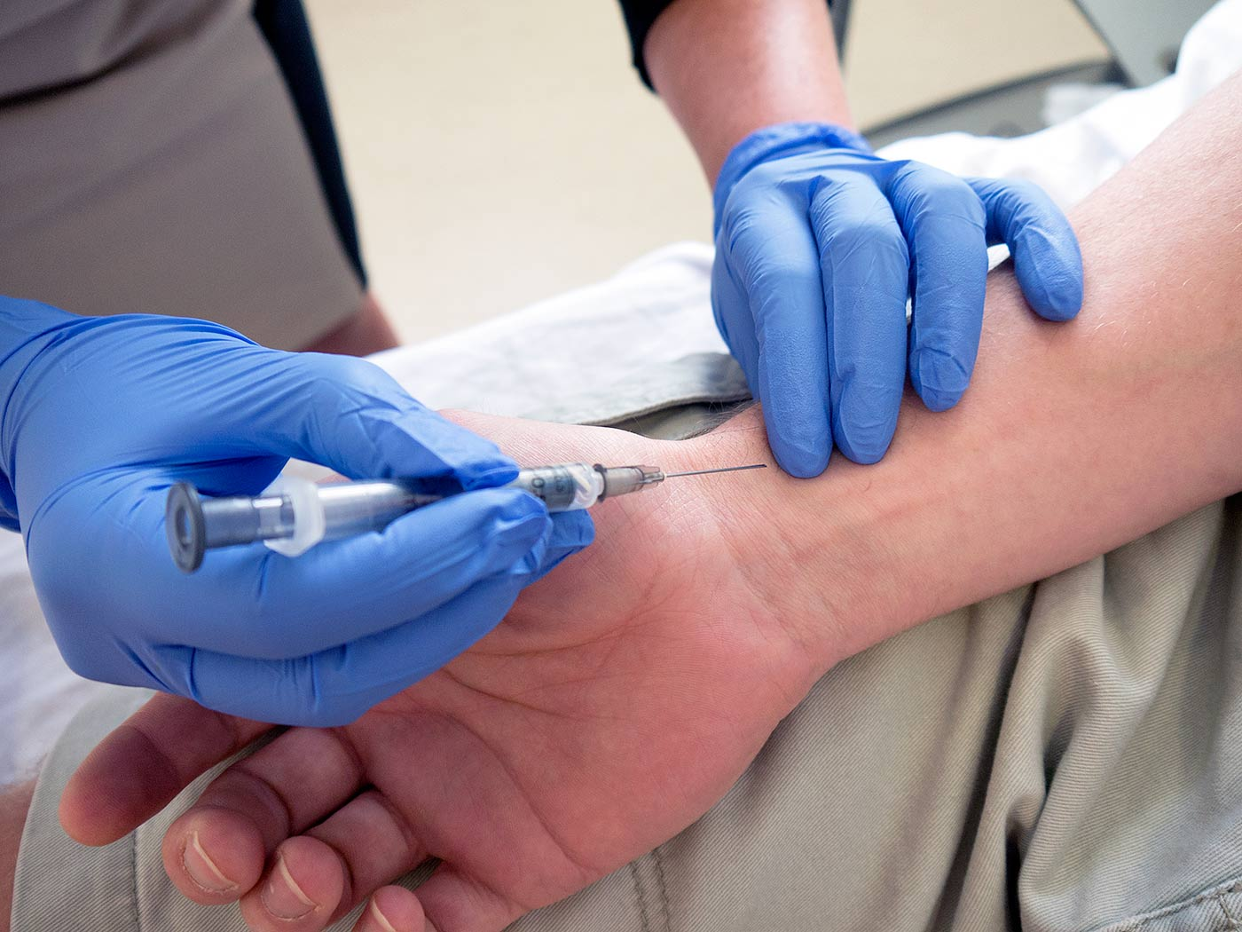
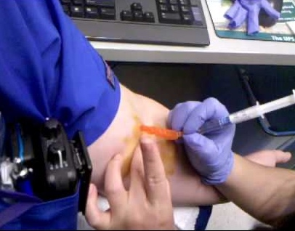
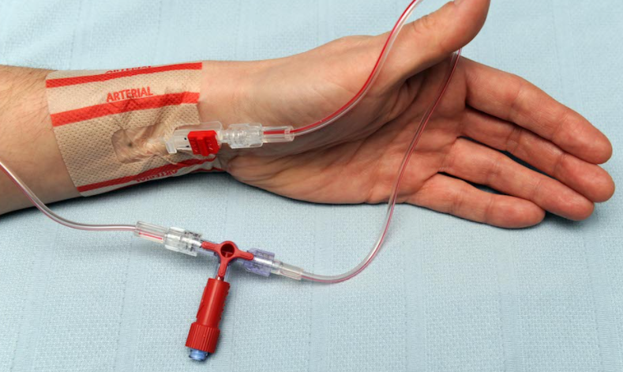
Where is an ABG usually drawn?
Stick
  Standard
    Radial artery (wrist)
  Less common
    Femoral artery (groin)
  Rarely
    Brachial artery (elbow)
Arterial Line Draw
  A-Lines are common when frequent draws are necessary
  Typically, more acute patients
INTERNAL USE ONLY

Slide 8
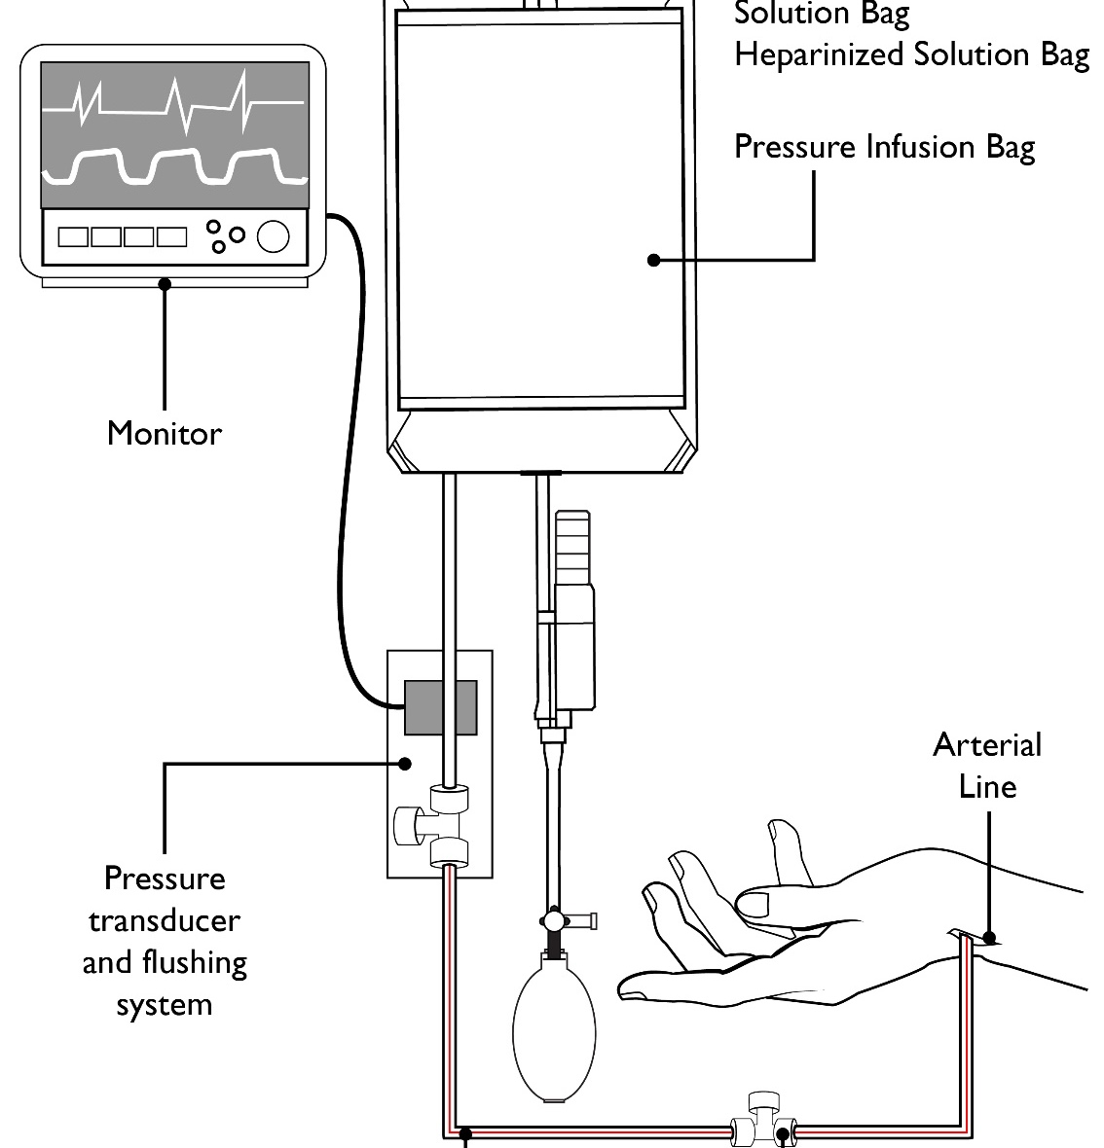
Arterial Line (A-Line, ART Line)
An arterial line is a thin, flexible tube that is placed into an artery. It helps providers check blood pressure and take blood samples.
INTERNAL USE ONLY

Slide 9
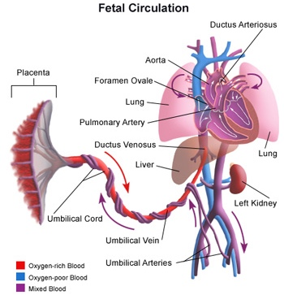
Umbilical Cord Blood Gas
Used to assess a newborn’s metabolic condition
Recommended in all high-risk deliveries
Two heparinized 1cc syringes are used, one for the umbilical artery and one for the umbilical vein
Umbilical artery reflects fetus
Umbilical vein reflects placenta
INTERNAL USE ONLY

Slide 10
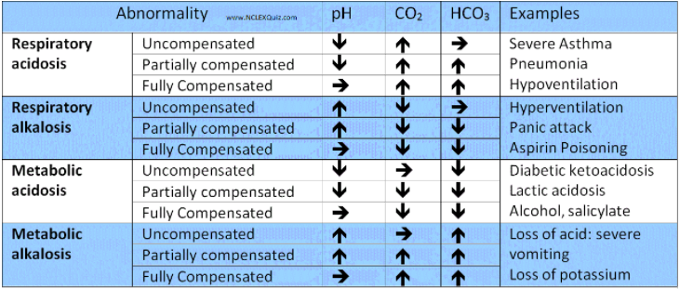
Analyzing Arterial Blood Gases
Causes | Assessment Findings
Hypoventilation CNS depression Pulmonary edema Respiratory arrest Airway obstruction | Bradycardia Hypotension Confusion Somnolence
Hyperventilation Excessive mechanical ventilation Anxiety Fever Pneumothorax | Tachycardia Palpitations Anxiety Seizures Perspiration/diaphoresis
Acid Gain Shock Ketoacidosis Renal failure bicarbonate loss Diarrhea | Nausea/vomiting Malaise Tachypnea Hypotension Confusion
Primary - Direct values
  PaCO₂: Partial pressure of CO₂ in the blood
  PaO₂: Partial pressure of O₂ in the blood
  pH: Acid/Base balance of the blood
  SaO₂: Oxygen Saturation
Secondary - Calculated Values
  HCO₃: Bicarbonate concentration in blood
  Total CO₂: Bicarbonate plus dissolved CO₂
  Base Excess: Acid required to restore a liter of blood to normal PH
  Increasingly, electrolytes are also being measured, i.e. ,calcium and magnesium.
INTERNAL USE ONLY

Slide 11
Product Overview
INTERNAL USE ONLY

Slide 12
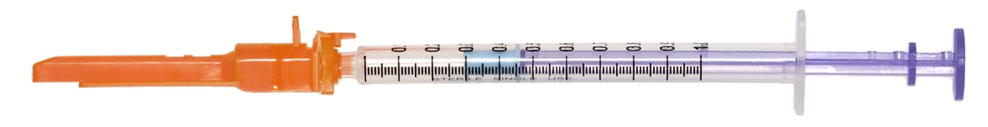
1cc Vented Syringe Options
Usually smaller patient population – infants, pediatrics, etc.
Item | Description | Alcohol Prep | Iodine Prep Pad | Gauze | Ice Bag | Bandage | Q-Cork | Patient Label | Qty
3103-91* | Pulset™ 1cc Syringe 23g x 1” SafetyTip, 25u BH |  |  |  |  |  |  |  | 100
3105-91* | Pulset™ 1cc Syringe 25g x 5/8” SafetyTip, 25u BH |  |  |  |  |  |  |  | 100
3165-91* | Kit Pulset™ 1cc Syringe 25g x 5/8” SafetyTip, 25u BH | X | X | X | X | X |  | X | 100
3173-91* | Kit Pulset™ 1cc Syringe 25g x 5/8” SafetyTip, 23” x 1” secondary needle, 25u BH | X | X | X | X | X | X | X | 100
*Items include CE Mark.
3105-91
INTERNAL USE ONLY

Slide 13
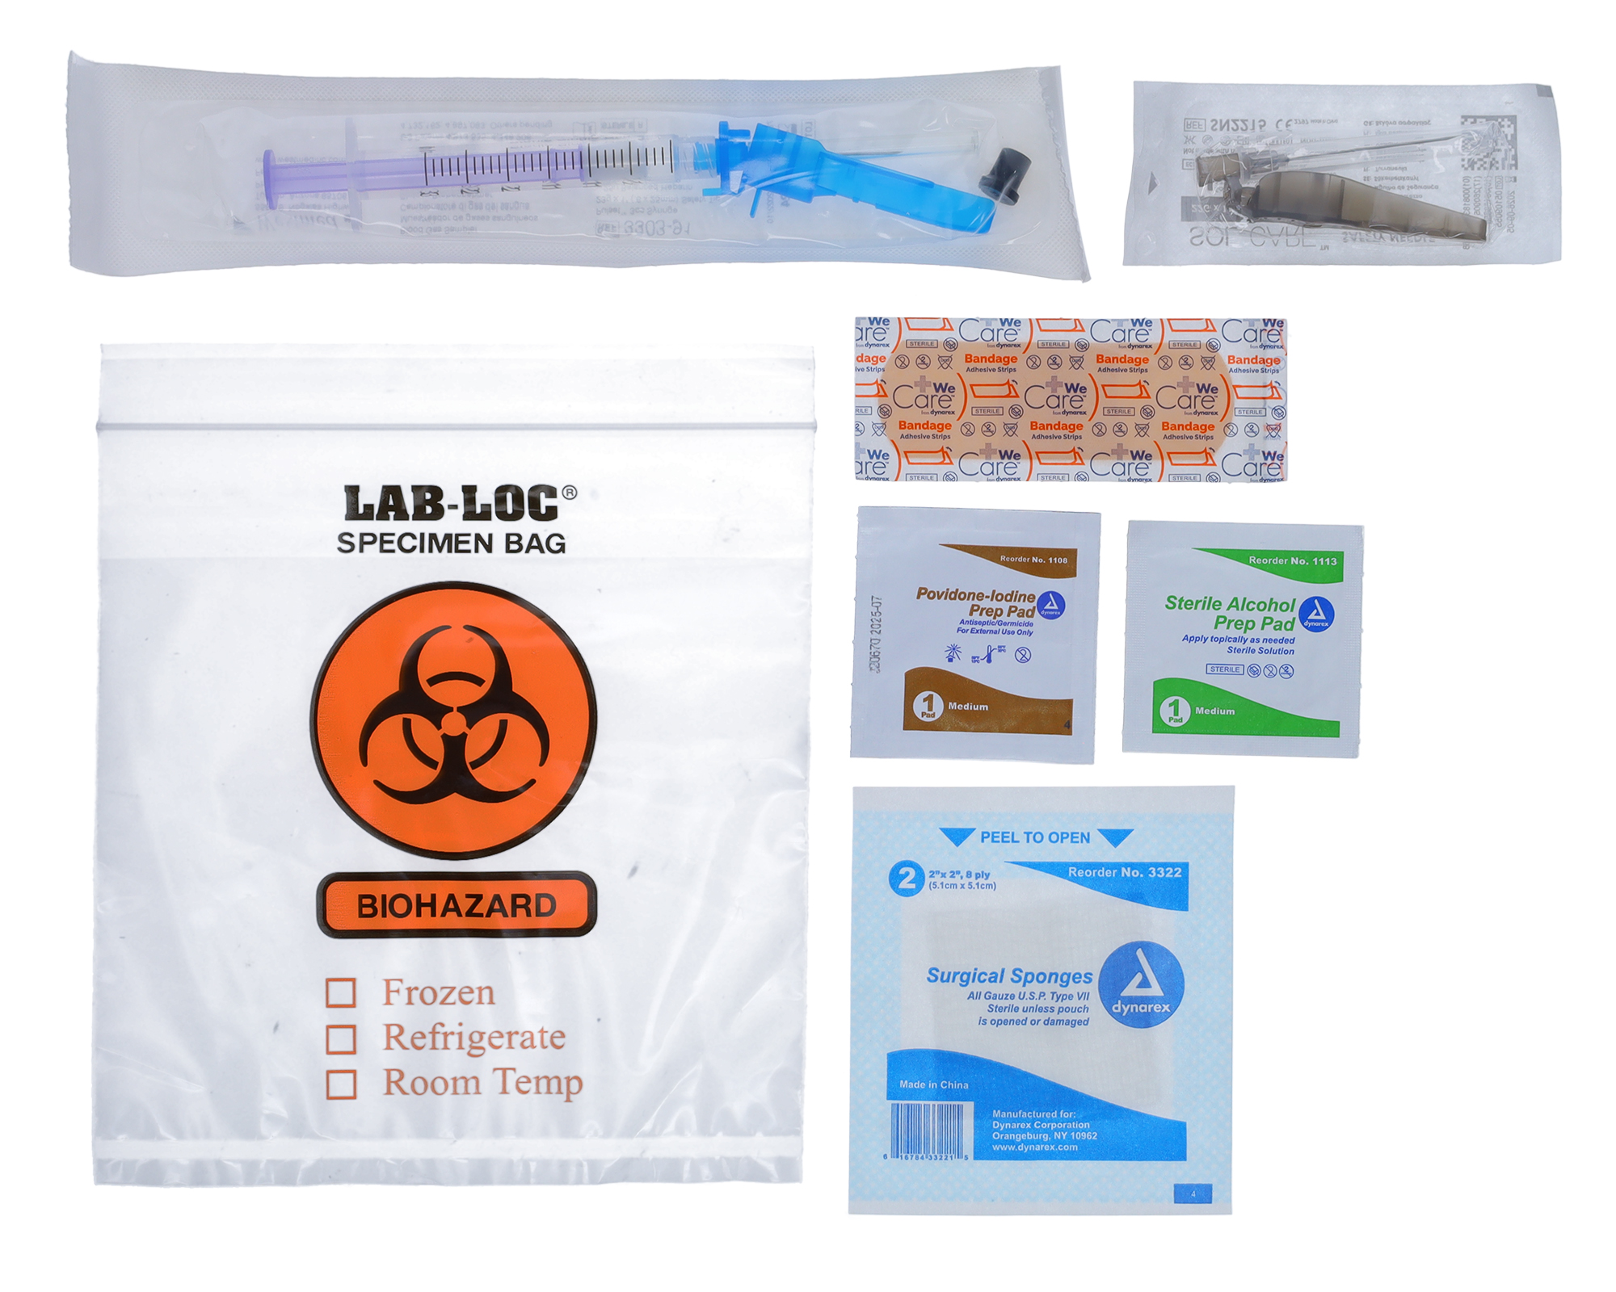
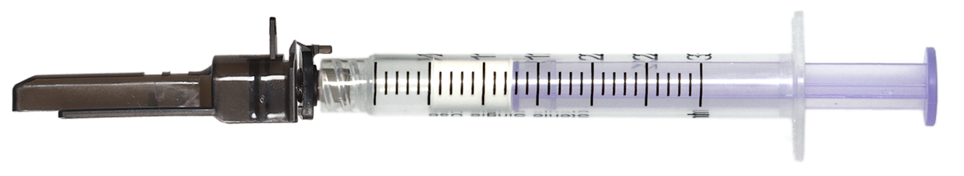
3cc Vented Syringe Options
Usually larger patient population – adults, large peds, etc.
Item | Description | Alcohol Prep | Iodine Prep Pad | Gauze | Ice Bag | Bandage | Q-Cork | Patient Label | Qty
3302-91* | Pulset™ 3cc Syringe 22g x 1” SafetyTip, 25u BH |  |  |  |  |  |  |  | 100
3303-91* | Pulset™ 3cc Syringe 23g x 1” SafetyTip, 25u BH |  |  |  |  |  |  |  | 100
3362-91 | Kit Pulset™ 3cc Syringe 22g x 1” SafetyTip, 25u BH | X | X | X | X | X |  | X | 100
3363-91 | Kit Pulset™ 3cc Syringe 23g x 1” SafetyTip, 25u BH | X | X | X | X | X |  | X | 100
3373-91 | Pulset™ 3cc Syringe 23g x 1” SafetyTip, 22” x 1.5” secondary needle, 25u BH | X | X | X | X | X |  | X | 100
*Items include CE Mark.
3373-91
3302-91
INTERNAL USE ONLY

Slide 14


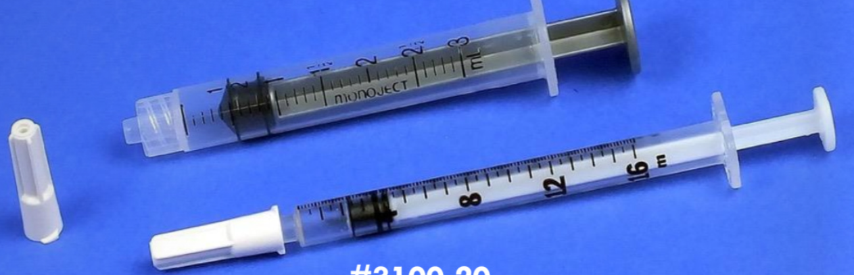
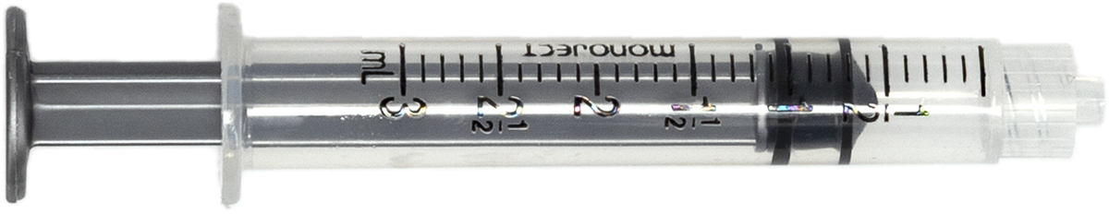
A-Line Options
Item | Description | Qty
3100-30* | A-Line 1cc syringe, Blunt Tip Cannula, 25u BH | 100
3300-30* | A-Line 3cc syringe, Blunt Tip Cannula, 25u BH | 100
3100-20* | A-Line 1cc syringe, 3cc Waste Syringe, 25u BH | 100
3100-25* | A-Line 1cc syringe, 25u BH | 100
3300-21* | A-Line 3cc syringe, 5cc - 6cc Waste Syringe, 25u BH | 100
3300-25* | A-Line 3cc Syringe, 25u BH | 100
3100-30
3100-25
*Items include CE Mark.
3100-20
3300-25
INTERNAL USE ONLY

Slide 15
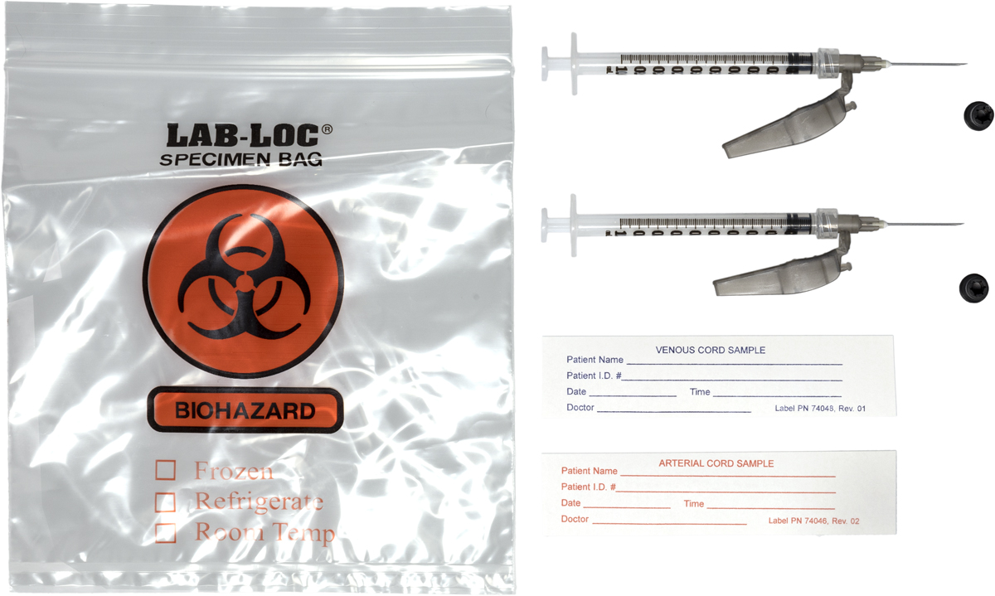
Umbilical Cord Gas Kit
Item | Description | Alcohol Prep | Iodine Prep Pad | Gauze | Ice Bag | Bandage | Q-Cork | Patient Label | Qty
3182-91 | Cord Gas Kit, two 1cc syringes 22g x 1” SafetyTip 25u BH |  |  |  | X |  |  | 2x | 100
3182-91
INTERNAL USE ONLY

Slide 16
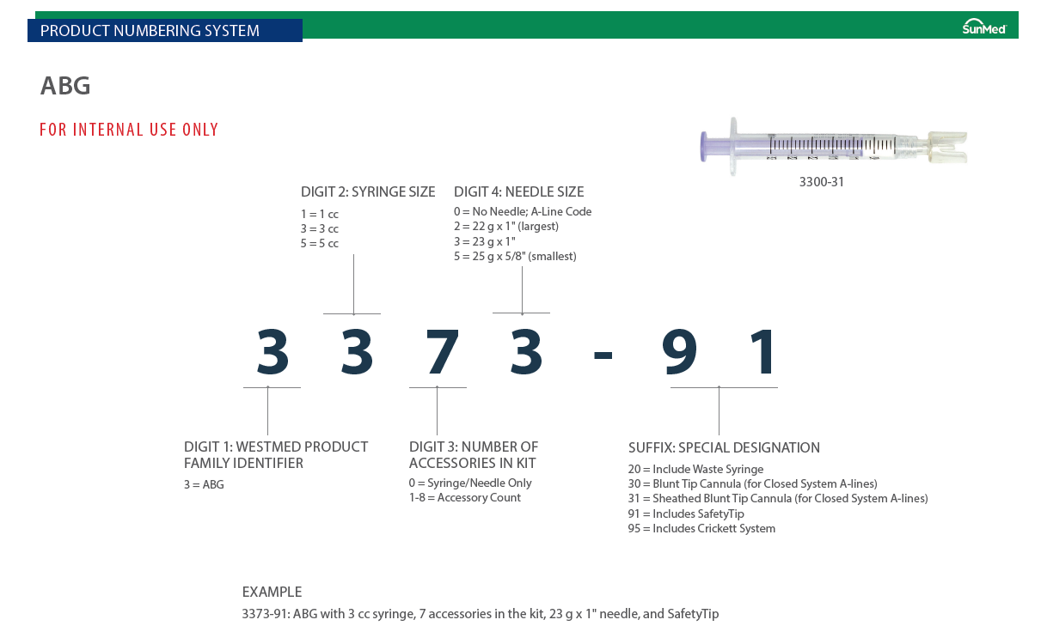
INTERNAL USE ONLY

Slide 17
Clinical Selling
INTERNAL USE ONLY

Slide 18
Call Points
Respiratory Therapist
  Perform most of the ABG sticks
  Will be extremely influential in the success of the roll-out
  Involve early and often
  In-servicing is key - needles will feel different to them
ICU Nurses
  Will perform A-line draws in the ICU
  Need to be on board
Supply Chain
  Can and will make choice based on price
  No technique difference between needles can be deciding factor
INTERNAL USE ONLY

Slide 19
Features and Benefits
Integrated plunger venting design
Dry balanced Lithium-Zinc heparin
Thin-walled needle technology
Sharps protection device
INTERNAL USE ONLY

Slide 20
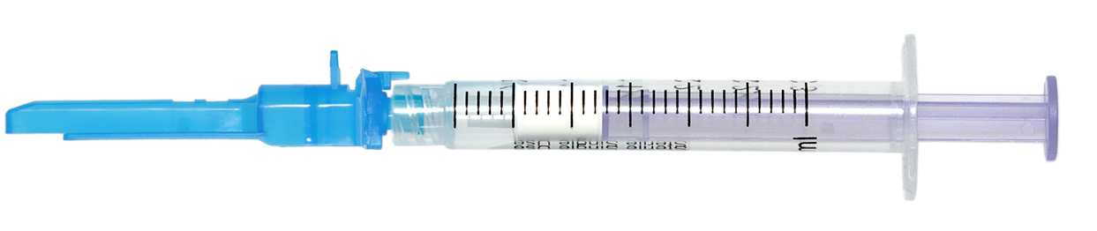
Plunger Types
Vented: For puncture or A-line sampling. Allows air inside of syringe to pass through the plunger tip via a specially designed filter and plunger design. (Pulset)
Non-Vented (Aspirating): Syringes used primarily for A-line sampling feature a solid rubber plunger tip design to draw “aspirate” blood out.
  Primary sizes: 1cc and 3cc
INTERNAL USE ONLY

Slide 21
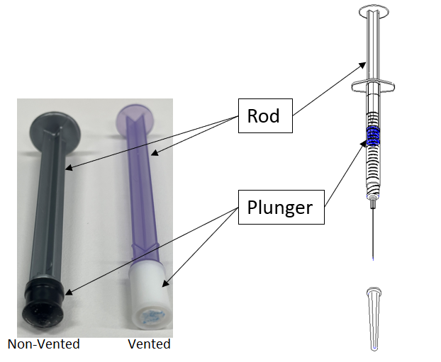
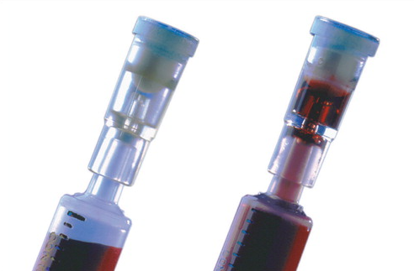
Why a Vented Plunger?
Directly Measured values
  PaCO₂: Partial pressure of CO₂ in the blood
  PaO₂: Partial pressure of O₂ in the blood
Air bubbles mix with blood and can bias the PaO₂ and PaCO₂ reading
The vented plunger allows for air to pass through filter
  Eliminates need for vented tip
  Eliminates need for expelling air from syringe
  Protects HCW from blood exposure
INTERNAL USE ONLY

Slide 22
Integrated Plunger Venting Syringe
Rod (Aspiration)
Plunger Tip
Filter (CMC)
Barrel (contains heparin)
Luer Lock Tip
Luer Tip
INTERNAL USE ONLY

Slide 23
Integrated Plunger Venting Syringe
Blood fills the barrel until it hits the plunger
The filter becomes engorged with blood and seals
Blood fills the barrel forcing air through the plunger and out
AIR
INTERNAL USE ONLY

Slide 24
Features and Benefits
Integrated plunger venting design
Dry balanced Lithium-Zinc heparin
Thin-walled needle technology
Sharps protection device
INTERNAL USE ONLY

Slide 25
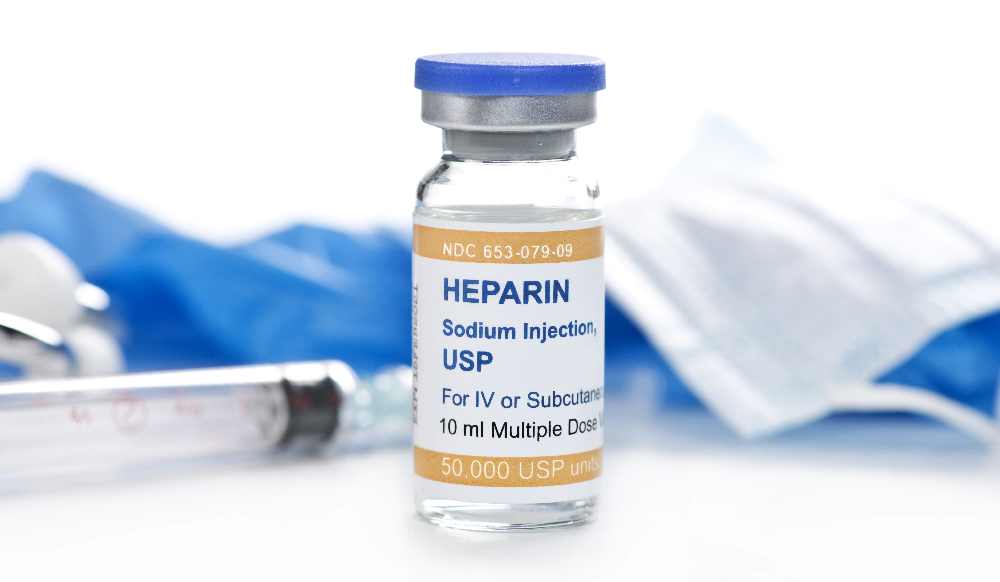
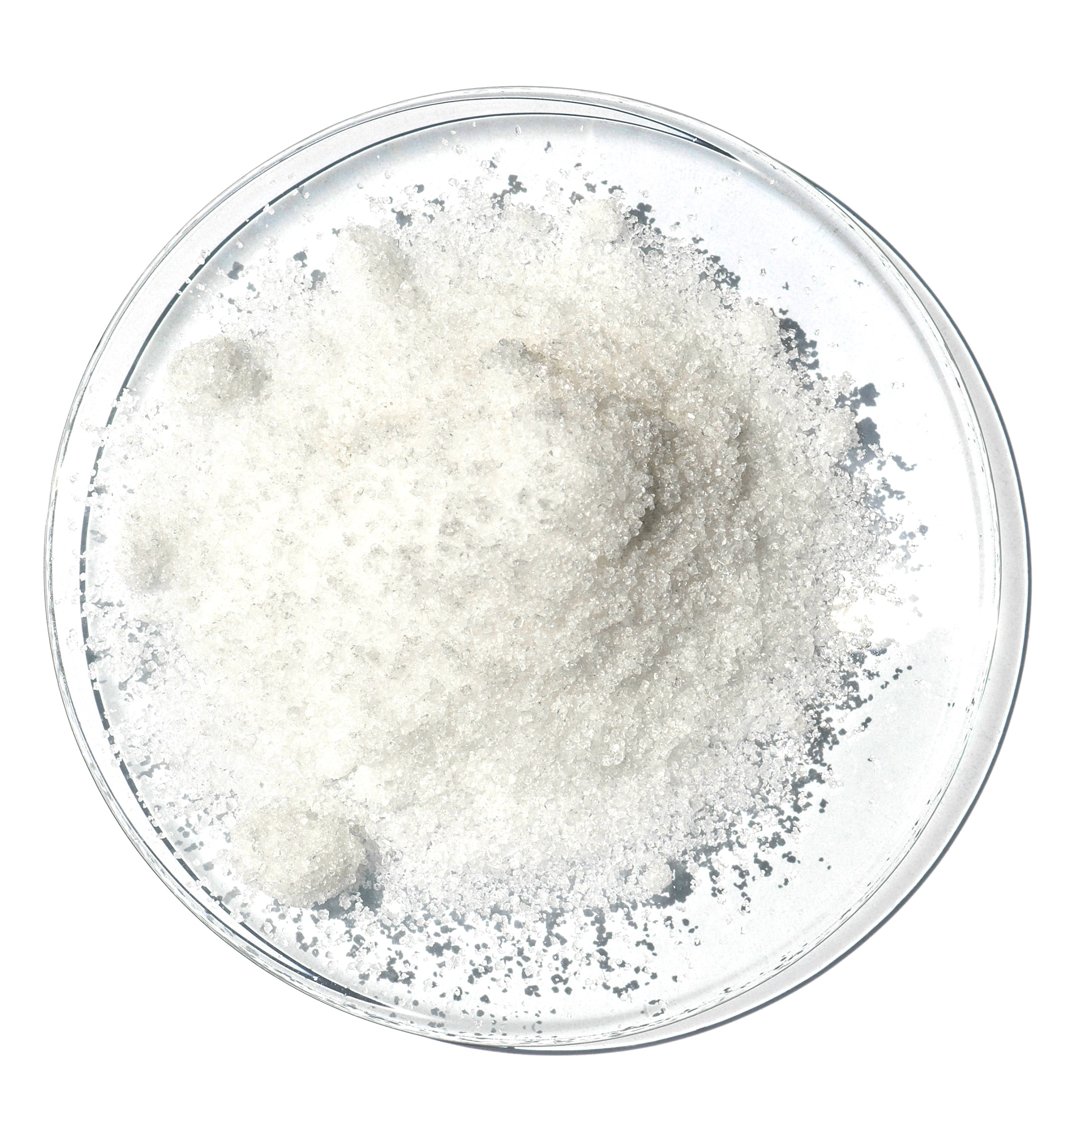
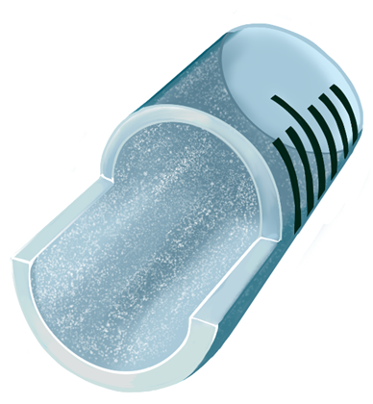
Heparin – Liquid vs. Dry
Heparin is an anticoagulant: Used to keep the blood sample viable for (clot free) analysis.
Liquid
  Mixes Easily
  Potential to dilute sample
Crystalline
  Heparin is in the form of large crystals like sugar
  Does not mix easily
Lyophilized (freeze-dried) pellet
  The pelletized version is freeze-dried matrix
  Susceptible to rehydration
  Does not mix easily
Powdered (AirLife)
  Crystalline + freeze-dried = powdered
  Smaller pieces = more surface area
  Easily mixes with blood to prevent clotting
  Removes potential risk of dilution
INTERNAL USE ONLY

Slide 26
Heparin – Blended Li:Zn Formulation
Conventional lithium heparin skews calcium results
Competitors – Reduce the amount of lithium heparin
  Reduced side effects
  May not eliminate clotting
Balanced blended Lithium Zinc heparin truly balances the electrolytes
  Zinc (Zn) binds with Lithium (Li)
  Stops Lithium from binding with Calcium in the blood (CA++)
  Blended at a 1:1 ratio, regardless of the electrolyte reading the result is balanced
  Allows for one needle to draw for any analysis
INTERNAL USE ONLY

Slide 27
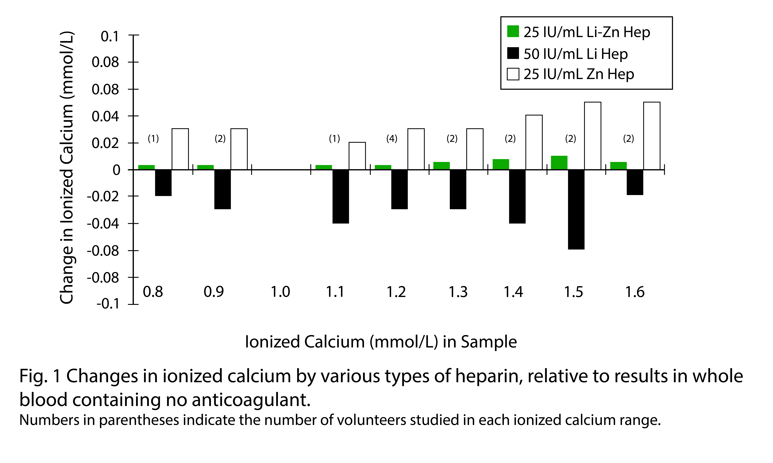
Lithium Zinc Heparin – Calcium Measurement
Heparin Effects Compared to the
Baseline Value
 | Calcium Measurement | Other Measurements
Lithium Heparin
Zinc Heparin
1:1 Blend Li ZN Heparin
Toffaletti J, Ernst P, Hunt P, Abrams B. Dry electrolyte-balanced heparinized syringes evaluated for determining ionized calcium and other electrolytes in whole blood.
Clin Chem. 1991 Oct;37(10 Pt 1):1730-3. PMID: 1914173.
INTERNAL USE ONLY

Slide 28
Features and Benefits
Integrated plunger venting design
Dry balanced Lithium-Zinc heparin
Thin-walled needle technology
Sharps protection device
INTERNAL USE ONLY

Slide 29
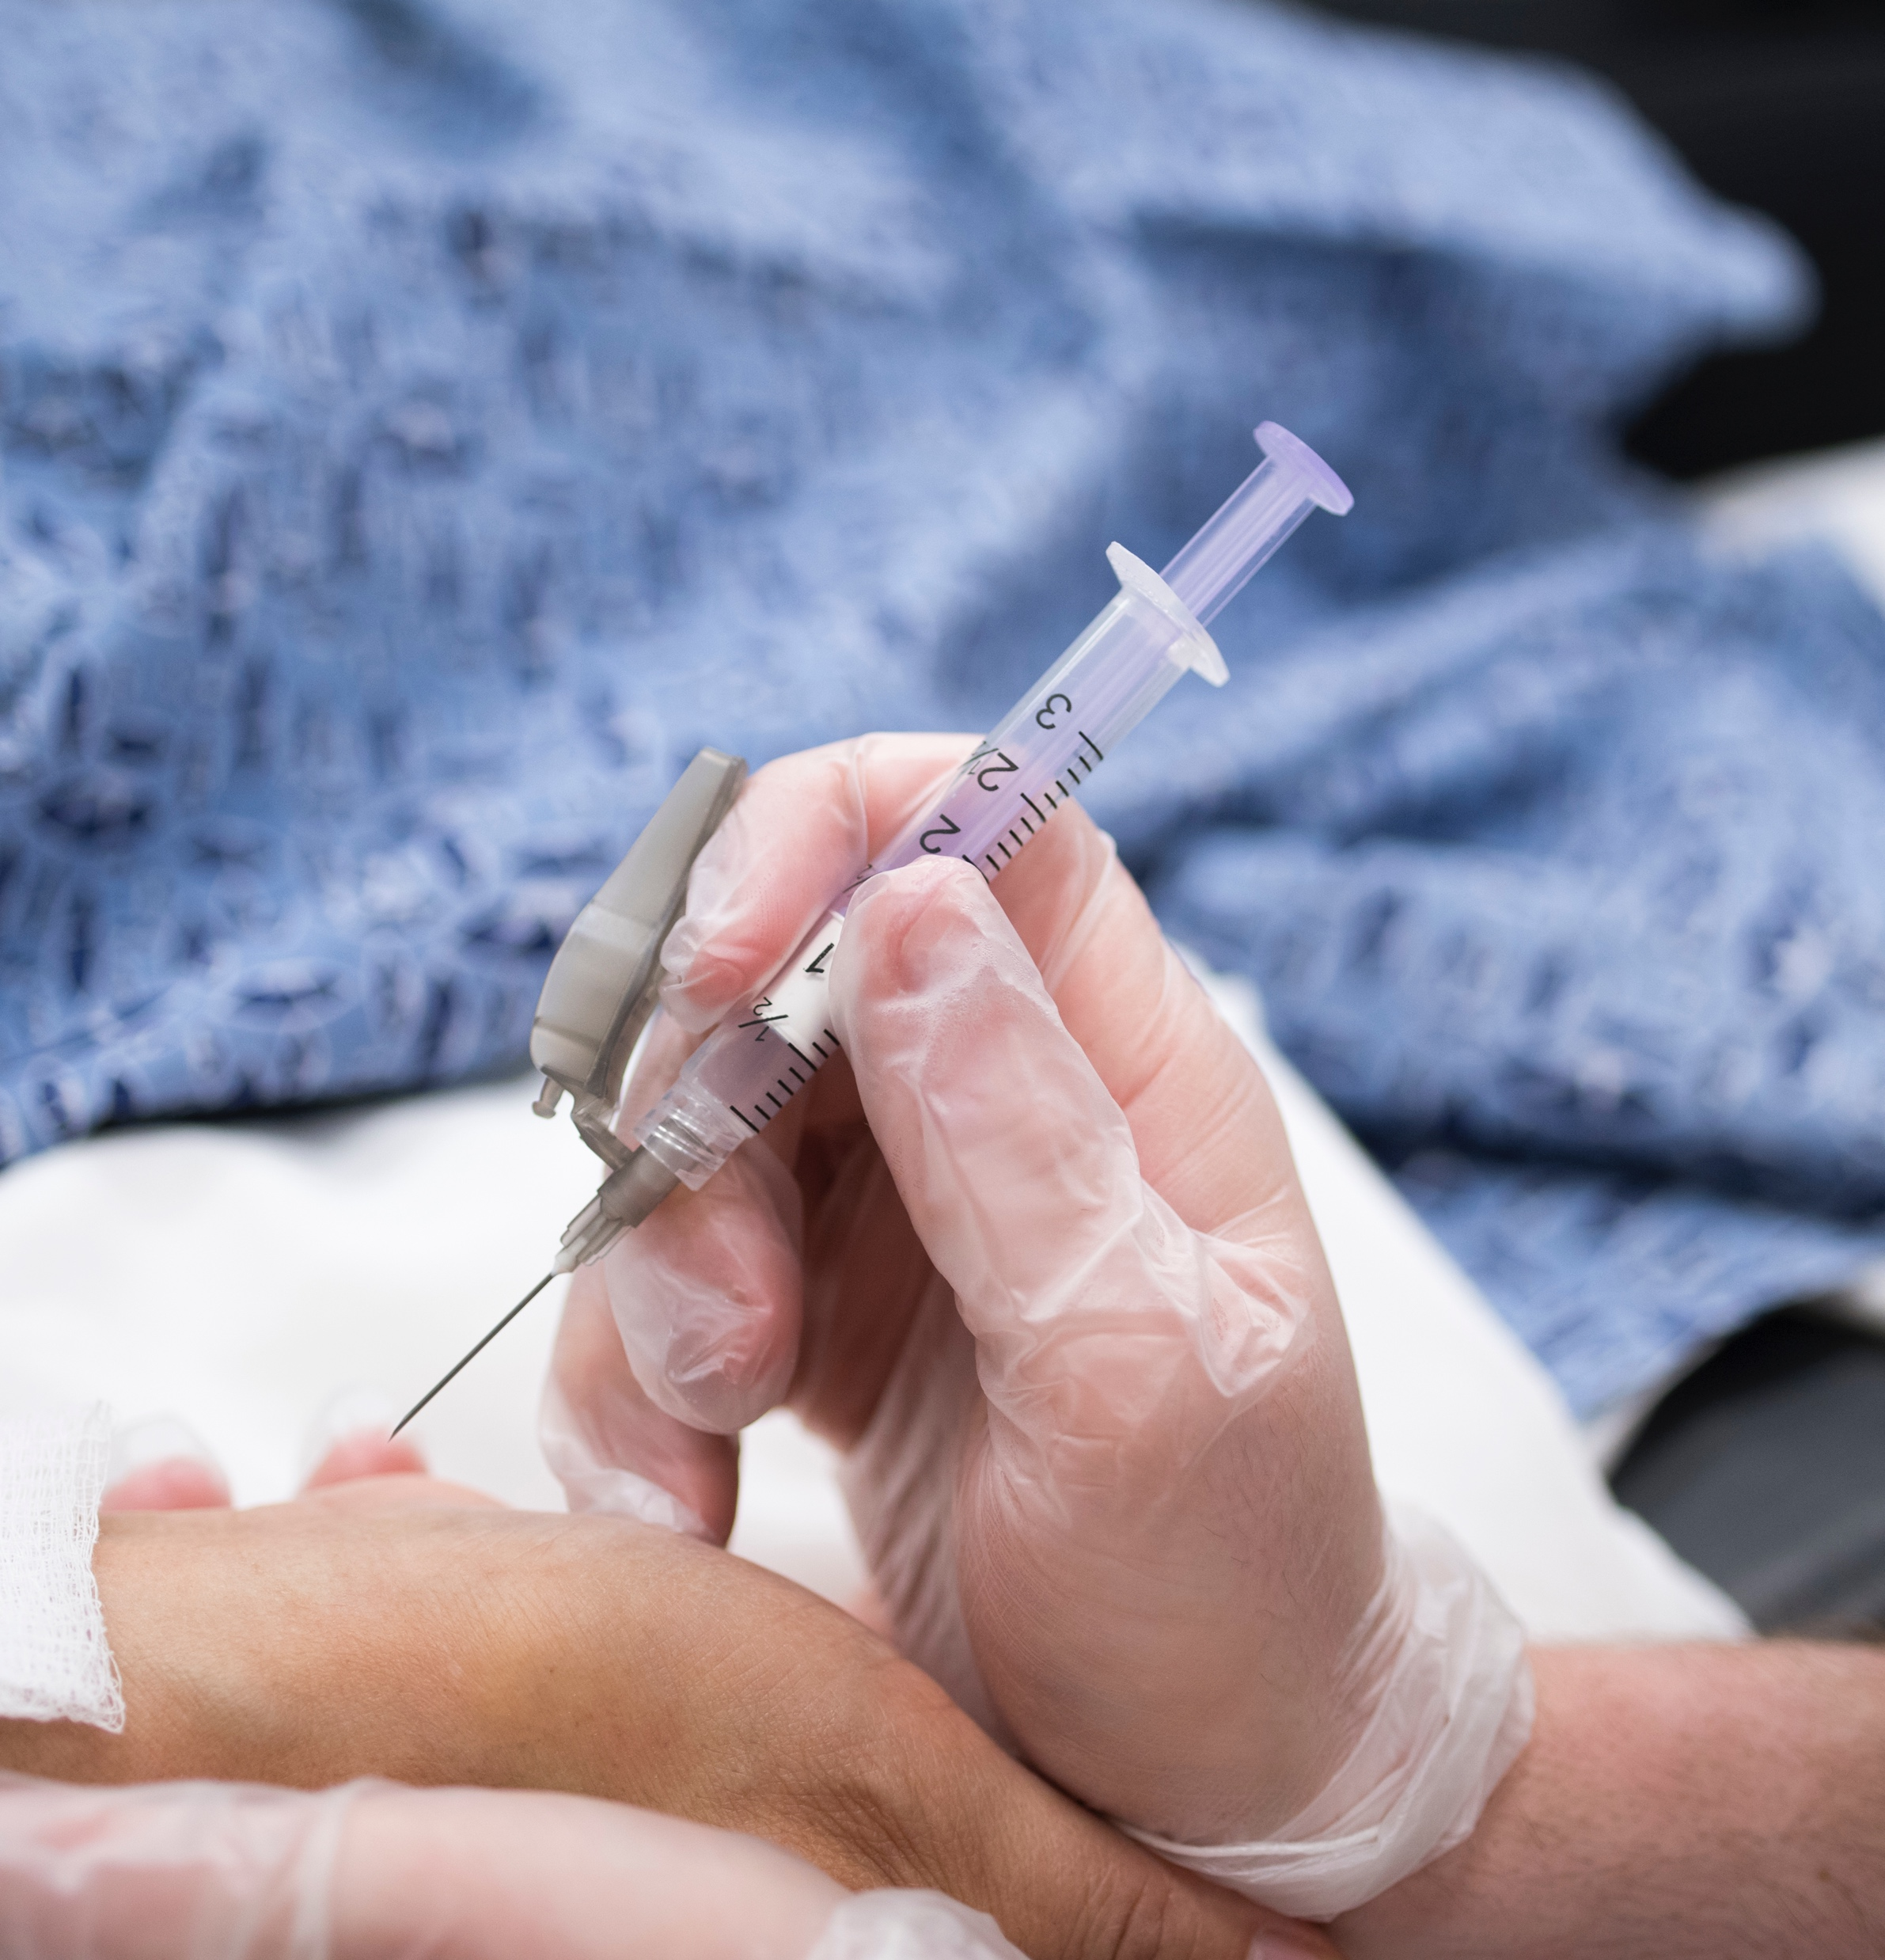
Thin-walled Needle
There is a large measure of clinician preference for a sharp, easy-to-use needle
The needle offers thin-wall technology with the following features:
Sharp “A” bevel
Electronically honed surface for a finer, smoother cutting edge
INTERNAL USE ONLY

Slide 30


Why thin-wall technology?
Same inner diameter: Maintains flow characteristics and fill time as
standard needles
Smaller outer diameter: Smaller puncture, without sacrificing sampler performance
Standard Wall
Thin Wall
Same ID
Smaller OD
INTERNAL USE ONLY

Slide 31
AirLife A-bevel
A-Bevel (slicer)
  Benefit: Less patient discomfort
    Designed for tissue penetration
    Less chance for patient “pull back”
B-Bevel (puncture)
  Benefit: Less “tissue coring”
    Less clotting
    Less scar tissue
    Easier to stop bleeding
AB-Bevel
    22G x 1.5” – Largest size; Generally reserved for femoral sticks
    22G x 1” – Provider preference; Commonly used on bigger arteries
    23G x 1” – Generally considered to be standard
    25G x 5/8” – Used on neonates and others with abnormally small arteries
A-Bevel (Slicer)
B-Bevel (Puncturer)
AB-Bevel
INTERNAL USE ONLY

Slide 32
Features and Benefits
Integrated plunger venting design
Dry balanced Lithium-Zinc heparin
Thin-walled needle technology
Sharps protection device
INTERNAL USE ONLY

Slide 33
Current Regulatory Climate
Design Recommendations for Sharps Injury Prevention Features
OSHA’s Revised Bloodborne Pathogen Standard
FDA/OSHA-Recommended “Desirable Design Features”
  “Needle protection device should be an integral part of the needle and not an accessory”
  The safety feature is fixed and provides a barrier between the hands and the needle after use
Type of Feature | Recommendation
All | The user should be able to easily tell whether the sharps injury prevention feature is activated
All | Once activated, the sharps injury prevention feature cannot be deactivated and should remain protective through disposal.
Activate (i.e., feature requires activation by the user) | It should be possible to activate the feature with a single-handled technique, allowing the user’s hands to remain behind the exposed sharp.
Needle Shield | The shield should completely enclose the needle and prevent finger access when activated.
Retractable Sharp | The sharp should be fully retracted within the housing of the device.
Fixed Recessed Needle | The housing should extend beyond, i.e., fully cover the sharp and prevent finger access.
Colored Feature or Component | The use of color should achieve a specific purpose, (e.g., differentiate device models or sizes) and conform with user conventions, (e.g. orange hubs and needle covers for insulin syringes).
INTERNAL USE ONLY

Slide 34
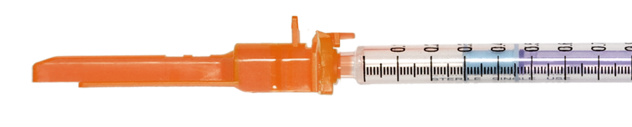
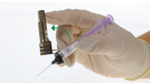

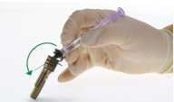
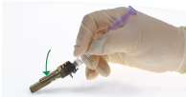
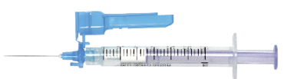
SafetyTip™ Sharps Protection Device
Two-point locking mechanism with 2 audible clicks
SafetyTip out of provider field of view
SafetyTip always aligned with A-bevel up
Easy to use one-handed
22G
23G
25G
INTERNAL USE ONLY

Slide 35
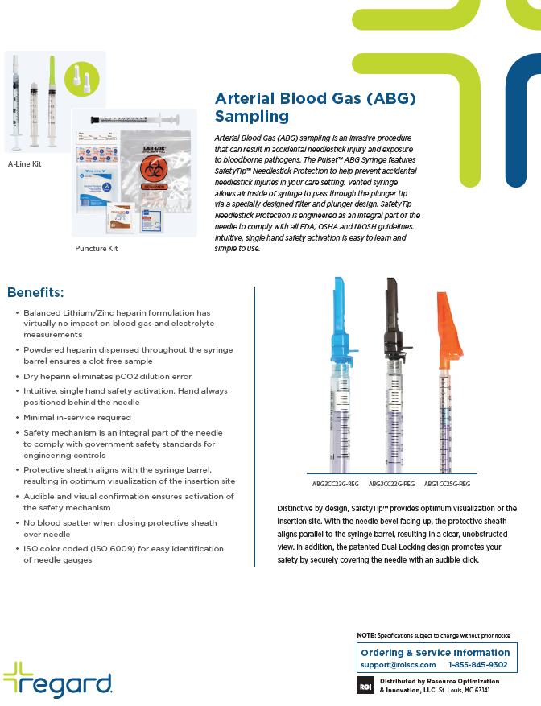
Regard ABG Portfolio
INTERNAL USE ONLY

Slide 36
Regard ABG Portfolio
 | Submitted HealthTrust Cross
Product Description | Smiths | Westmed | Regard Catalog # | Regard Reorder #
ABG-PROVENT 3ML LI F % 100/CA | 4599P-1 | 3373-91 | ABGFLKT3CC23G-REG | 1364159
PRO-VENT PLUS 25GX5/8IN NEEDLE1CC SYR, NP & FILTER-PRO 200/CA | 4619P-2 | 3105-91 | ABG1CC25G-REG | 1388651
ABG-PROVENT 3ML LI M + 200/CA | 4598P-2 | 3303-91 | ABG3CC23G-REG | 1391466
ABG-PROVENT 3ML LI F POINTLOK % 100/CA | 4589P-1 | 3373-91 | ABGFLKT3CC23G-REG | 1364159
ABG-LINEDRAW 3ML LI M % 200/CA | 4042-2 | 3300-25 | ABGALN3CC-REG | 779276
PRO-VENT LUER SLIP NEEDLE 200/CA | 4645P-2 | 3302-91 | ABG3CC22G-REG | 1391095
ABG-PULSATOR 3ML LI F % 100/CA | 4084P-1 | 3373-91 | ABGFLKT3CC23G-REG | 1364159
Mod Kit Pulset 3cc Syringe 23g x 1" Crickett 25u BH | 4698P-2 | 3363-91 | ABGKT3CC23G-REG | 1392061
Mod Kit Pulset 3cc Syringe 22g x 1" Crickett 25u BH | 4590P-2 | 3362-91 | ABGKT3CC22G-REG | 1391772
Mod Kit Pulset 3cc Syringe 23g x 1" Safety Tip 25u BH | 4660P-1 | 3363-91 | ABGKT3CC23G-REG | 1392061
Pulset 3cc Syringe 23g x 1" Crickett 25u BH | 4598P-2 | 3303-91 | ABG3CC23G-REG | 1391466
Full Kit Pulset 3cc Syringe 23g x 1" Safety Tip 25u BH | 4599P-1 | 3373-91 | ABGFLKT3CC23G-REG | 1364159
Pulset 1cc Syringe 23g x 1" Crickett 25u BH | 4629P-2 | 3103-91 | ABG1CC23G-REG | 1389288
A-Line 3cc Syringe 25u BH (México) | 4042-2 | 3300-25 | ABGALN3CC-REG | 779276
A-Line 3cc Syringe Blunt Tip, 25u BH | 4646-2 | 3300-30 | ABGALN3CCBLNT-REG | 1931890
Pulset 3cc Syringe Blunt Tip Cannula, 25u BH | 4043-2 | 3300-31 | ABG3CCBLNT-REG | 1628482
Full Kit Pulset, 1cc Syringe 25g x 5/8" Safety Tip 25u B | 4640P-1 | 3173-91 | ABGFLKT1CC25G-REG | 1388341
A-Line, 3cc Non-Vented Syringe, Luer Lock, 25U Balanced Heparin | 4042-2 | 3300-25 | ABGALN3CC-REG | 779276
 |  | 3101 | ABGALN1CCLL-REG | 1926516
 |  | 3165-91 | ABGKT1CC25G-REG | 2531307
All accounts are ranked by HealthTrust/AirLife priority
Cross reference for ABG SKUs
AirLife
INTERNAL USE ONLY

Slide 37
Possible Objections
Thin-walled needle
Objection
Feels different when performing a stick
Feels flimsy/cheaply made
Response
Made from surgical steel which maintains strength while allowing for flex
Sharps protection device
Objection
It gets in the line of sight when performing a stick
Response
The SafetyTip™ folds back along the barrel of the syringe and locks in place so it is out of the line of sight when performing the stick
The SafetyTip™ is positioned with the bevel up so the needle is always in the proper position when performing a stick
Lithium-Zinc Heparin
Objection
Not traditional electrolyte balanced heparin
“Ours works fine”
Response
Ours works well also and has been used for over 15 years
Studies have shown lithium zinc balanced heparin has no clinical significance on ionized calcium levels
Our dry lyophilized powder allows for variable heparin amount based on blood volume
Vented Plunger
Objection
Your kits don’t include the vented tip
Response
With the vented plunger, there is no need for a secondary device to remove bubbles
When using a vented cap, pushing blood back through the end of the syringe adds positive pressure to the area, which could result in higher blood spillage when the cap is removed
INTERNAL USE ONLY

Slide 38
What to focus on…
Performing a successful stick the first time is based on feel and technique
First time success is extremely important due to the discomfort the patient can experience
Sell on features and benefits
Go after HealthTrust accounts with Regard ABG line and our own contract HPG-5147
INTERNAL USE ONLY

Slide 39
Competition
INTERNAL USE ONLY

Slide 40
Competitors in the Market
Smith’s/ICU Medical
Becton Dickinson
AirLife
Radiometer
Others
70%
15%
5%
5%
5%
INTERNAL USE ONLY

Slide 41
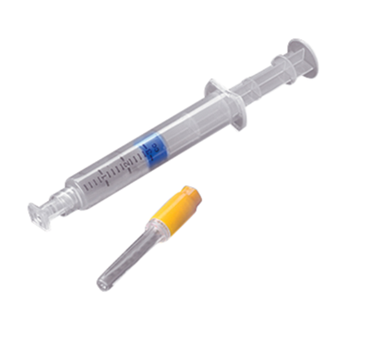
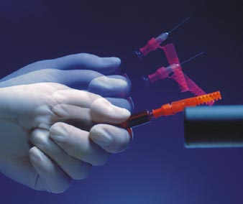
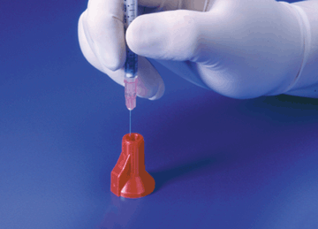
Smiths/ICU Medical
Portex® Anaerobic Pulsator ® Plus – Liquid Sodium Heparin
Pulsator Plus syringes, with liquid sodium heparin concentration of 23.5 IU per mL, allowing blood sampling with minimal risk of sample dilution. The syringes use a specially formulated electrolyte-balanced liquid sodium heparin that offsets both binding and dilution factors by chemically pre-adjusting key electrolytes to normal blood levels. This provides consistent and accurate analysis for all parameters tested. The syringes are available with a broad choice of product features.
Needle-Pro
Point-Lok
INTERNAL USE ONLY

Slide 42
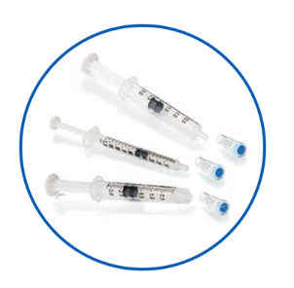
Smiths/ICU Medical
Portex® Anaerobic Line Draw – Liquid Sodium Heparin
Anaerobic Line Draw aspirating syringes, with a liquid sodium heparin concentration of 23.5 IU per mL, allows for blood sampling directly from an arterial line. The syringes use a specially formulated electrolyte-balanced liquid sodium heparin that offsets both binding and dilution factors by chemically pre-adjusting key electrolytes to normal blood levels. This provides consistent and accurate analysis for all parameters tested.
INTERNAL USE ONLY
Notes:
ICU Medical portfolio: https://www.icumed.com/products/infusion-therapy/vascular-access/sharps-safety-and-blood-collection/linedraw-arterial-blood-sampling-kits

Slide 43
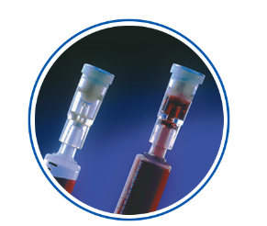
Smiths/ICU Medical
Portex® Filter-Pro® Air Bubble Removal Device
Umbilical Line Draw Plus aspirating syringes, with a lithium heparin concentration of 23.5 IU per mL, allows for blood sampling directly from the umbilical cord or an arterial line. The syringes use an advanced formula of dry lithium heparin that provides consistent and accurate readings. The syringes are packaged in sterile pouches and are ideal for use in Labor and Delivery and NICU environments.
INTERNAL USE ONLY
Notes:
ICU Medical portfolio: https://www.icumed.com/products/infusion-therapy/vascular-access/sharps-safety-and-blood-collection/linedraw-arterial-blood-sampling-kits

Slide 44
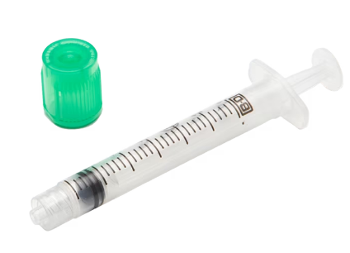
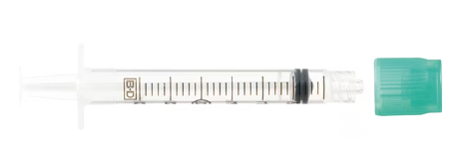
Becton Dickinson (BD)
BD Critical Care Collection Syringes can be used to collect blood from a patient’s artery. All syringes contain spray-dried calcium-balanced lithium heparin that enables the specimen to be analyzed for ABGs and a host of critical care analytes.
BD A-Line™ syringes are used for blood collection by manual aspiration and are supplied without needles. They are designed to be used for arterial blood collection from an arterial line, and are available in 1 mL and 3 mL slip tip, and 3 mL BD Luer-Lok™ syringes
INTERNAL USE ONLY
Notes:
BD portfolio: https://www.bd.com/en-in/offerings/capabilities/specimen-collection/blood-specimen-collection/arterial-blood-collection-syringes

Slide 45
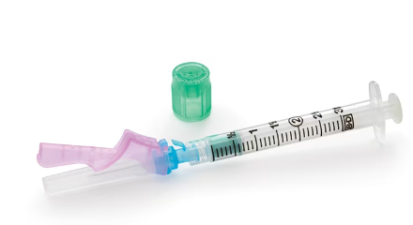
Becton Dickinson (BD)
BD Preset™ Syringes are available with the BD Eclipse™ safety-engineered needle to minimize the chances of a needlestick injury to the healthcare worker. The safety shield is integrated and is not an accessory to the needle. The needle bevel and safety shield are in alignment, ensuring no extra manipulation. The single-handed technique ensures no change in the collection technique and the double-locking mechanism is both visually and audibly confirmed for the healthcare worker.
INTERNAL USE ONLY
Notes:
BD portfolio: https://www.bd.com/en-in/offerings/capabilities/specimen-collection/blood-specimen-collection/arterial-blood-collection-syringes

Slide 46
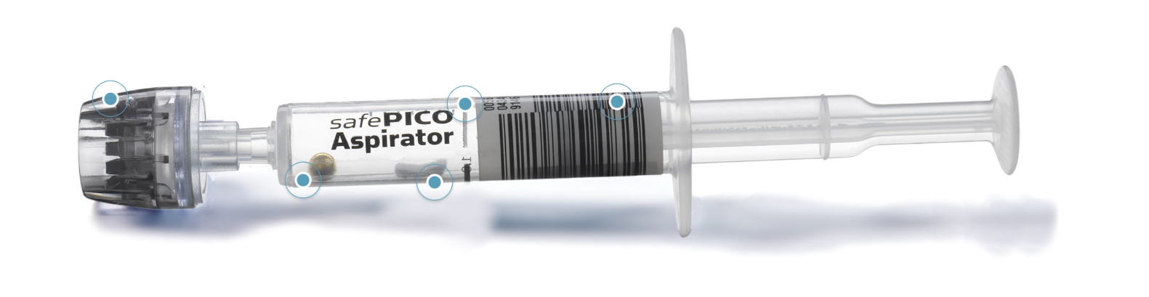
Radiometer
safePICO Aspirator blood gas syringe
The safePICO Aspirator has an integrated mixing ball and a recommended fill volume of 1.0 mL. The label clearly shows the amount of blood you need to measure all parameters on Radiometer blood gas analyzers.
The pre-barcoded safePICO Aspirator syringe helps ensure correct patient-sample identification every time when using with a Radiometer blood gas analyzer with 1st Automatic.
INTERNAL USE ONLY
Notes:
Radiometer portfolio: https://www.radiometeramerica.com/en-us/products/blood-gas-syringes-and-capillaries

Slide 47
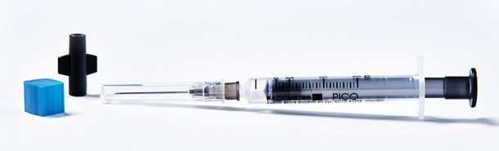
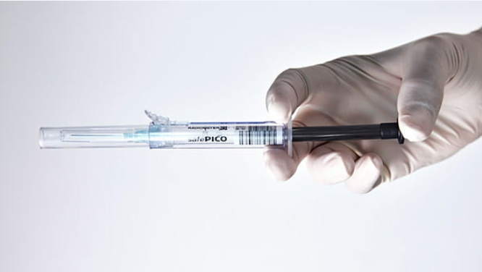
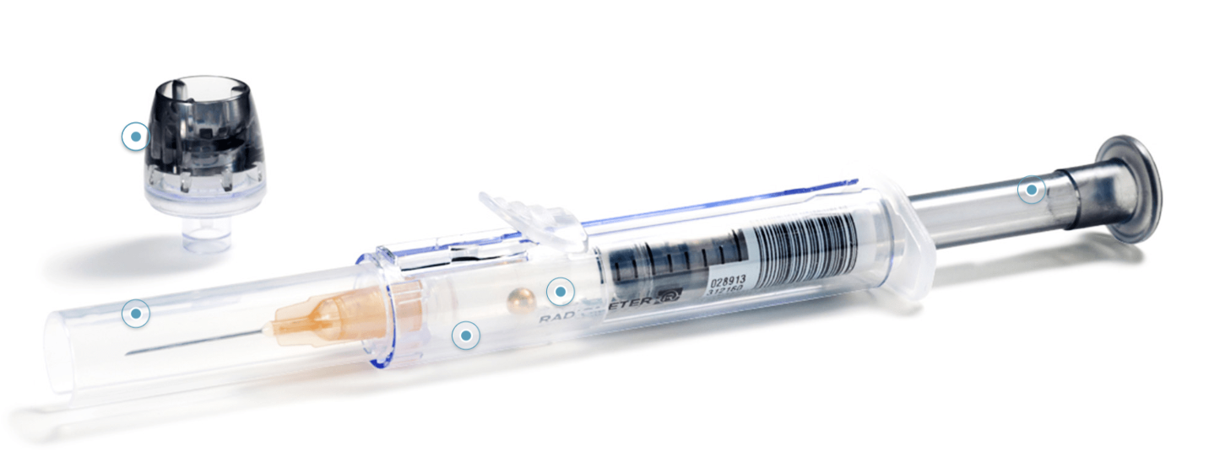
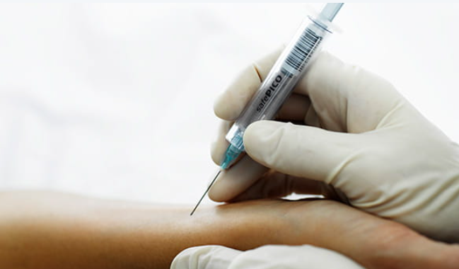
Radiometer
safePICO and PICO 70 self-fill syringe
Compatible with an A-line catheter stopcock, enabling it to be attached to the arterial catheter/line. The PICO70 self-fill syringe helps you deliver a blood sample with high analytical quality. It contains Radiometer’s uniquely formulated dry, electrolyte-balanced heparin. It minimizes risk of clot formation in the sample. The PICO70 self-fill syringe is available with a safeTIPCAP. The TIPCAP attaches to the syringe to reduce the risk of blood spillage.
INTERNAL USE ONLY
Notes:
Radiometer portfolio: https://www.radiometeramerica.com/en-us/products/blood-gas-syringes-and-capillaries

Slide 48
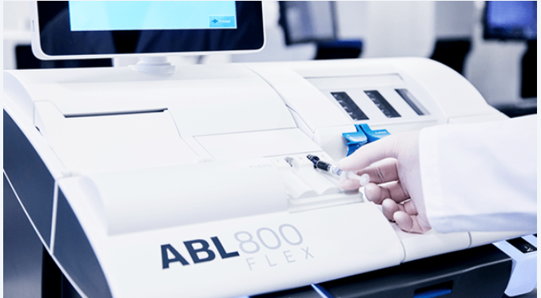
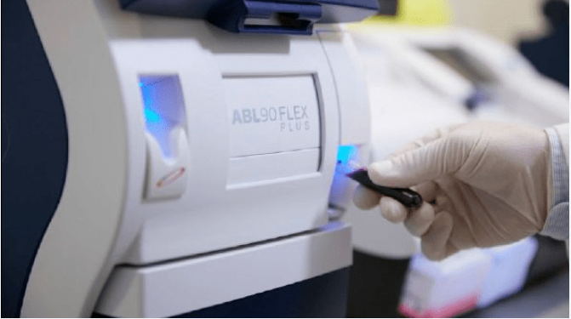
Radiometer Analyzers
ABL800 FLEX blood gas analyzer
Benchtop analyzer for high volume: high throughput, automated sample handling. Up to 3 blood gas samples in one workflow.
ABL90 FLEX PLUS blood gas analyzer
Compact blood gas analyzer designed for point-of-care testing in the ED, ICU, and NICU. Get results in 35 seconds on 17 parameters on 65 mL of blood.
INTERNAL USE ONLY
Notes:
ABL800: https://www.radiometeramerica.com/en-us/products/blood-gas-testing/abl800-flex-blood-gas-analyzer
ABL90: https://www.radiometeramerica.com/en-us/products/blood-gas-testing/abl90-flex-plus-blood-gas-analyzer

Slide 49
Know Your Competition
 | AirLife | Smiths/ ICU Medical | BD | Radiometer
GPO Contract | HPG-5147 Dual | HealthTrust, Premier, Vizient | None | None
Portfolio Breadth | Large | Large | Syringes for sticks & A-Line draws | Syringes for sticks & A-Line draws
Market Strategy | Sell on quality and features | Brand recognition Low-cost market leader | Manufacturer of syringes, sharps containers - so in wheelhouse | Convenience, less mistakes Tie to their system blood gas analyzers
Key Product | Pulset | Pulsator | BD Eclipse | safePICO
Strengths | Quality & Features (vented plunger, Li/Zn heparin, thin-walled needle, SafetyTip) | Brand recognition Market leader | Manufacturing | Bar code system
Weaknesses | Used to be a lack of focus and understanding of product line | Quality, low margin | Lack of focus on this line | Cost more
INTERNAL USE ONLY

Slide 50
Thank you!
INTERNAL USE ONLY

