Slide 1
Air-Q®sp3G Product Training

Slide 2
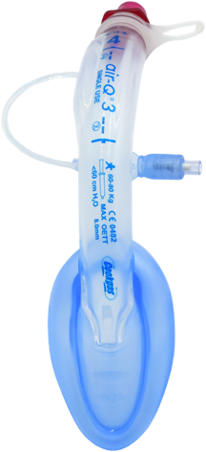
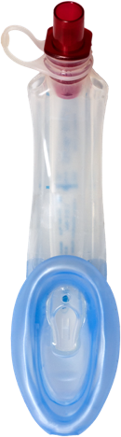
All Models
Air-Q®3
Single tube
Provides ease of ETT placement when unexpected intubation
is required.
Air-Q®sp3
Single tube
Self-pressuring cuff
Automatically inflates to patient-specific, optimized pressure to form a seal.
Air-Q®3G
Extra wide gastric inlet
Two gastric channels for OG tubes up to 18 Fr.
Air-Q®sp3G
Self-pressurizing cuff
Extra wide gastric inlet
Two gastric channels for OG tubes up to 18 Fr.

Slide 3
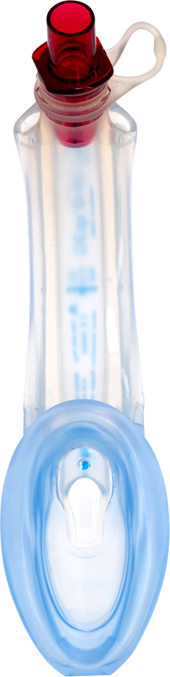
Air-Q®sp3G Features
1
Color coded connector
Anatomical curve
All silicone
Elevated mask heel
Aperture
Epiglottis elevator
ETT ramp
Self pressurizing mask
Large gastric inlet
Dual gastric channels
10
2,3
4
5
7
6
8
9
Notes:
Color-coded connector for easy size identification. Removable tethered connector enables insertion of endotracheal tube through airway tube.
Anatomically curved airway tube with integrated bite block, follows the anatomy for easier placement.
Made of medical grade silicone
Silicone has been deemed body safe in a solid form, for implantation and use in invasive procedures.
Silicone is unaffected by body heat and humidity, which means it will retain its shape.
Silicone also requires very little lubricant when inserting into an airway, which will allow it to slide in with little difficulty.
This also applies to intubating with a PVC tube or placing a gastric tube. PVC and silicone do not ‘stick’ together, like PVC on PVC will.
Thus, requiring very little, if any, lubricant to allow insertion of the ETT or gastric catheter into the Air-Q®3.
Built up, larger mask heel for improved seal.
Aperture enables transfer of air if inlet becomes blocked
Exclusive epiglottis elevator lifts the epiglottis to maximize cuff placement
ET Tube Ramp helps facilitate intubation, allows epiglottis to rise further up, opening the glottis further and directs the endotracheal tube toward the laryngeal inlet, for more chances of 1st pass success when intubating.
Self pressurizing cuff inflation is controlled by inspiratory/expiratory pressure. No manual inflation is needed
Extra large gastric inlet at the distal tip available in the Air-Q®3G series
The large dual gastric channels and gastric inlet allow for better flow (circle drain), removing more secretions and lessening the chance of blockage. It also allows for larger catheters to be placed if desired.

Slide 4
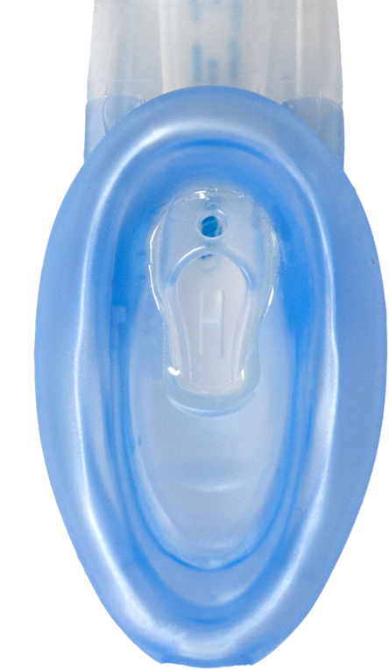
The Benefits of Air-Q®sp3G
Air-Q®sp3, and Air-Qsp3G models allow for no cuff monitoring.
Allows for gastric catheterization for those that will have the airway in longer.
Gastric access can relieve the pressure of too much air in the stomach
Gastric access allows for decompression of air from positive pressure ventilation, and to remove stomach contents to prevent aspiration.

Slide 5
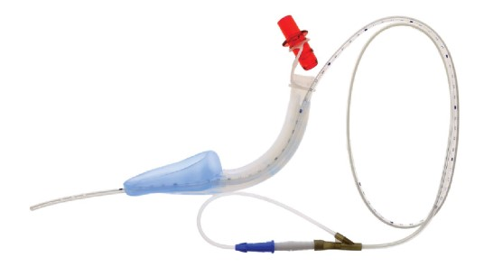
How Gastric Access Works
ITEM | SIZE | IBW (lbs) | IBW (kg) | MAX. OETT | MOUTH OPENING | LENGTH OF TUBE | MAX. OGTUBE
60005 | 0 | <4 Ibs | <2 kg | 3.0mm | 5 mm | 6 cm | 5 fr
60055 | 0.5 | 4-9 Ibs | 2-4k | 4.0 mm | 8 mm | 7 cm | 6Fr
60105 | 1 | 9-15 lbs | 4-7 kg | 4.5 mm | 11 mm | 9 cm | 8 Fr
60155 | 1.5 | 15-37 lbs | 7-17 kg | 5.0mm | 14 mm | 11 cm | 8 Fr
60205 | 2 | 37-66 lbs | 17-30 kg | 5.5 mm | 17 mm | 14 cm | 10 Fr
60305 | 3 | 66-132 Ibs | 30-60 kg | 7.0 mm | 20 mm | 16 cm | 14 Fr
60405 | 4 | 132 – 176 lbs | 60-80 kg | 8.0 mm | 23 mm | 18 cm | 16 Fr
60505 | 5 | > 176 lbs | >80 kg | 9.0 mm | 25 mm | 20 cm | 18Fr
Notes:
With LMA/ILA we are sealing above the glottis. This really allows for two pathways for gas to go, the lungs and the stomach. Since the airway is rigid and open, supported by rings of cartilage, it is the path of least resistance. There will always be some gas that will enter the stomach in most cases. More frequently with CPR or high ventilating pressures.
Solution
Gastric access can relieve the pressure of too much air in the stomach. It can also aid in draining secretions, so they do not migrate into the airway. With an ETT the cuff is in the trachea and can help prevent the secretions from going into the airway, however with an LMA/ILA the cuff is in the glottis and secretions could migrate into the airway if not suctioned out.

Slide 6
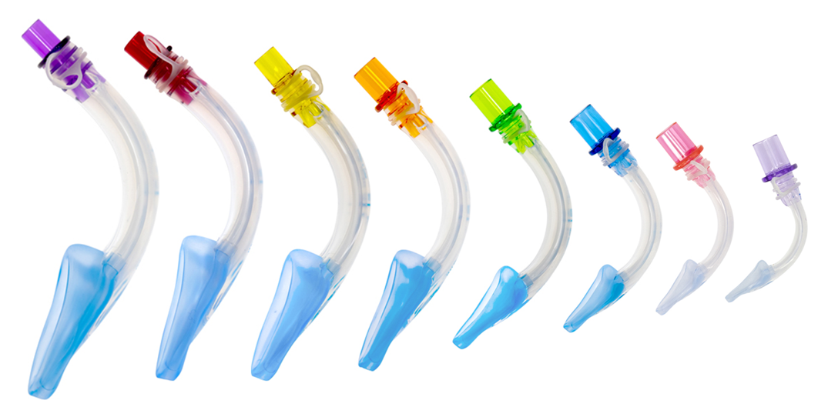
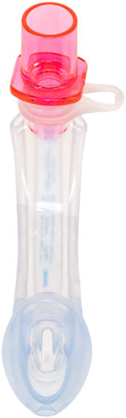
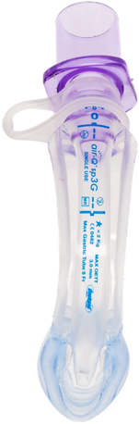
Sizes
Neonate Sizes
Air-Q®3 has the only size 0 SGA.
The tube, mask and bowl design are specifically for the infant anatomy.
0 and 0.5 size are available in all
Air-Q3 models.
ITEM | SIZE | IBW (lbs) | IBW (kg) | MAX. OETT | MOUTH OPENING | LENGTH OF TUBE | MAX. OGTUBE
60005 | 0 | <4 Ibs | <2 kg | 3.0mm | 5 mm | 6 cm | 5 fr
60055 | 0.5 | 4-9 Ibs | 2-4k | 4.0 mm | 8 mm | 7 cm | 6Fr
60105 | 1 | 9-15 lbs | 4-7 kg | 4.5 mm | 11 mm | 9 cm | 8 Fr
60155 | 1.5 | 15-37 lbs | 7-17 kg | 5.0mm | 14 mm | 11 cm | 8 Fr
60205 | 2 | 37-66 lbs | 17-30 kg | 5.5 mm | 17 mm | 14 cm | 10 Fr
60305 | 3 | 66-132 Ibs | 30-60 kg | 7.0 mm | 20 mm | 16 cm | 14 Fr
60405 | 4 | 132 – 176 lbs | 60-80 kg | 8.0 mm | 23 mm | 18 cm | 16 Fr
60505 | 5 | > 176 lbs | >80 kg | 9.0 mm | 25 mm | 20 cm | 18Fr

Slide 7
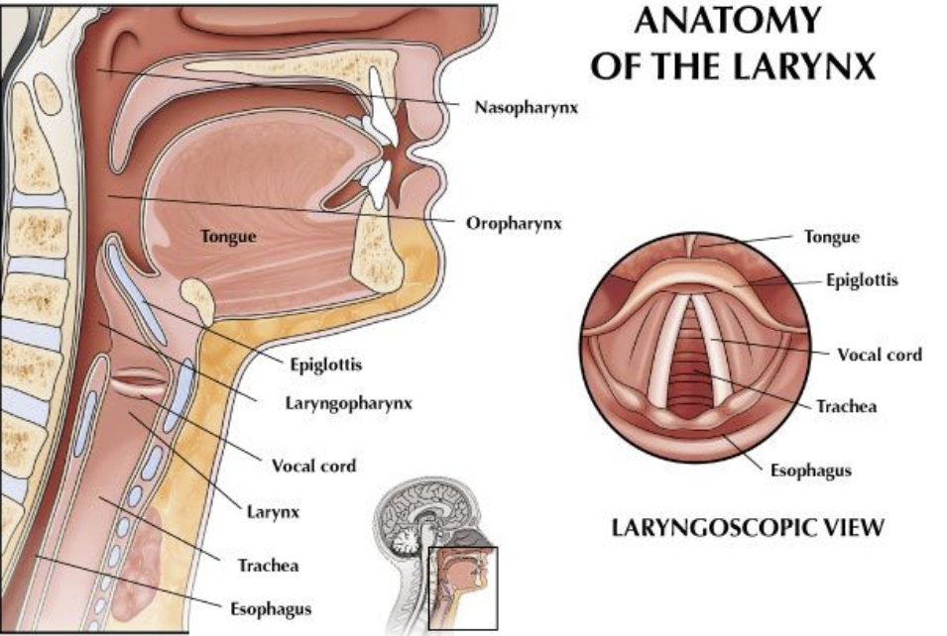
Larynx Anatomy

Slide 8
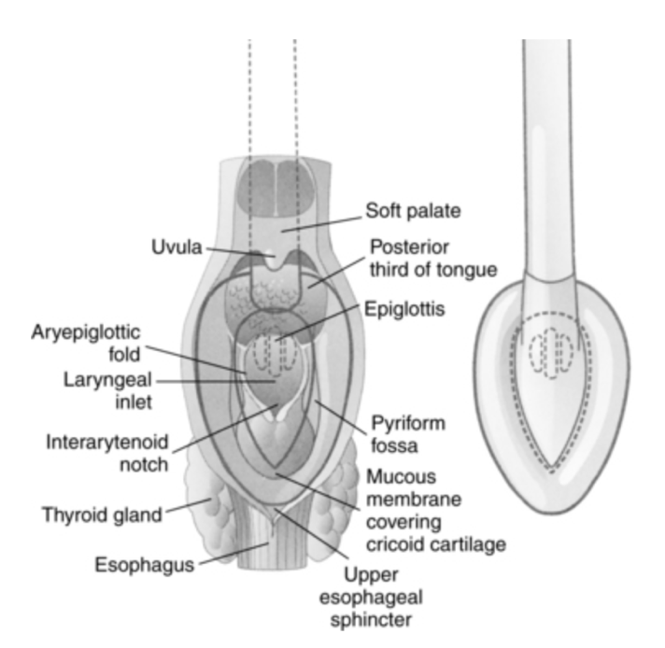
Anterior View
Cuff (seal)

Slide 9
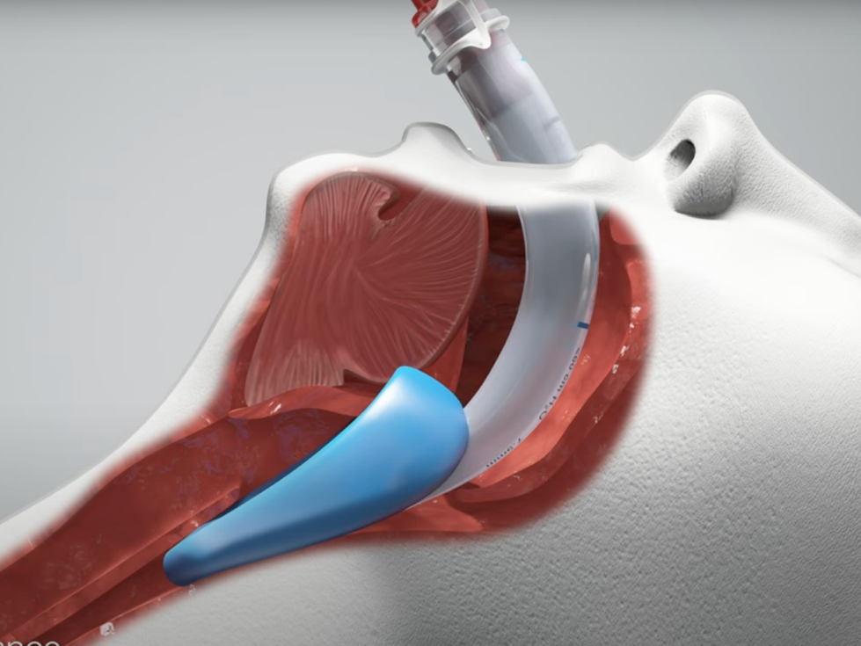
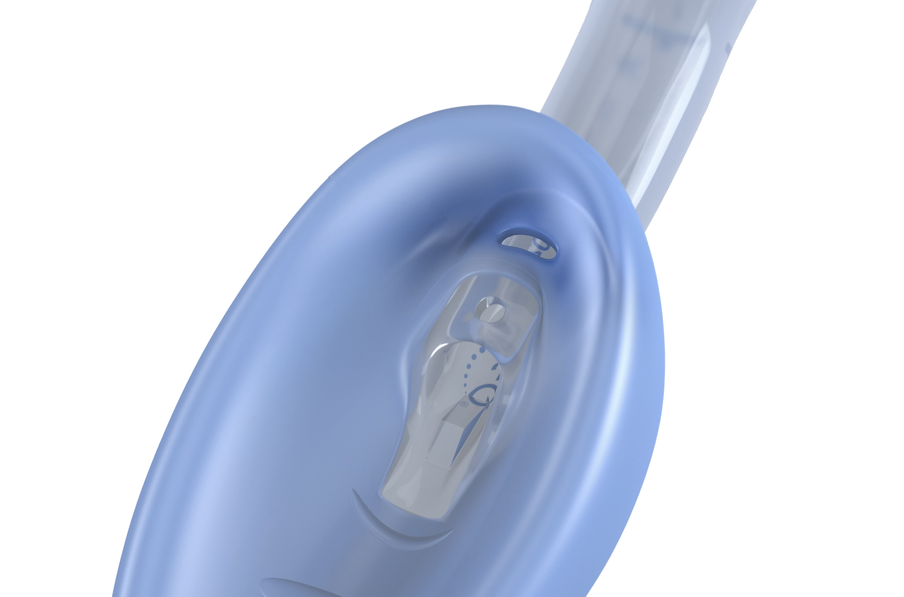
What is Self Pressurizing?
The Air-Q®3 self-pressurizing models allow for the mask to inflate based on the transpulmonary pressure that exists in the airways.
Cuff placement above glottis
Notes:
In spontaneously breathing patients, the mask itself creates a seal, and as transpulmonary pressure is minimal in spontaneous breathing, very little ‘seal’ is needed as the negative pressure from the dropping of the diaphragm and the chest wall expanding creates the gas flow and pressure needed to expand the lungs.
When an SGA is inserted, the mask is inflated to create a seal above the glottis allowing for gas flow to the lungs. This has traditionally been done using a syringe and a pilot line to fill the mask.
iGel launched a non-inflatable cuff device that uses a thermoplastic elastomer to ‘seal the airway’.
The Air-Q®3 self-pressurizing models allow for the mask to inflate based on the transpulmonary pressure that exists in the airways. When transpulmonary pressure is increased in the case of positive pressure ventilation with a ventilator, resuscitation device, or mouth-to-tube, there is an equilibrium port in the heel of the mask, that allows the mask to inflate proportional to the transpulmonary pressure increase, or ventilation pressure.

Slide 10
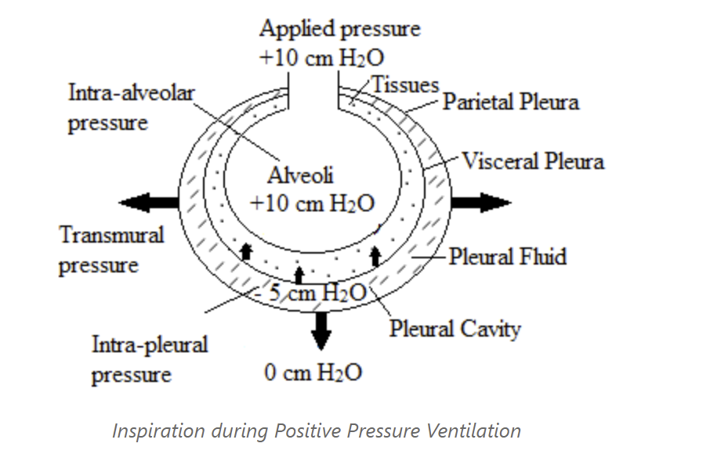
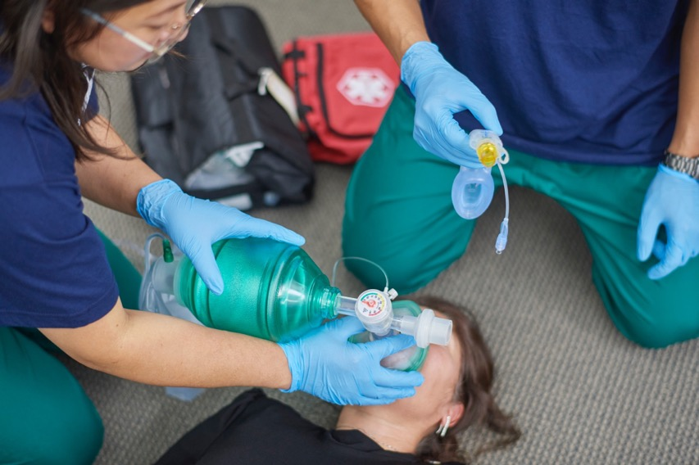
Positive Pressure Ventilation
Notes:
Whether we use a mechanical ventilator or a resus bag, we are introducing positive pressure into an airway. In the example we are applying 10 cmH20 to the airway, which will equilibrate to 10 cmH20 in the alveoli. In order to create that equilibrium, we need to transfer that positive pressure all they way down the conducting airways in order to reach the alveoli. When we have an ETT in place, the cuff at the end of the tube is in the trachea and it seals the upper airway off and allows gas to be directed through the airways. With an LMA/ILA, the cuff seals off the whole glottic region and essentially conducts gas down through the airways, however, because the cuff is above the glottis, there is a larger surface area to seal off and direct the gas flow. This is where the terms cuff pressure or seal pressure come from. With an ETT we look at cuff pressures, as only a minimal amount is needed in order to seal off the trachea to allow gas flow. With the LMA, the seal pressure is what is needed to seal off the glottis so that gas flow can be directed.

Slide 11
Cuff Pressure Does Not Equal Ventilating Pressure
ETT cuff pressures usually don’t exceed 30 cm H₂O, but a range of 20-35 is reasonable¹.
LMA cuff pressures are recommended in the 20-40 cm H₂O range¹.
1. de Castro, A., & Gopalan, P. (2016). Intraoperative management of ETT and LMA cuff pressures: a survey of anaesthetists’ knowledge, attitude and current practice. Southern African Journal of Anaesthesia and Analgesia, 22(5), 151–155. https://doi.org/10.1080/22201181.2016.1234664
Notes:
On questions about seal pressure, and cuff pressure. We have a competitor, iGel that has a non-inflating cuff. In EMS this is likely one of the larger competitors.
Here is how we address:
If the seal pressure is of Air-Q®3 is not adequate for ventilation, it is advised that a larger size than that recommended on weight basis is used. However, even if the seal pressure in a given patient would allow it, peak airway pressure of ventilation should not exceed 40cm H2O in order to prevent barotrauma and ineffective ventilation.
ETT pressures should not exceed 30 - 35 cmH20 when measured with a cufflator. You will also hear the term minimal leak technique, which implies that a small leak during peak inspiration is heard, which would indicate that there is not too much cuff pressure at the height of inspiration. Not enough pressure means no seal, which turns into inadequate ventilation pressures at the alveoli. Too much pressure means there can be tissue damage from cutting off blood supply around the capillary beds where the cuffs are positioned. This is where our SP model can be a benefit. DO NOT mistake cuff pressure with ventilating pressure. They are not the same. Ventilating pressure is what is needed to inflate the lungs for gas exchange, cuff pressure is what it takes to seal off the airway for the gas to inflate the lungs.

Slide 12
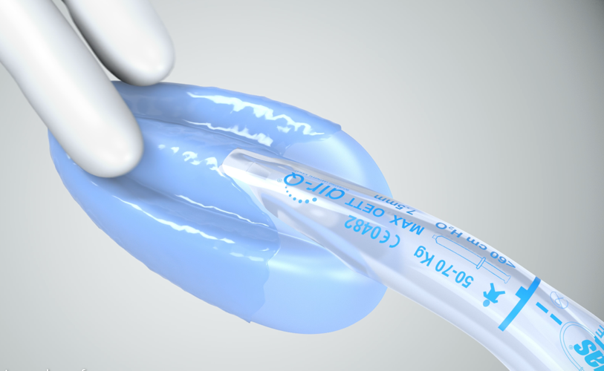
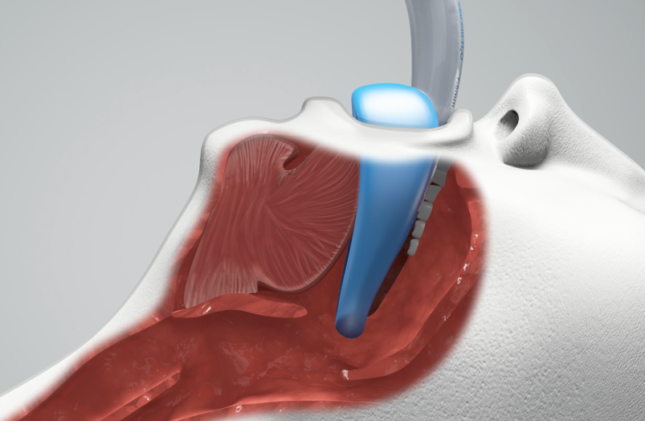
Insertion
Step 1
Lubricate the external surface including mask cavity ridges
Step 2
Place the front portion of the
Air-Q®3 mask between the base of the tongue and the soft palate at a slight forward angle.

Slide 13
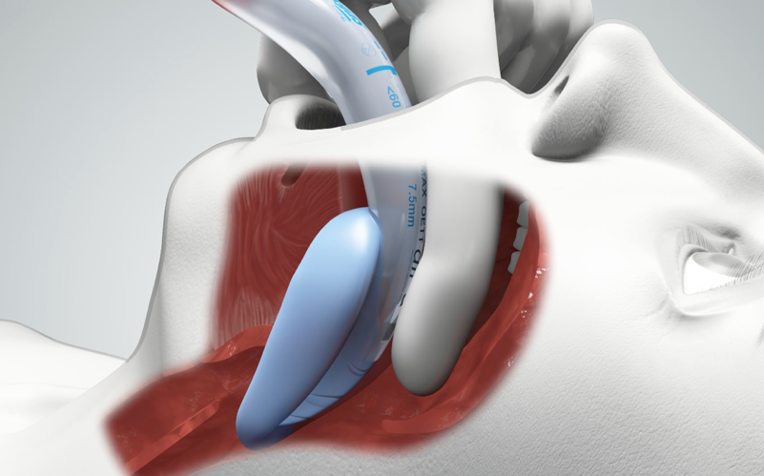
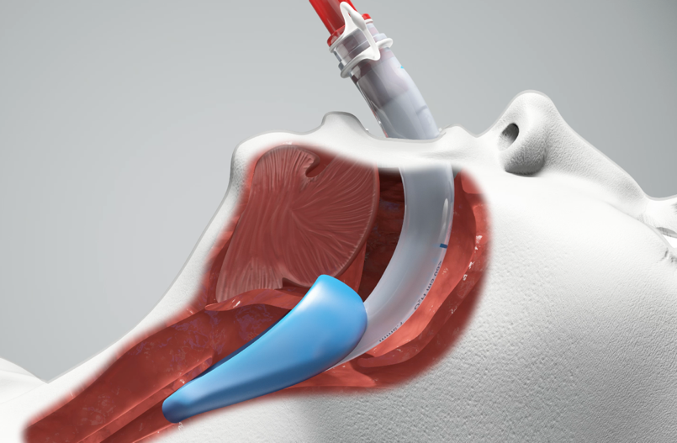
Insertion
Step 3
Place back of back of left index finger behind the mask, flexing the finger forward to help guide the mask around the corner into the pharynx.
Step 4
Continue to advance until fixed resistance to forward movement is felt. Correct placement is determined by this resistance to further advancement. Secure by taping the Air-Q3 in place.

Slide 14
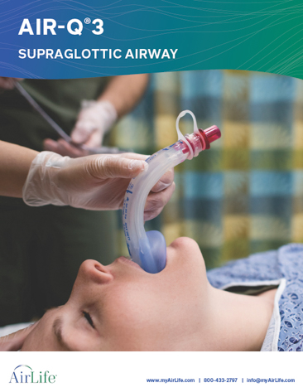
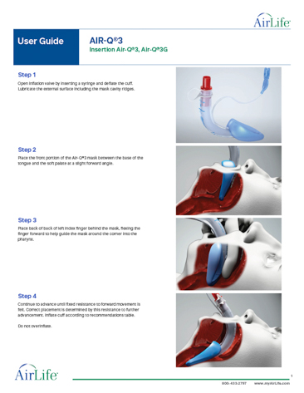
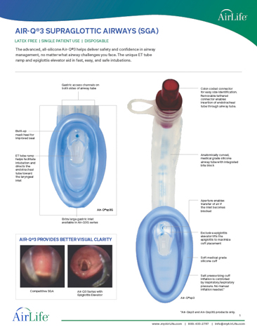
Additional Online Resources

Slide 15
Thank you
INS-20050-C1 Rev2

