Slide 1
X2 Leadwire System
Benefits Overview – February 2025
Nick Soler – Associate Director, Product Management
PPT-20013-C1 rev1

Slide 2
Multi-Link™ X2 ECG System
Your single-source solution for all your ECG needs!
AirLife is the only OEM-based supplier to offer a flexible universal ECG system to work with both reusable and disposable leadwires
One patient – One leadwire – One Supplier!
Compatible with GE HealthCare, Philips, Mindray, Drager, Nihon Kohden, Spacelabs, Physio Control and Zoll
Eliminate or reduce your dependency on pesky adapters
Reduce waste by utilizing shorter disposable leadwires
Improve signal quality with GE HealthCare telemetry systems
Seamlessly switch between reusable and disposable leads
Leadwire transfers with the patient – just unplug and plug back in!

Slide 3


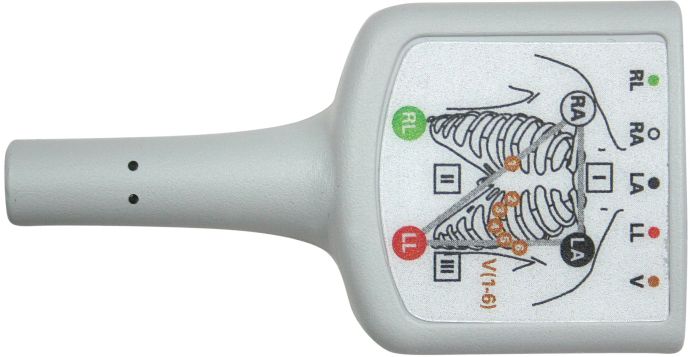



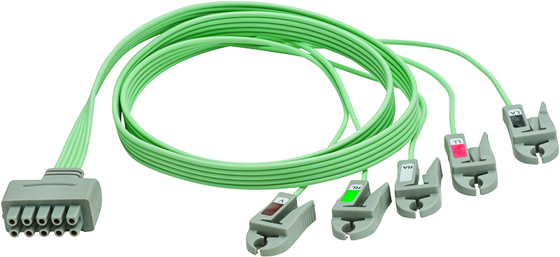




No matter the brand, X2 connects

Slide 4
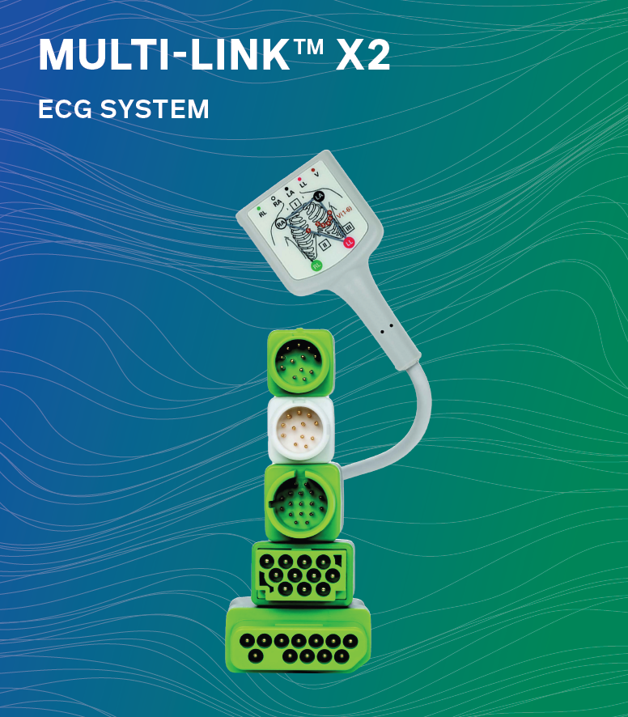
Portfolio full of options to meet your needs
Cables:
53 Cables covering 12 different ECG brands
  3-, 5-, 6-, and 12-lead available
  Multiple lengths
Leadwires:
Over 50 leadwire combinations available
Reusable and Disposable
Grabbers and Snaps
3-, 5-, 6- and V-lead offerings
29-in, 39-in, 51-in and mixed-length leadwire lengths

Slide 5
Patient Flow /Time Saving
Apply the electrodes and leadwire wherever the patient is admitted
Simply disconnect the lead from the cable when transporting, then re-attach in the next care area!
ER
Pre-Op
OR
PACU
Recovery
ICU
Med/Surg
Telemetry

Slide 6
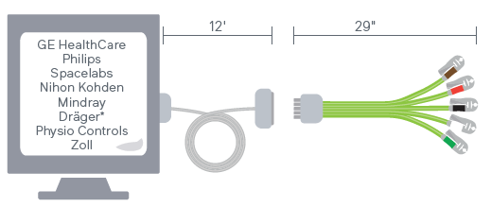

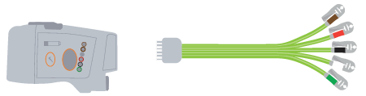
Fully Disposable Option
Customers that utilize disposable leadwires throughout their system:
Dedicated 12-ft cables for all bedside monitors
Dedicated adapters (if necessary) for telemetry transmitters
ONE 29-in leadwire per patient, disconnects and reconnects to the cables or adapters, providing seamless monitoring experience with minimal time

Slide 7
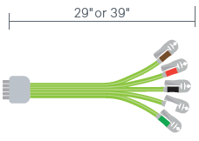
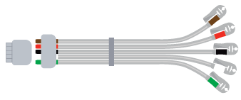
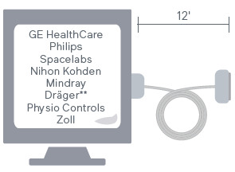
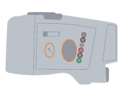
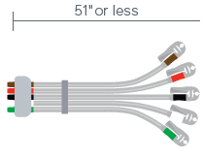
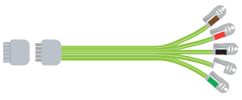
Mixed Use Scenario
Customers may also mix their use of disposable and reusable leadwires
based on patient population, surgery type or other factors
Dedicated 12-ft cables for all bedside monitors
Dedicated adapters (if necessary) for telemetry transmitters
Both reusable and disposable leads work with our line of cables
and adapters

Slide 8
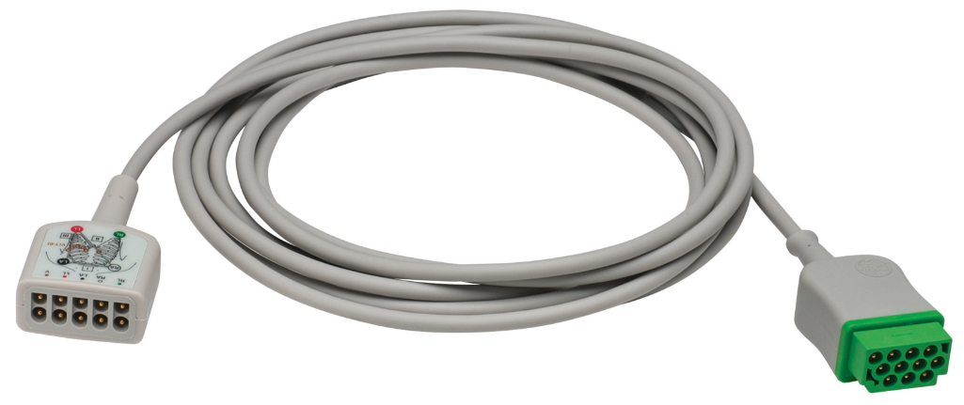
Dollar Cables
Every department that converts to the use of disposable Multi-Link X2 leadwires can receive their ECG Cables for $1 to help expedite conversion and lower your financial impact
This promotion is only available once per department
Customer must purchase 1 Box (10 each) of disposable leadwires
for every cable, on the same PO, direct from AirLife
Flexibility:
If you change monitoring brands in the future, you can use the dollar cable program again!
Expanding to a new department? No problem!

Slide 9
Thank you

