Slide 1
enFlow® Blood & Fluid Warming Device
®
Author / Subtitle
PPT-20015-C1 Rev. 1​

Slide 2
Table of Contents
01 Effects of Hypothermia
02 enFlow Product Overview
03 enFlow Controller
04 enFlow Warmer
05 enFlow Cartridge
06 Assembly
07 Power On
08 Insert Cartridge
09 Mounting
10 Frequently Asked Questions

Slide 3
Effects of Hypothermia
Increased lactate
Increased length of stay
Blood increases in acidity
Increased risk of surgical site infections
Coagulation impairment even at mild hypothermia
Decreased perfusion – A reduction in the flow of blood to tissues and organs in the body
Increased pain – Introducing blood or fluid at room temperature into the body can cause
significant discomfort or pain. The body maintains a temperature of around 37°C, so when fluids are introduced at room temperature (20°C – 22°C), the difference in temperature can lead to pain, particularly if it’s introduced into areas where nerves are sensitive or inn medical procedures like IV insertions or transfusions. The body may react to the temperature difference, causing sensations of cold, burning, or discomfort.

Slide 4
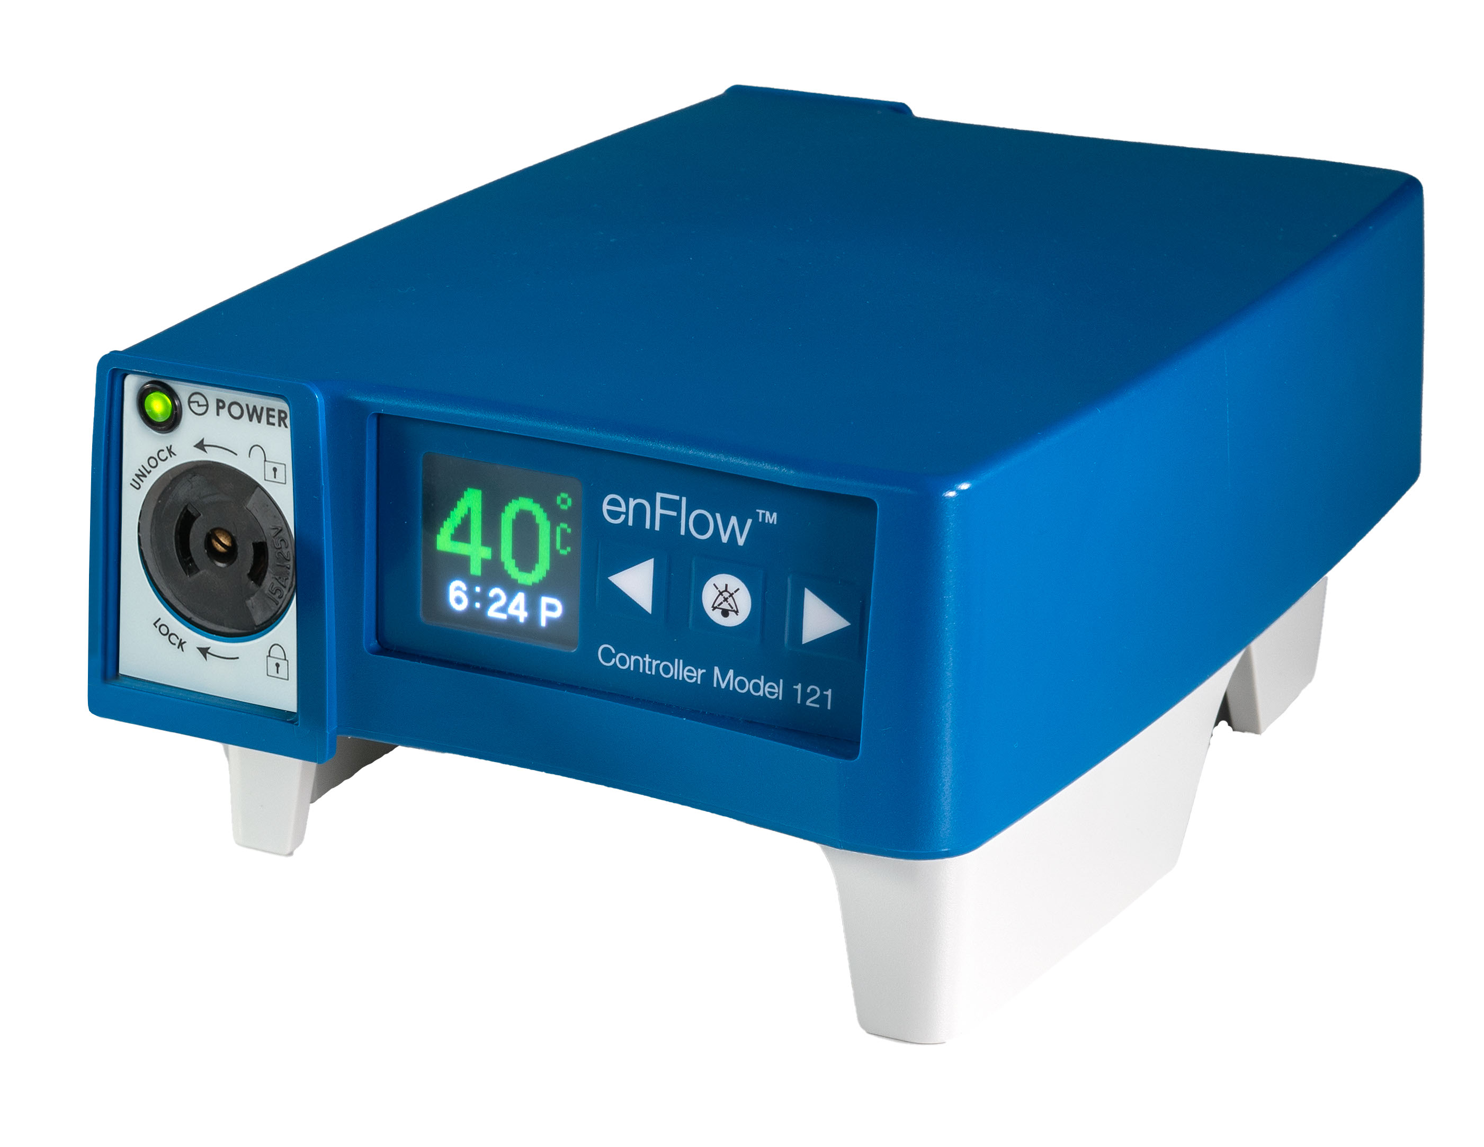
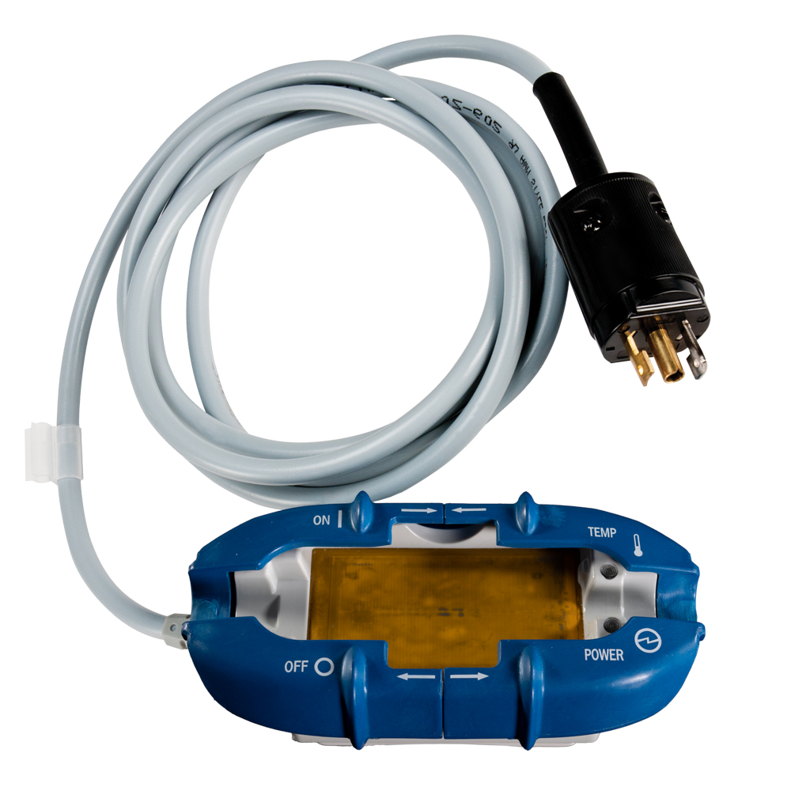
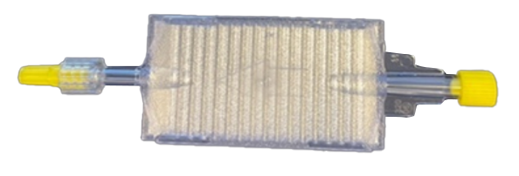
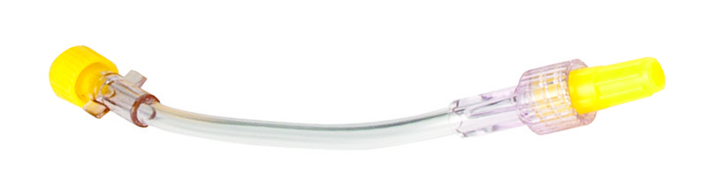
enFlow Product Overview
Controller
Warmer
Cartridge

Slide 5
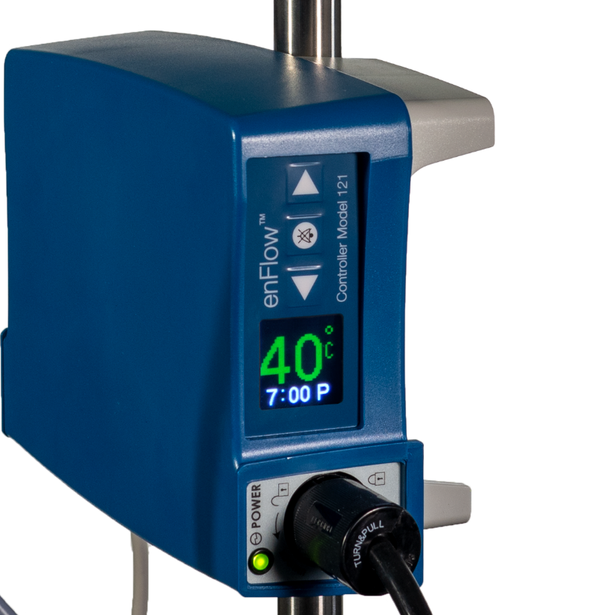
enFlow Controller
The controller serves as the power supply. On the front is:
A self orienting, easy to read OLED display that shows the temperature
Two (2) arrow buttons for adjusting
the clock
  One (1) alarm silence button
A socket for the warmer
The controller can withstand dripping fluid, with a rating of IPX1.

Slide 6
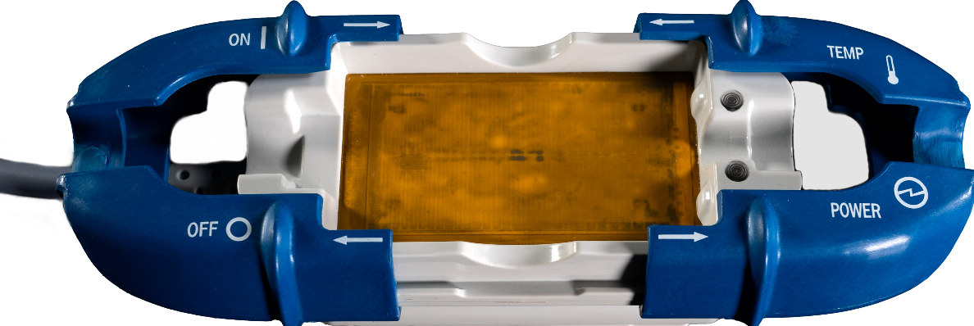
enFlow Warmer
The warmer works with the controller to warm fluids using electrical resistance.
Its unique design helps transfer heat evenly and effectively to the disposable cartridge.
To maintain 40°C output, the warmer utilizes:
Four (4) temperature sensors
Four (4) independent overheating temperature sensors

Slide 7
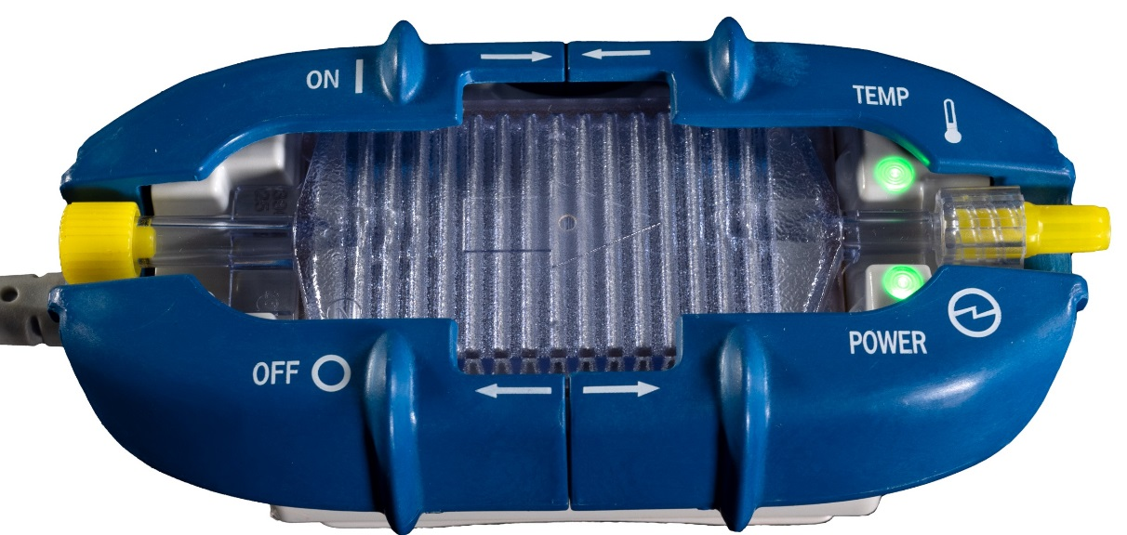
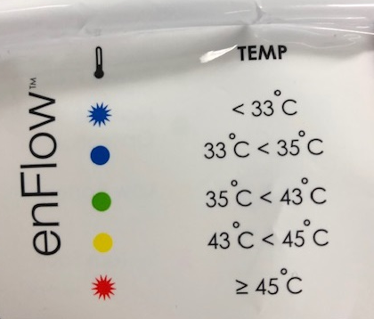
enFlow Warmer
On top of the warmer are two LEDs:
Shows that the power is on
Indicates fluid or blood infusate temperature
The flag label shows each temperature color code for the LEDs.

Slide 8
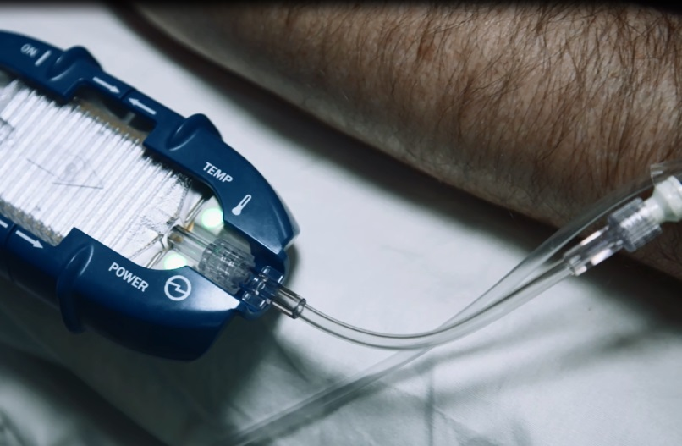
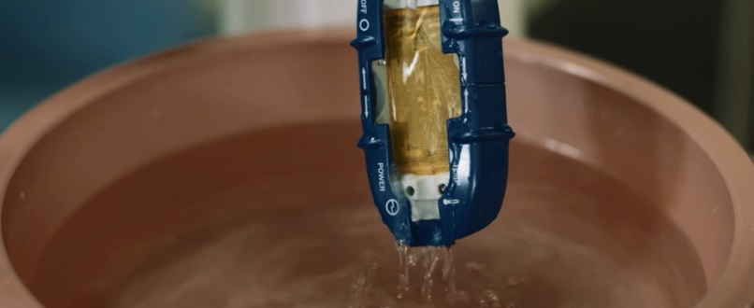
enFlow Warmer
The warmer is small and lightweight, allowing it to be placed very close to the patient. This way, less cooling occurs in the IV line.
The warmer is completely sealed against fluid ingress, with an IPX7 rating.

Slide 9
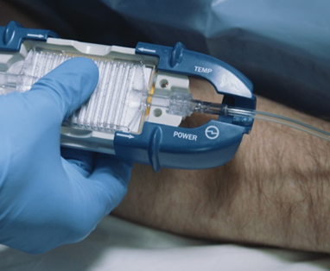
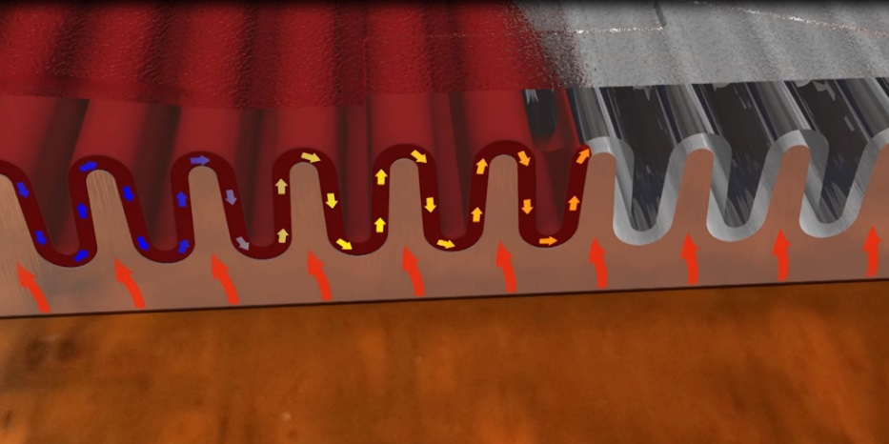
enFlow Cartridge
The enFlow cartridge is placed in the IV line, then into the enFlow warmer.
Heat from the warmer is transferred to fluids as the warmer surface is pressed against the aluminum on the underside of the cartridge.
Fluid is warmed as it passes over the corrugated aluminum surface inside the cartridge.
Aluminum is parylene coated to prevent fluids being in contact with aluminum and cause leaching.

Slide 10
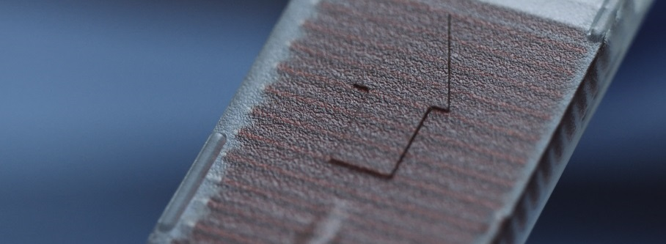
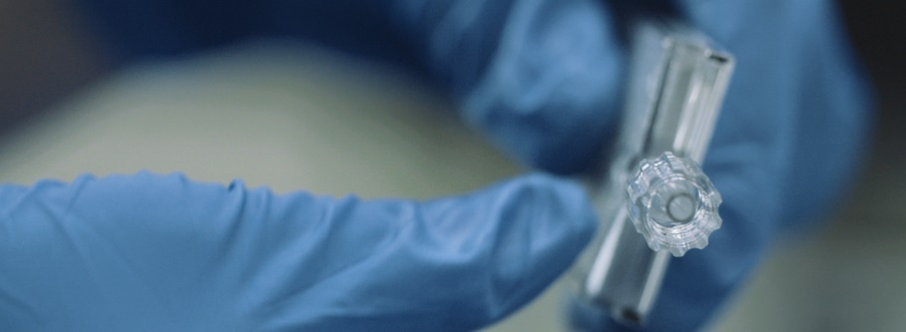
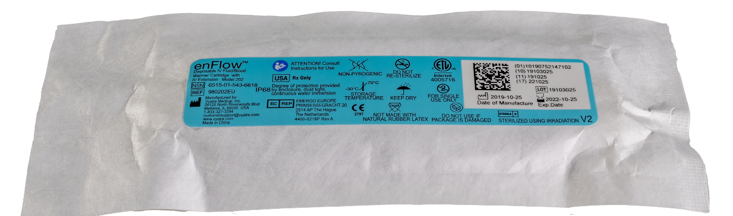
enFlow Cartridge
The Cartridge has a luer connection on each end—one male and one female.
It can connect to most standard IV sets.
Each disposable, parylene coated cartridge is radiation sterilized, non-pyrogenic, DEHP free, and does not contain natural rubber latex.
A cartridge may be used on a single patient for up to 24 hours.
If you are warming whole blood products, you should change the cartridge according to your hospital blood protocol for IV sets.

Slide 11
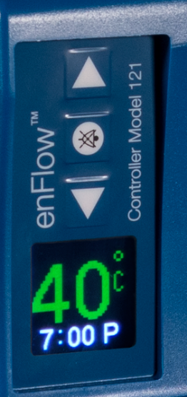
enFlow Cartridge
enFlow has a priming volume of just 4 mL.
enFlow will reach and maintain
40°C ± 2°C in just 18 seconds or less.

Slide 12
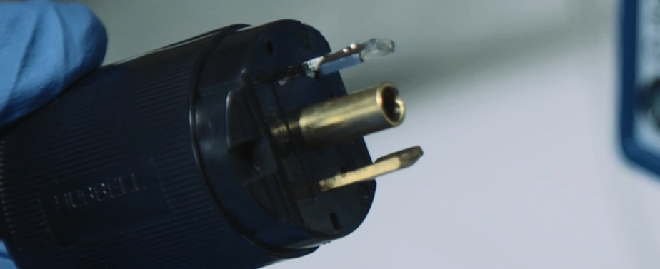
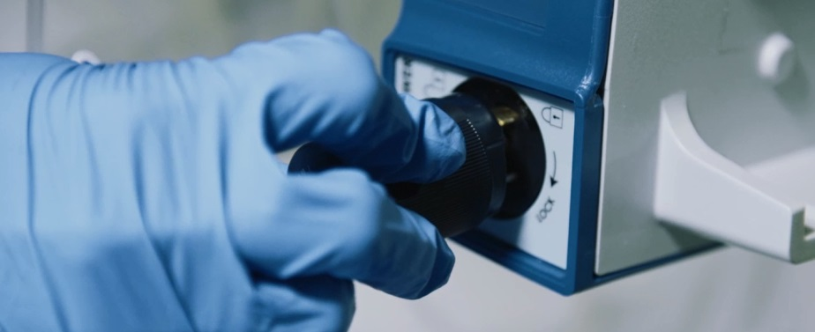
Assembly
Insert the electrical power cord into its keyed receptacle on the back of the controller.
Plug the other end into a grounded outlet.
Find the Hubbell connector at the end of the warmer unit’s cord and carefully align the tabs with the receptacle slots found on the front of the controller.
Press the tabs into place so the base of the connector is flush with the face of the receptacle.
Carefully twist the connector, following the arrows on the controller.
The enFlow controller comes with a standard IV pole clamp mount, or you can place the controller on the tabletop.

Slide 13
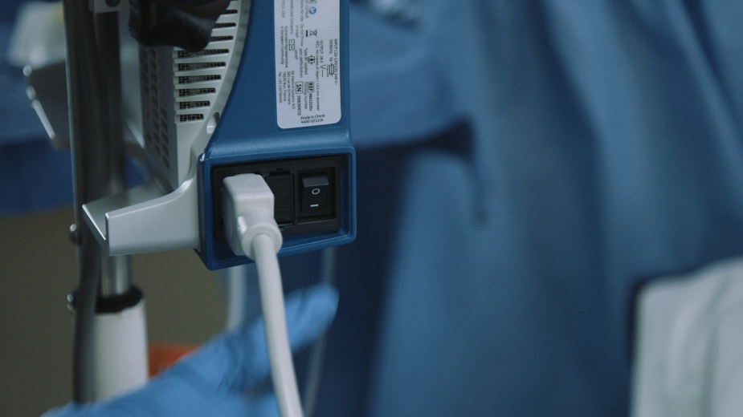
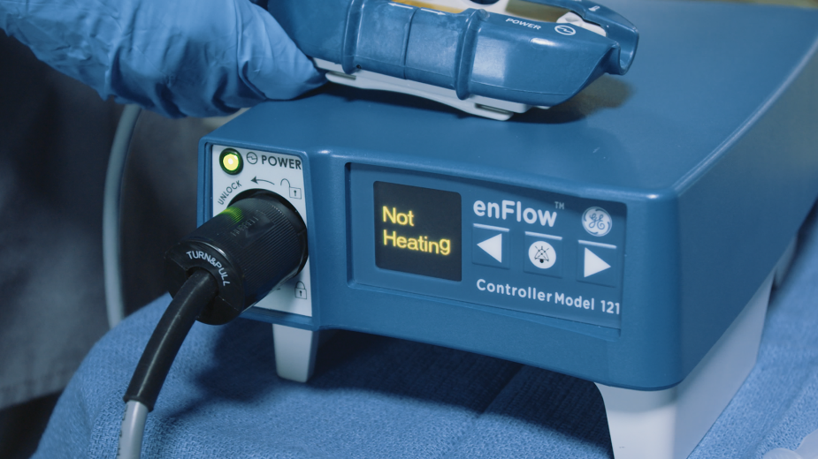

Power On
Turn on the power switch found on the back of the controller. The power LED should illuminate and emit a beep.
enFlow performs a self check during power on sequence.

Slide 14
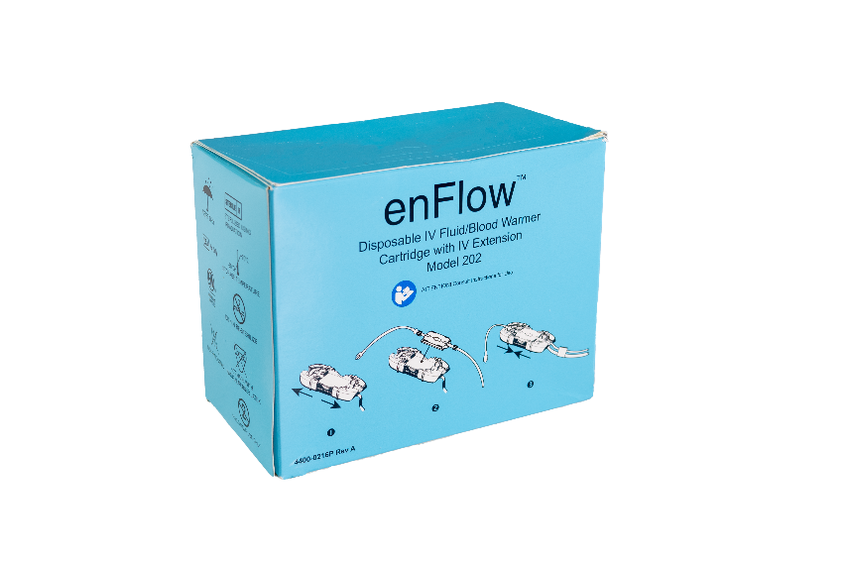
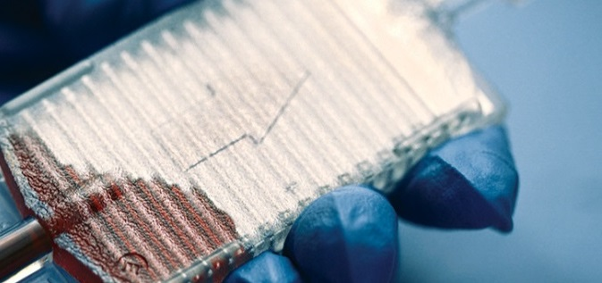
Insert Cartridge
Remove a packaged cartridge from the dispenser box. The cartridge’s fluid pathway remains sterile so long as the cartridge is kept in its single unit pouch.
Spike the IV fluid bag as you normally would.
Connect the IV set to the inlet of the cartridge and, if needed, to the outlet of the cartridge.
Prime the line and cartridge with fluid using standard protocols.

Slide 15
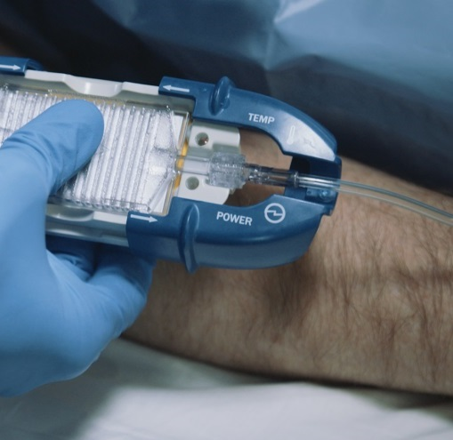
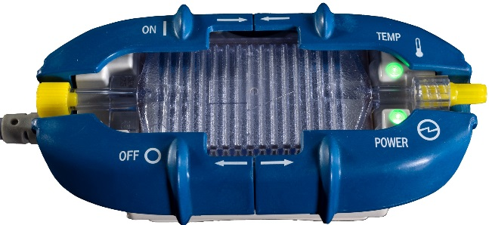
Insert Cartridge
Open both warmer covers.
Using the landmarks on the cartridge, aluminum base down, square key aligned with square opening on the warmer, and arrow pointing toward the patient, place the cartridge in the warmer.
Slide the covers closed.
You’ll hear a beep when the covers close, and the device will automatically begin to warm.

Slide 16
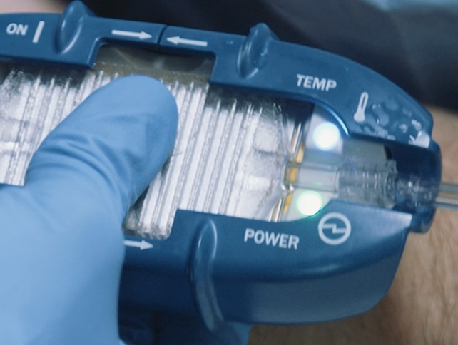
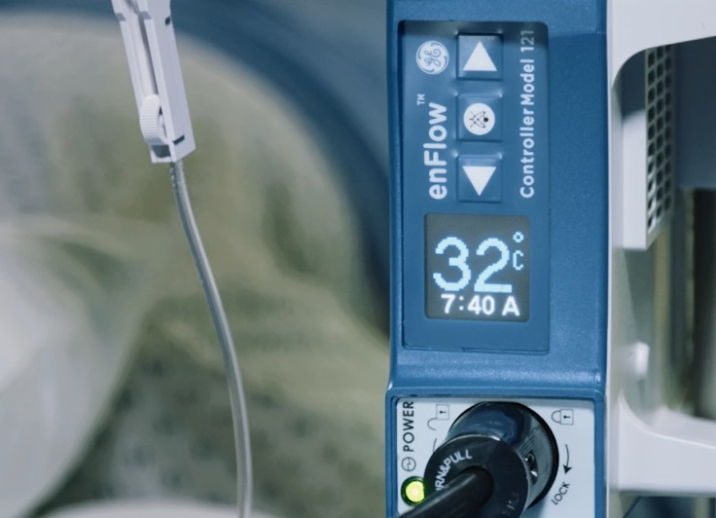
Insert Cartridge
The temperature LED is blue until the fluid reaches 35°C, at which point it turns green.
The system will quickly reach 40°C. The two LEDs will be a steady green.

Slide 17
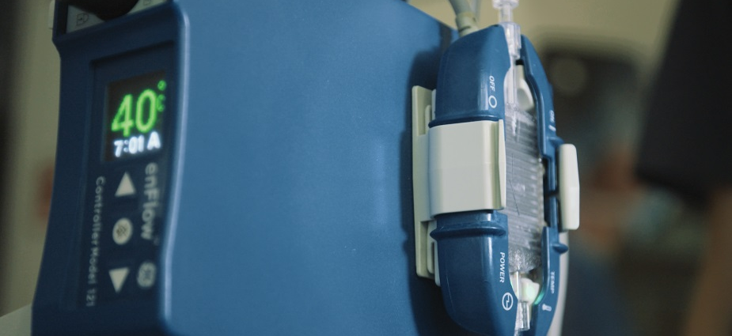
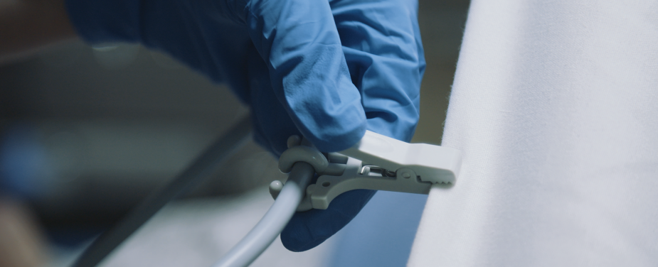
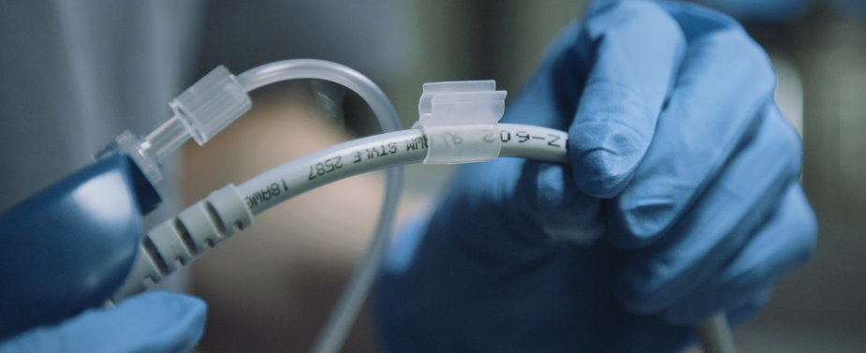
Mounting
Use the cord clip on the warmer cord to secure the warmer to the bed, or place the warmer in the warmer holder cradle on the side of the controller.
Place the IV line in the IV line clip to prevent it from kinking.

Slide 18

Frequently Asked Questions
What is enFlow? | A fast and reliable blood and fluid warmer.
How fast is it? | Blood is warmed to 40°C in less than 18 seconds. Room temp fluids are even faster.
How easy is it to set up? | Prime the cartridge, clip it in, connect to patient, and go!
What’s the priming volume? | 4 mL
What is the flow rate? | 2 mL/min (KVO) to 200 mL/min
How long can you use each cartridge? | In line with your local IV line disposal policy.

Slide 19
Thank you

