Slide 1
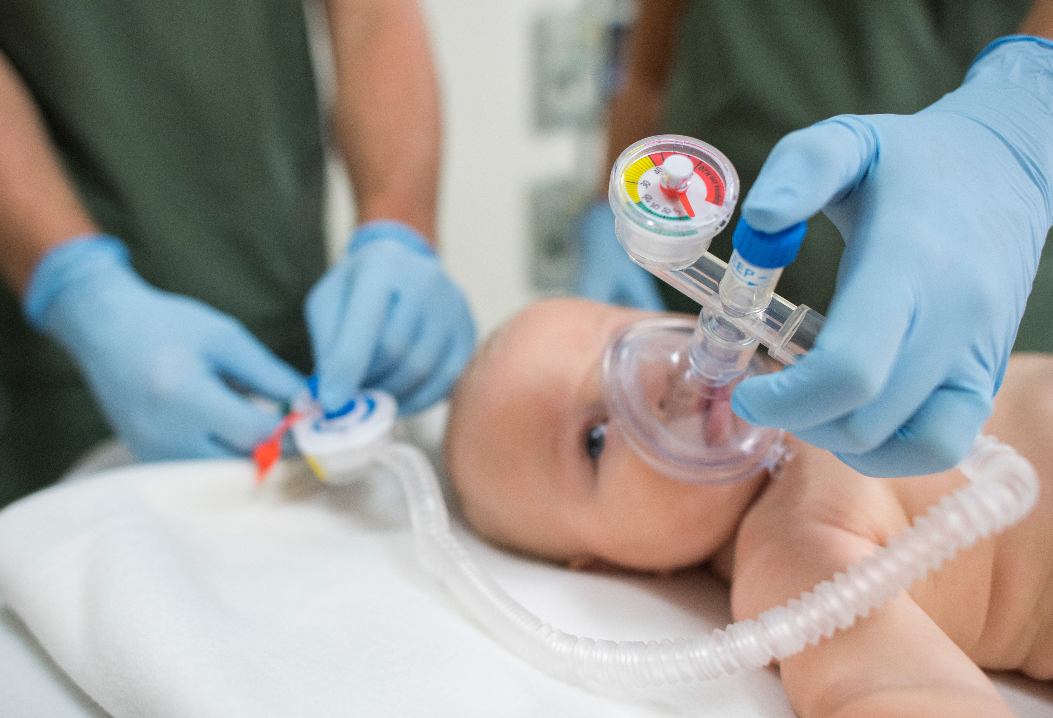
Neonatal Resuscitation Program
AirLife NRP
Designed Products

Slide 2
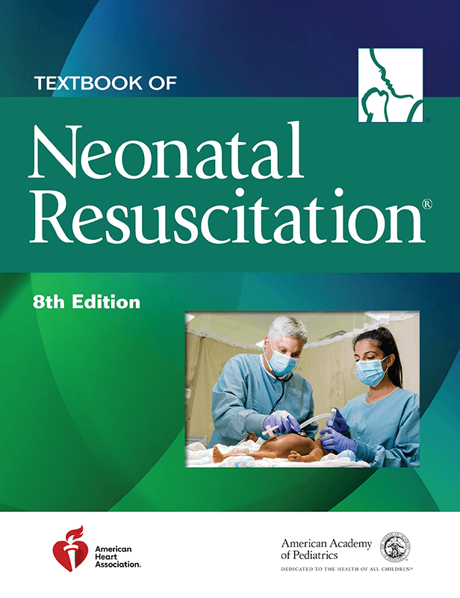
What is the NRP?
“The Neonatal Resuscitation Program (NRP ) materials are based on the American Academy of Pediatrics (AAP) and American Heart Association (AHA) Guidelines for Cardiopulmonary Resuscitation and Emergency Cardiovascular Care.”
“Since 1987, the Neonatal Resuscitation Program (NRP ) has helped over 4.5 million health care providers fulfill this responsibility be acquiring the knowledge and skills necessary to save
newborn lives.”⁴
®
®
®
2

Slide 3
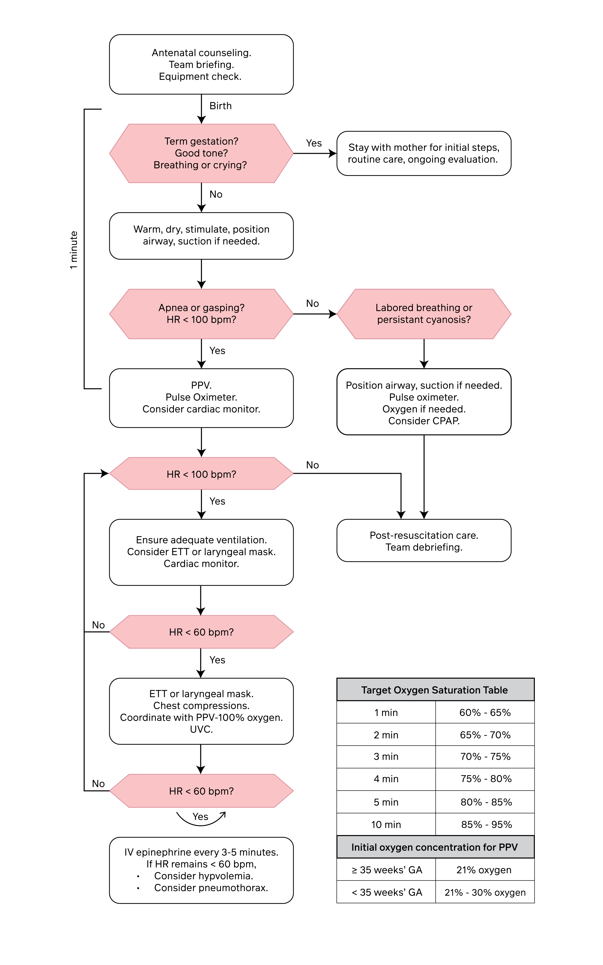

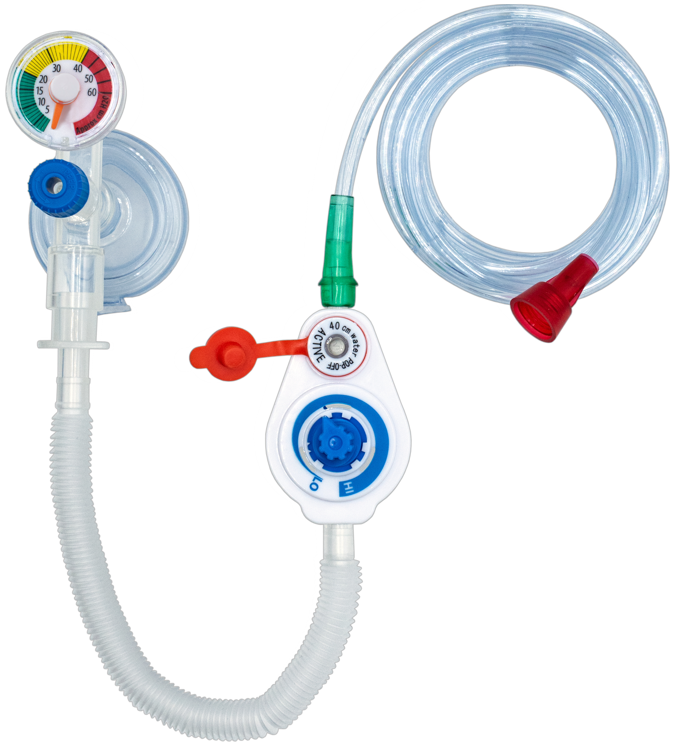
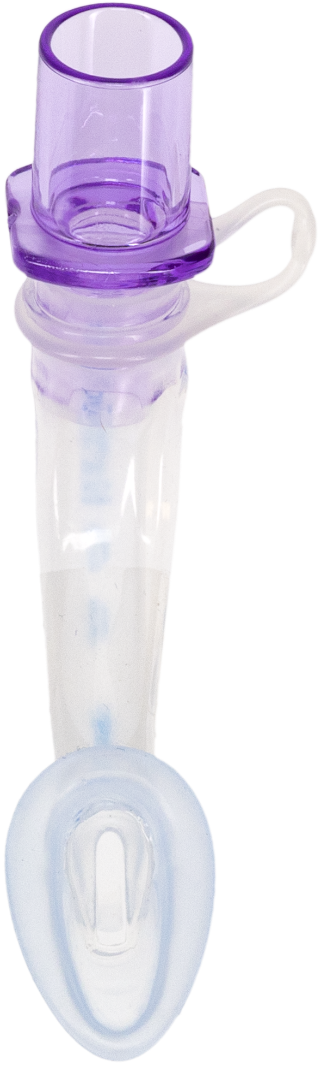
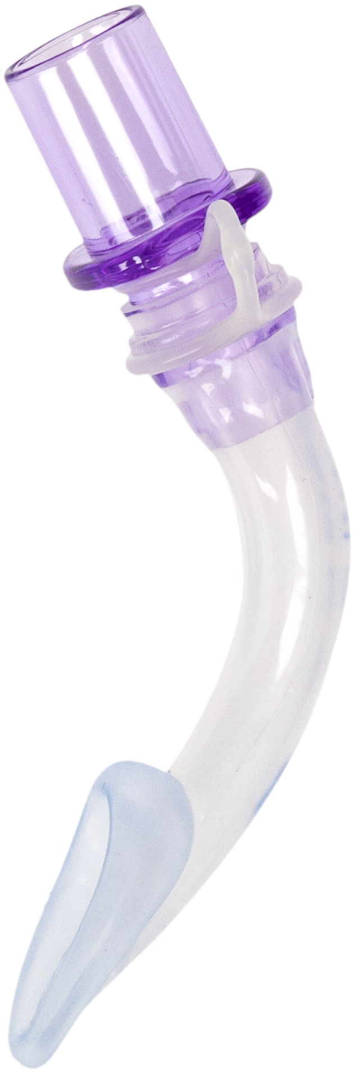
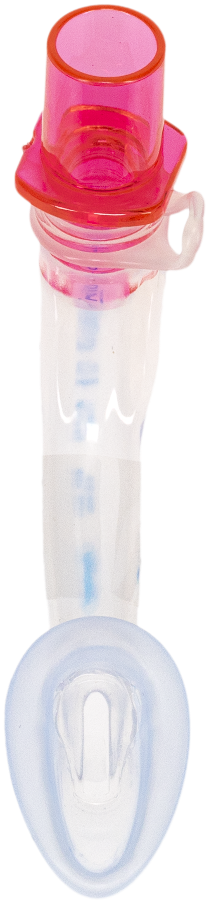
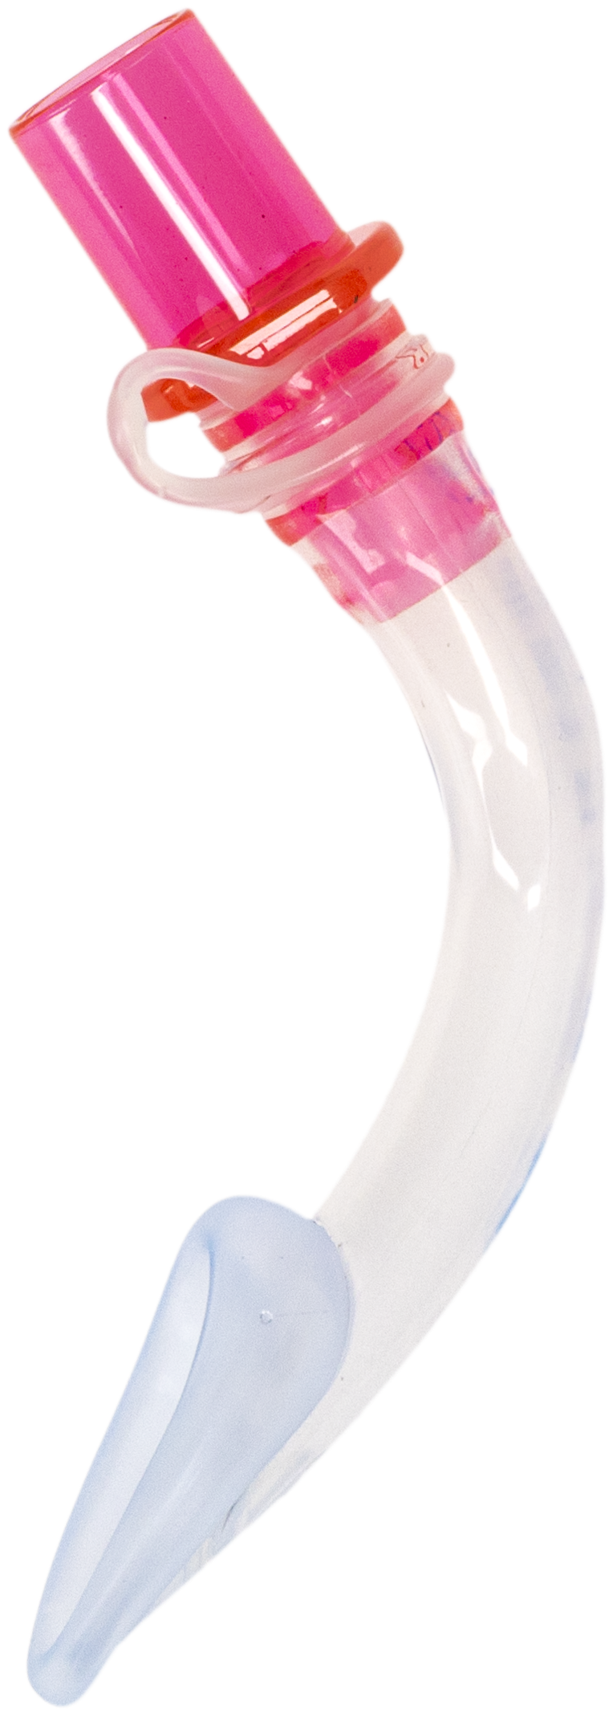
AirLife NRP Designed Products
“Using a T-piece resuscitator to deliver PPV is preferred to the use of a self-inflating bag.”³
“…healthcare providers must be aware of the usefulness of laryngeal masks in depressed neonates requiring PPV or endotracheal intubation, which can promptly resuscitate these infants and improve their outcomes, resulting in decreased morbidity and mortality rates.”¹
“Recent studies support the NRP recommendation to use the LM as a rescue airway when PPV fails and intubation is not feasible. The LM provides more effective PPV than face-mask ventilation.”²
3
Figure 1.5 Neonatal Resuscitation Program Algorithm from The Textbook of Neonatal Resuscitation, 8th Edition

Slide 4
SafeT T-Piece Resuscitator with Pop-Off
TM
The SafeT T-Piece Resuscitator is a safe solution during neonatal resuscitation and CPAP therapy.
Delivering continuous oxygen flow, while also providing consistent PIP and PEEP pressures, allows clinicians to provide the necessary ventilatory support during resuscitation.
SafeT promotes lung protection by minimizing the potential risk of barotrauma through controlled ventilation.
4

Slide 5
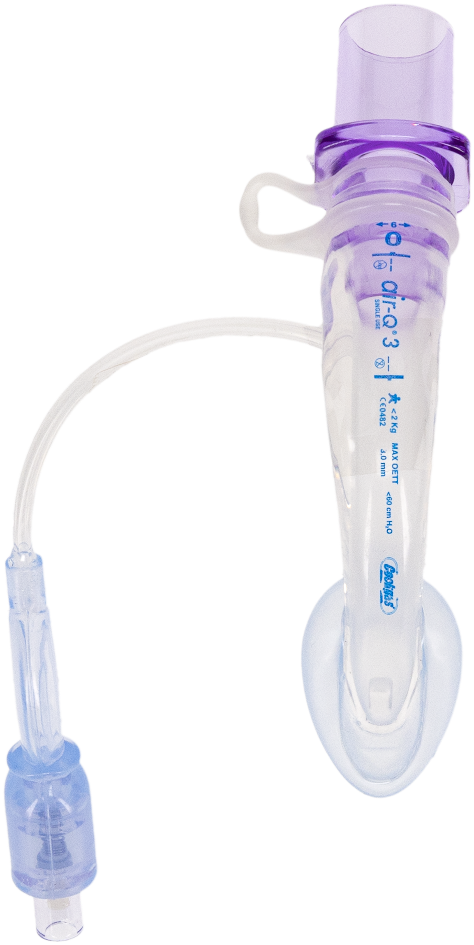
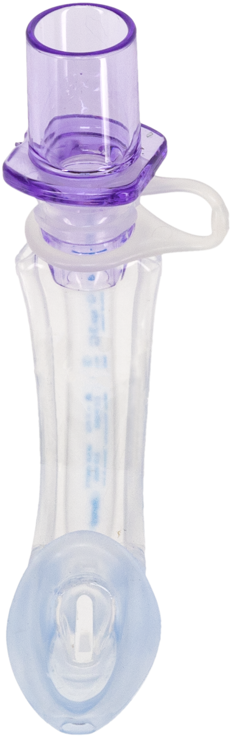
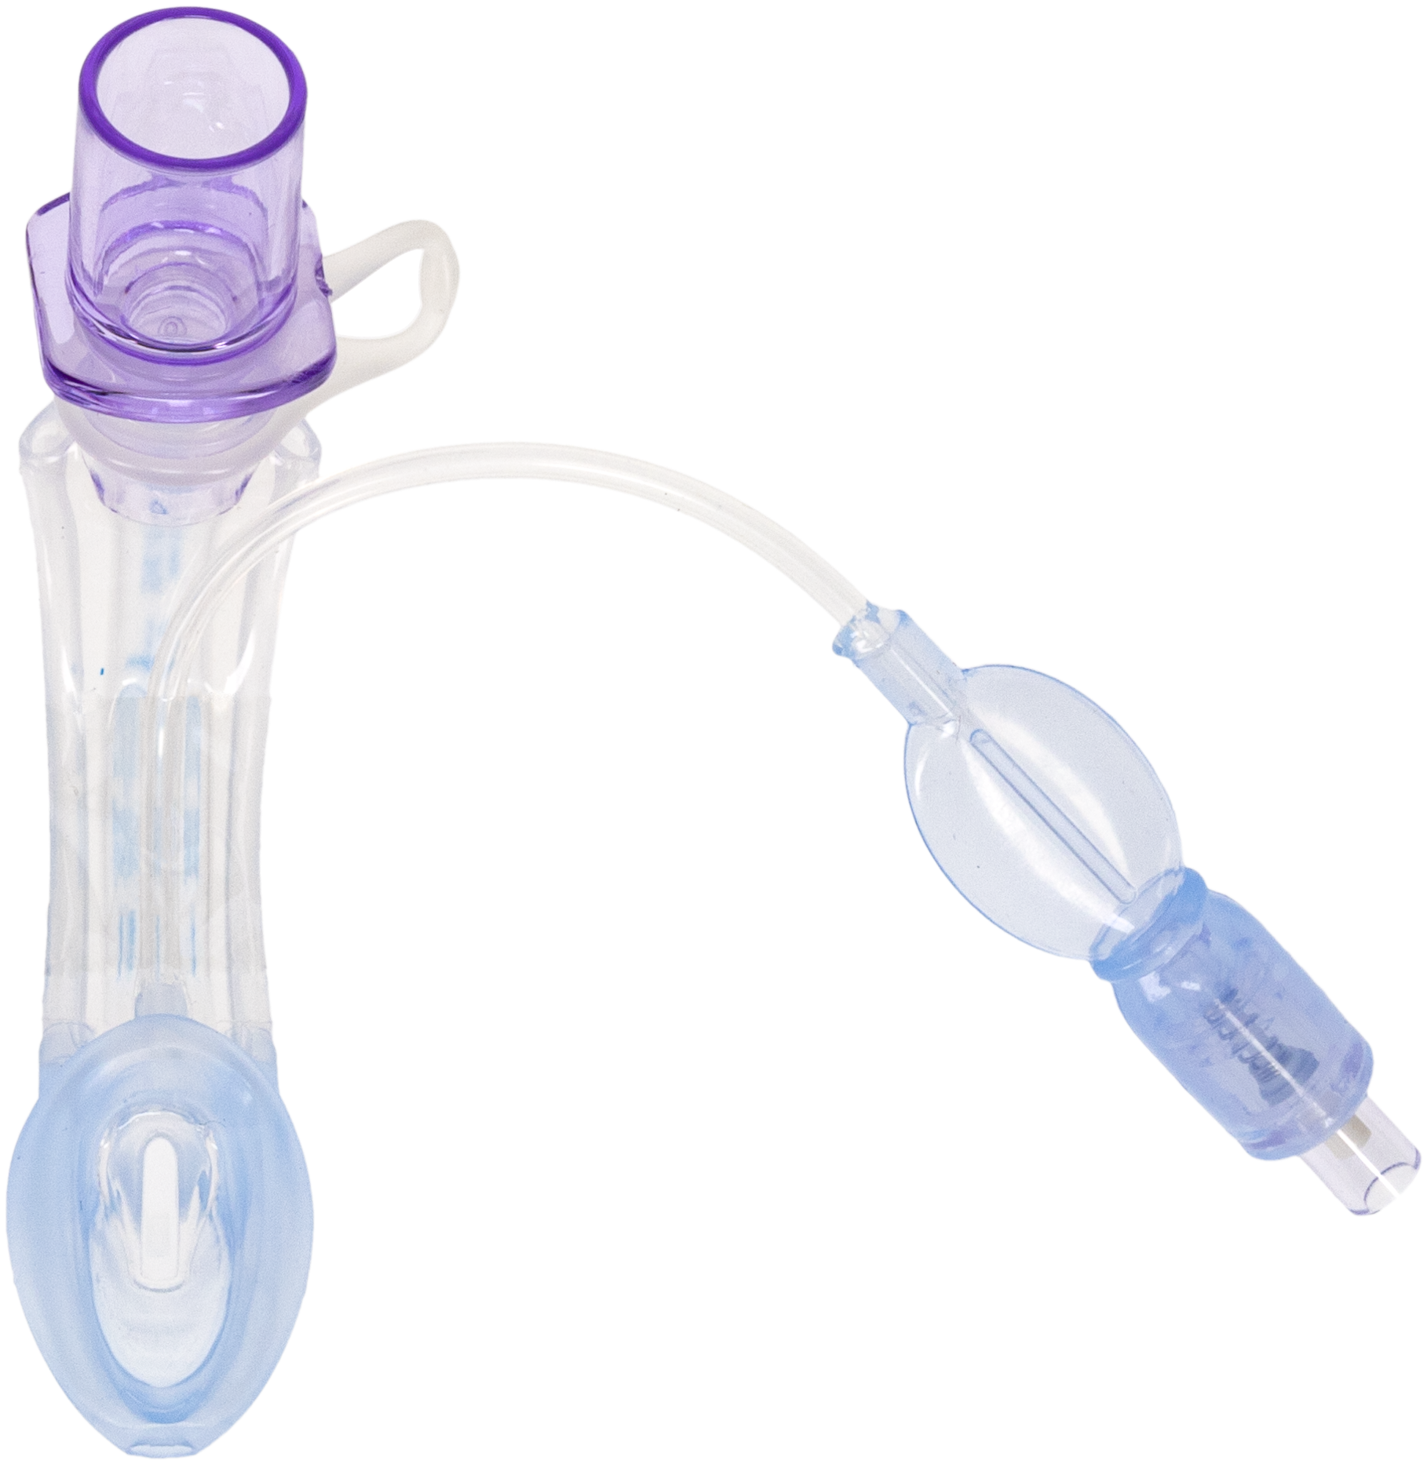
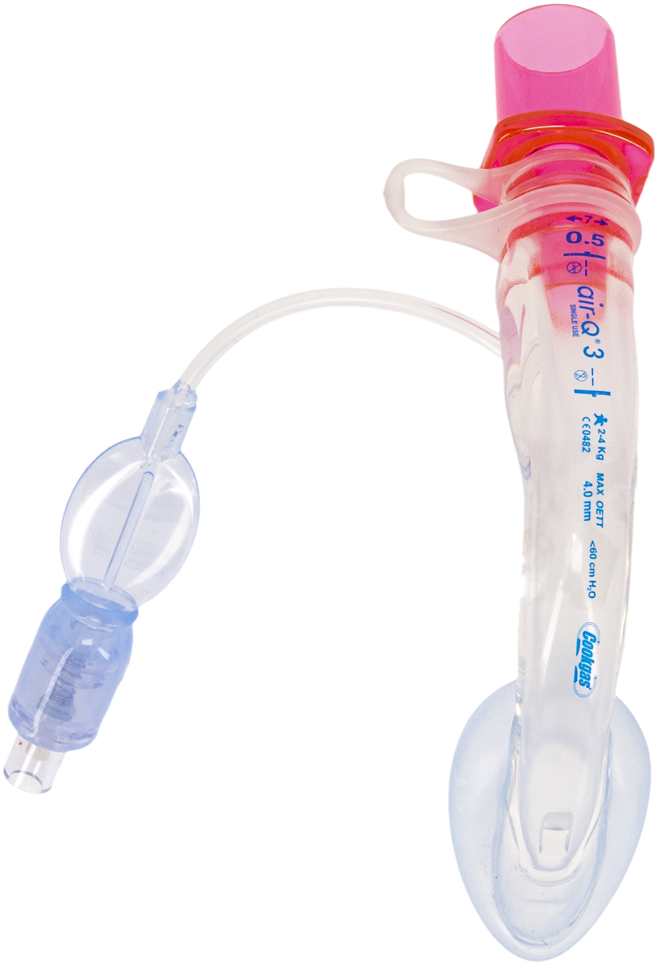
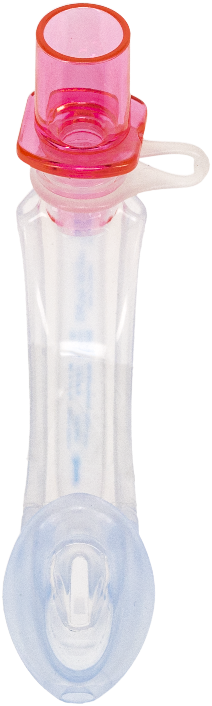
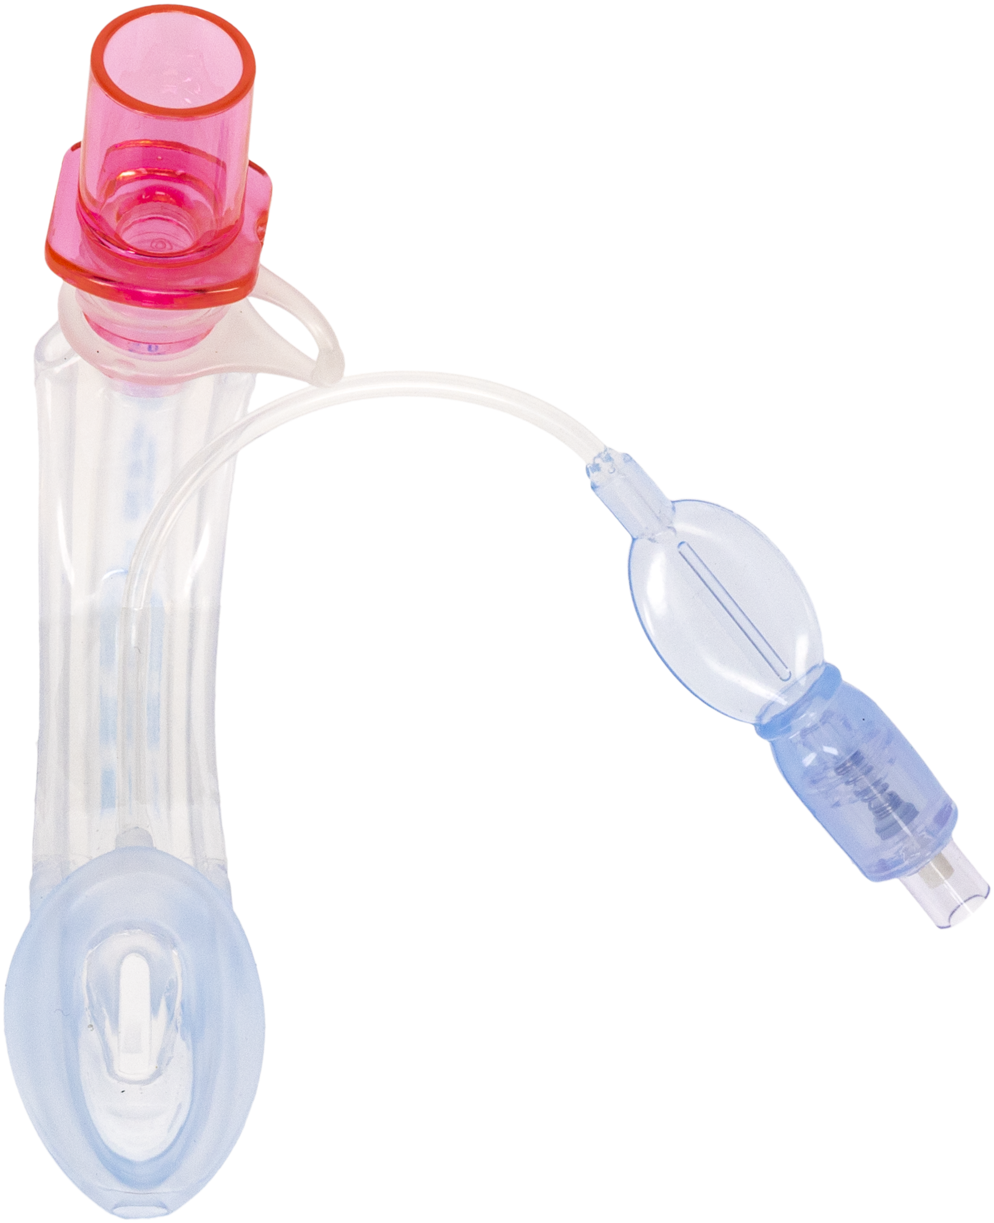
Air-Q 3 Supraglottic Airway
®
The advanced, all-silicone Air-Q3 Supraglottic Airway (SGA) helps deliver safety and confidence in airway management, no matter what airway challenges you may face.
Sizes 0 and 0.5 come in all styles, helping you perform safe SGA intubations and resuscitation on smaller infants.
The self-pressurizing model seals instantly and allows for insertion & ventilation with no additional steps.
Gastric access models have gastric channels, allowing for placement of a gastric tube and gastric decompression.
The anatomically curved tube assists in cuff sealing.
5

Slide 6
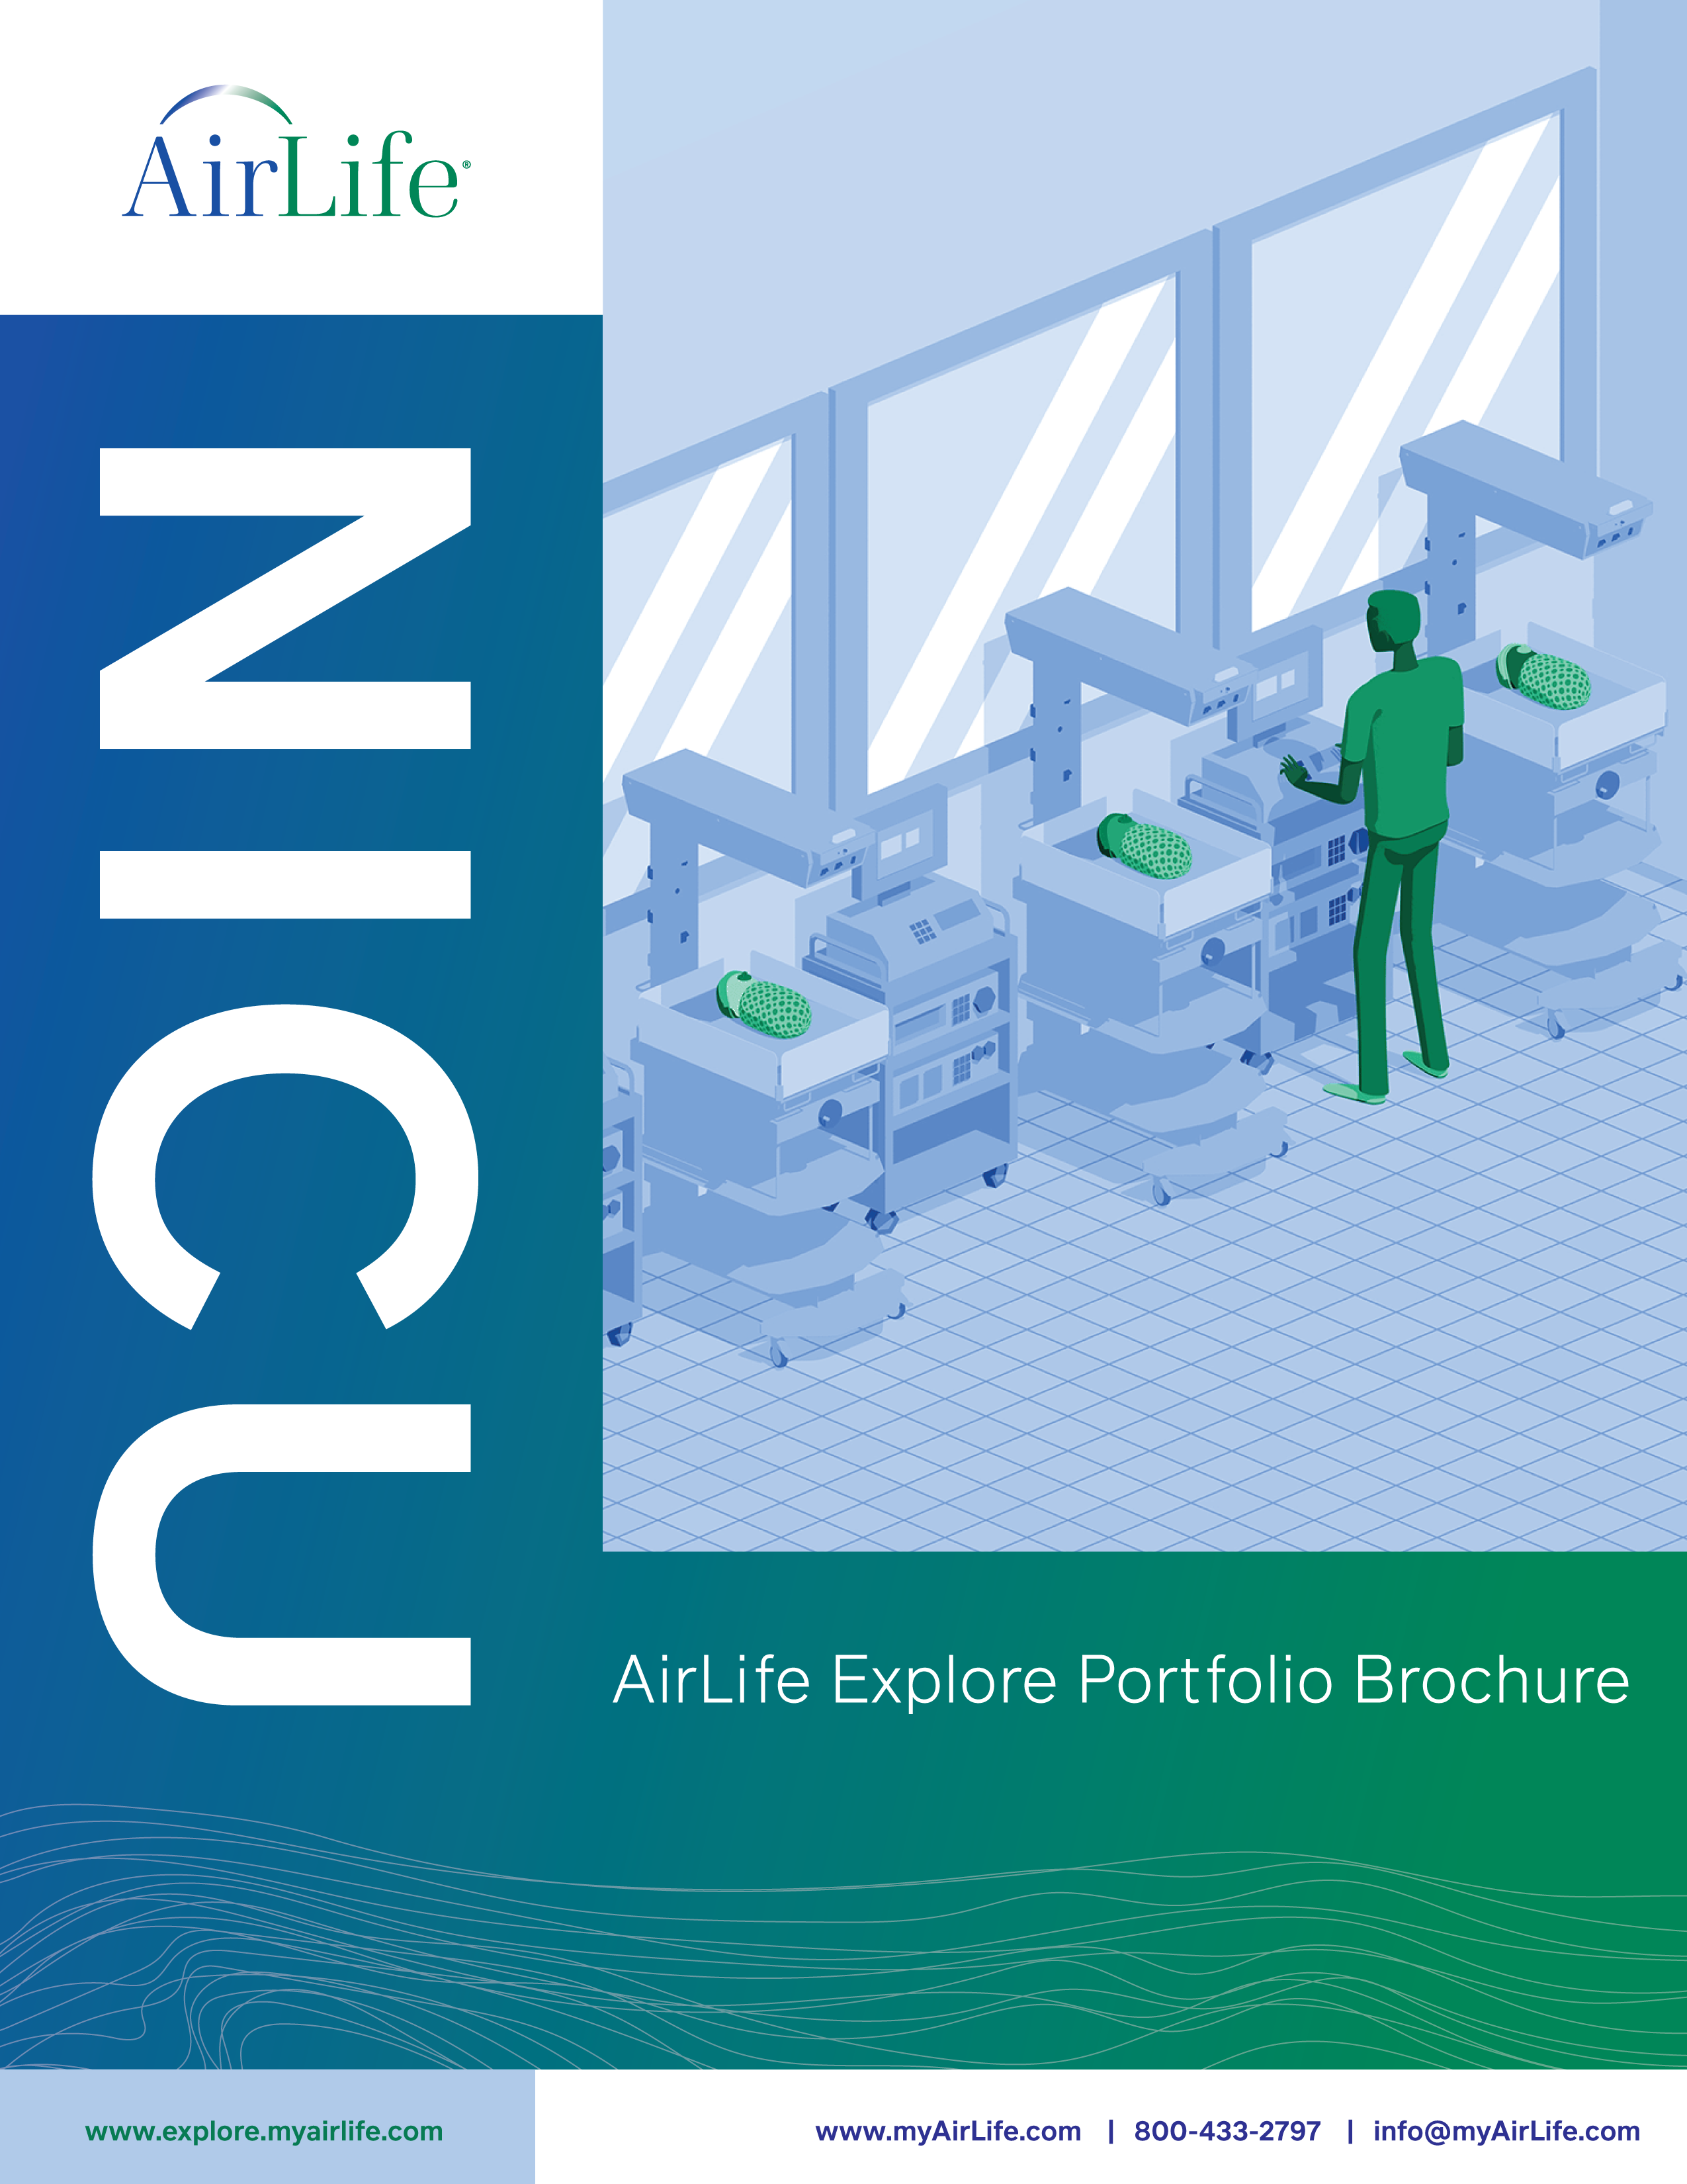
Explore AirLife’s Comprehensive NICU Portfolio
AirLife Neonatal Resuscitation NICU Web Page
AirLife NRP One Pager
AirLife NICU Brochure
AirLife Explore: NICU
Visit AirLife Connect for additional product specific resources
6

Slide 7
Thank You
Song ES, Jeon GW. Updates in neonatal resuscitation: routine use of laryngeal masks as an alternative to face masks. Clin Exp Pediatr. 2024 May;67(5):240-246. doi: 10.3345/cep.2023.00619. Epub 2023 Jul 11. PMID: 37448129; PMCID: PMC11065637.
Zaichkin, Jeanette MN, RN, NNP-BC; McCarney, Linda D. MSN, APRN, NNP-BC; Rhein, Michelle MSN, RN, CNS, RNC-NIC. The Laryngeal Mask: Empowering Nurses to Rescue Newborns. Advances in Neonatal Care 23(2):p 140-150, April 2023. | DOI: 10.1097/ANC.0000000000001044 ​
Nicole K. Yamada, MD, MS, Edgardo Szyld, MD, MSc, Co-Chair, Marya L. Strand, MD, MS, Emer Finan, MB, MEd, Jessica L. Illuzzi, MD, MS, Beena D. Kamath-Rayne, MD, MPH, Vishal S. Kapadia, MD, MSCS, on behalf of the American Heart Association and American Academy of Pediatrics. Circulation. Volume 149, Number 1. https://doi.org/10.1161/CIR.0000000000001181
Weiner, G. M., Zaichkin, J., & American Academy of Pediatrics. (2021). Textbook of neonatal resuscitation (8th ed., p. vii, xi). American Academy of Pediatrics.​
​
7

