Slide 1
Excellence with Every Breath™
AirFlow ™ Resuscitation & Hyperinflation Training

Slide 2
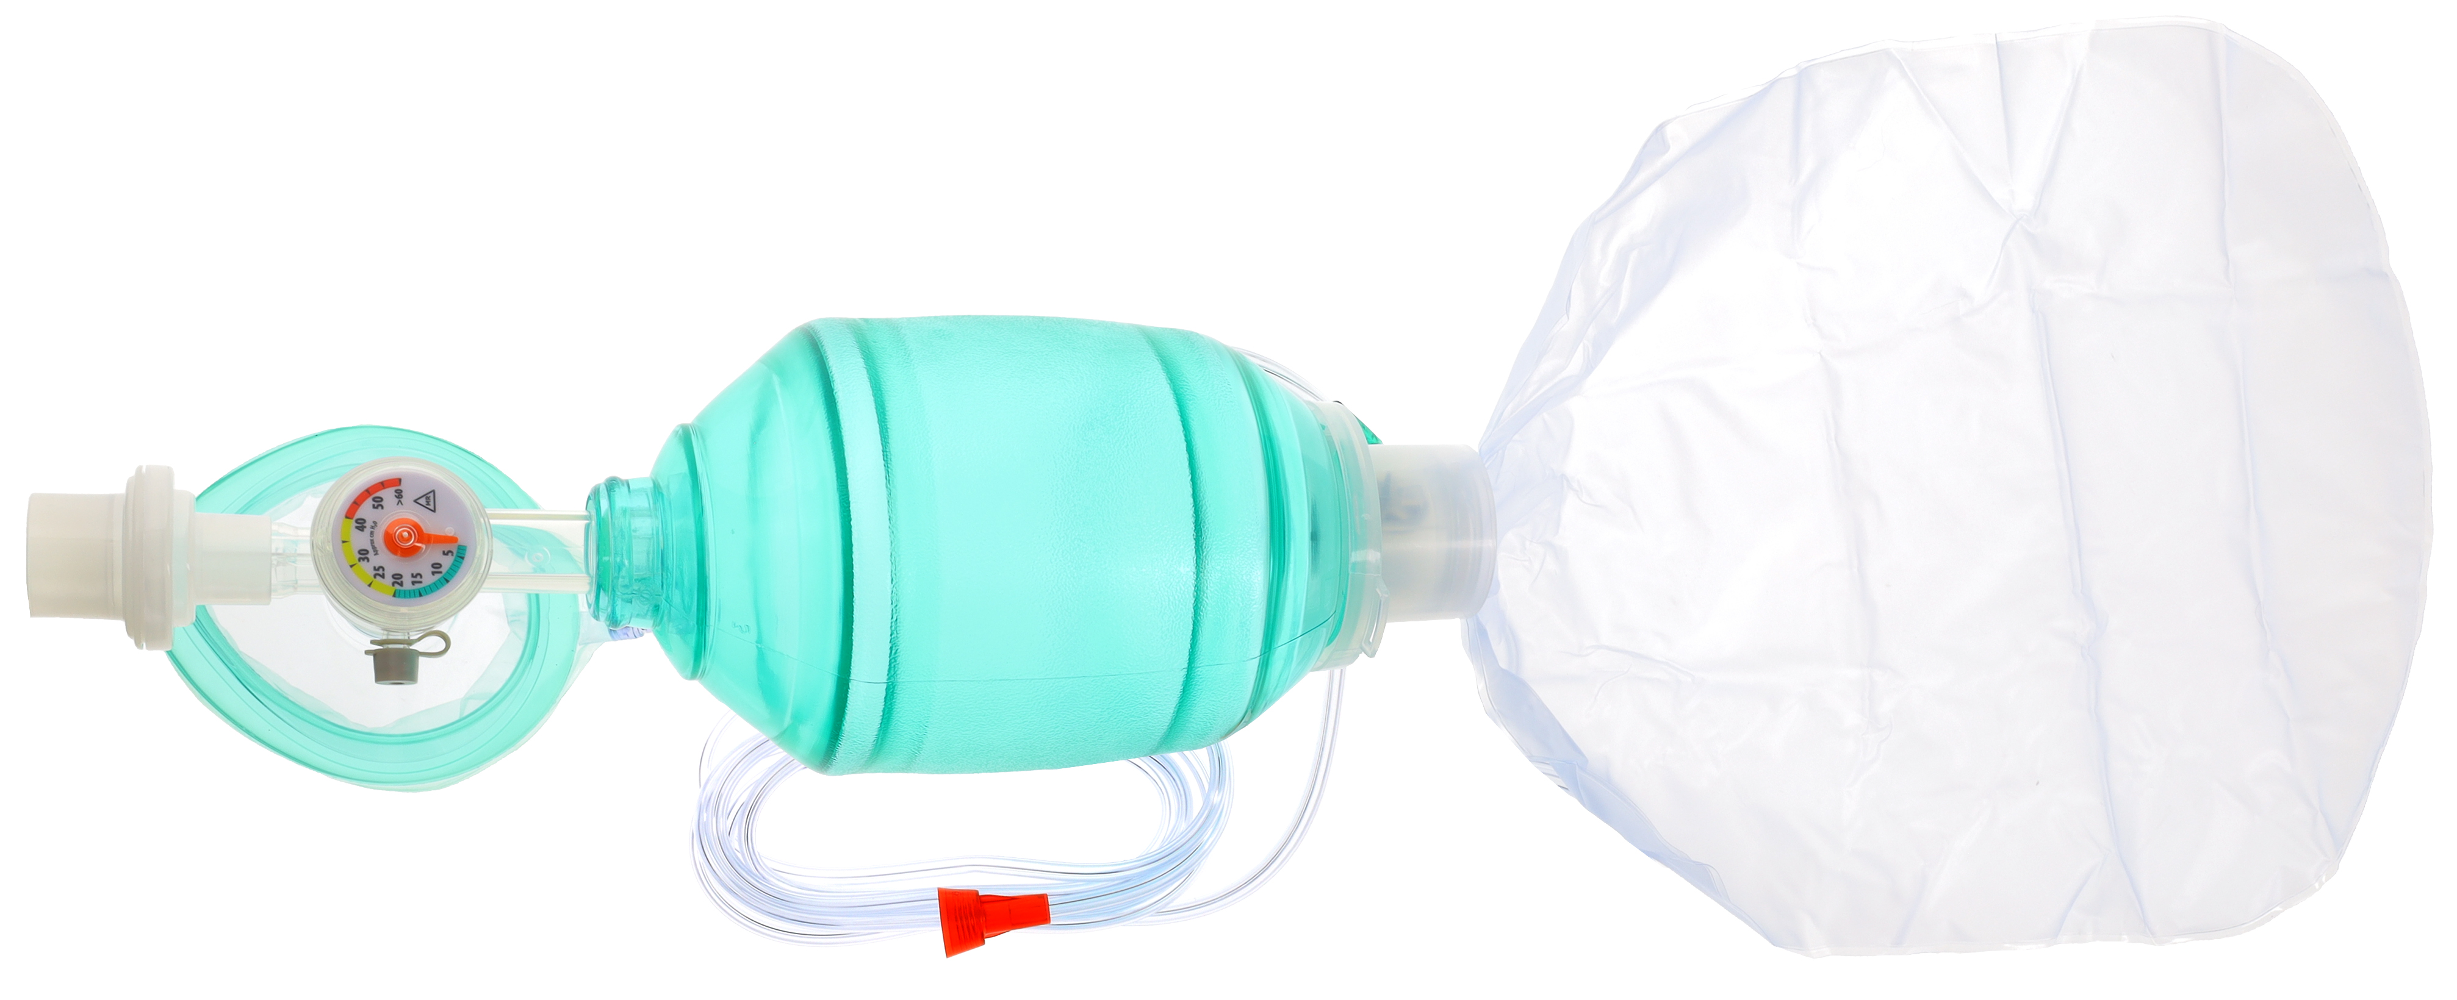

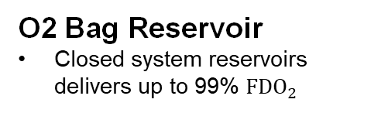
AirFlow Resuscitation Bags:
Key Features, Adult
Patient Port Swivel
Allows clinician to easily position resuscitation bag
Integrated Manometer
Promotes proper
pressure delivery
PVC Bag Body
Pliable, textured grip
for secure handling
Pre-Attached
Expiratory Filter
Protects clinician from
99.99% expelled B/V content
Sampling Port
End tidal ${CO}_{2}$ monitoring
Red Fits-All
O2 Connector
For easy visualization
of proper connection
O2 Bag Reservoir
Closed system reservoirs delivers up to 99% ${FDO}_{2}$
2

Slide 3
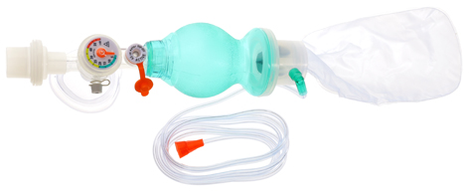

AirFlow Resuscitation Bags:
Key Features, Infant
Pre-Attached Expiratory Filter
Integrated Manometer
PVC Bag Body
Ergonomic bag shape
Pop-Off Valve
40 cm $H_{2}O$ pop-off
allows clinician to use
an appropriate
pop-off level

Slide 4
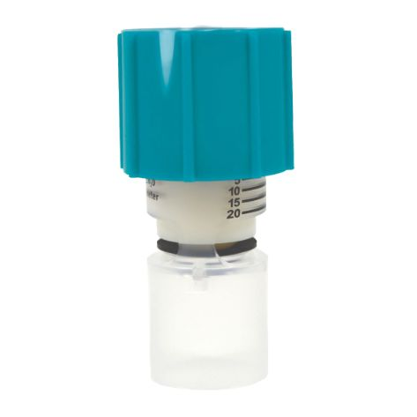
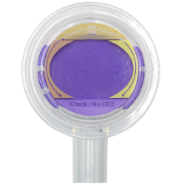
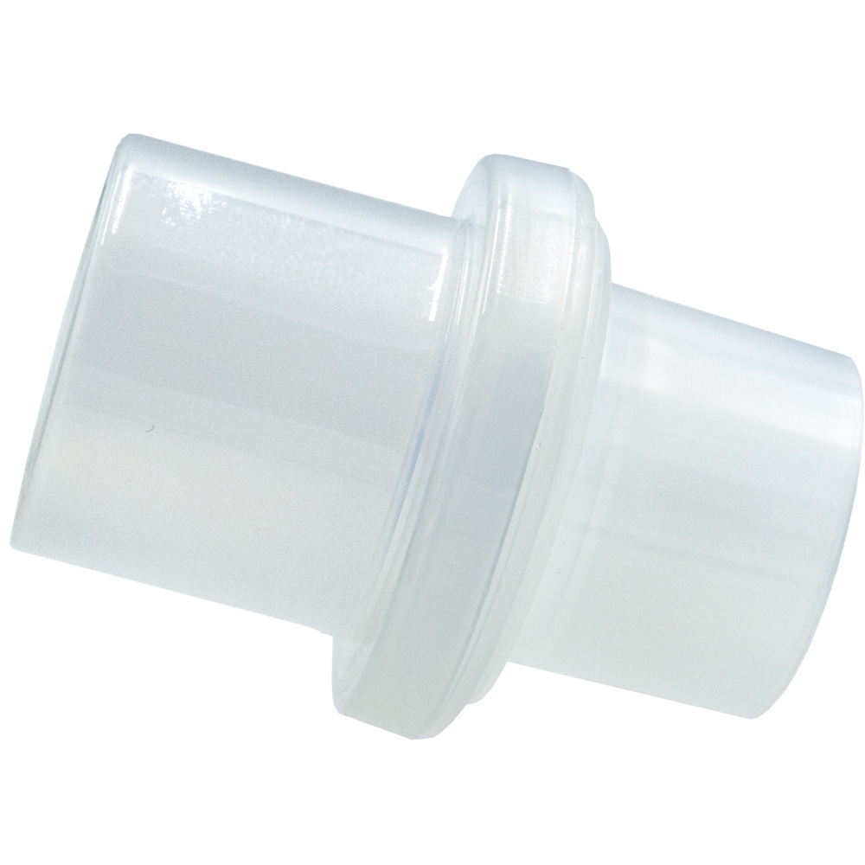
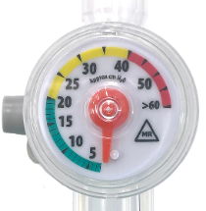

AirFlow Accessories
B/V Filter
Manometer
PEEP Valve
CO2 Easy®
Pre-attached expiratory filter protects clinician from up to 99.99% expelled bacterial/viral content
Enhanced dial scale on manometer allows for more accurate readings
Adjustable PEEP valves; 5-20 cm $H_{2}O$
For assessment of proper airway placement

Slide 5

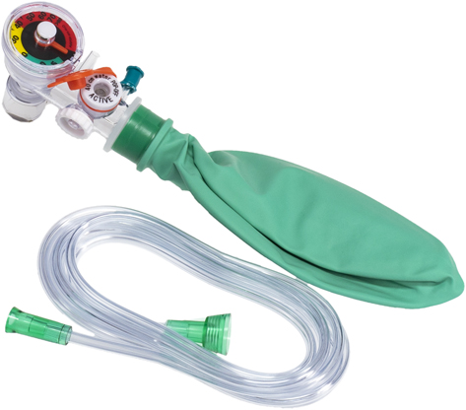
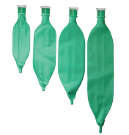
Hyperinflation System:
Key Features, NICU
Integrated Manometer
Promotes proper
pressure delivery
Pop-Off Valve
Prevents excessive pressure from being applied to lungs
Stay-Put Dial
Comes standard to enable clinician to achieve targeted static pressure
4 Sizes
0.5L,1L, 2L, 3L

Slide 6
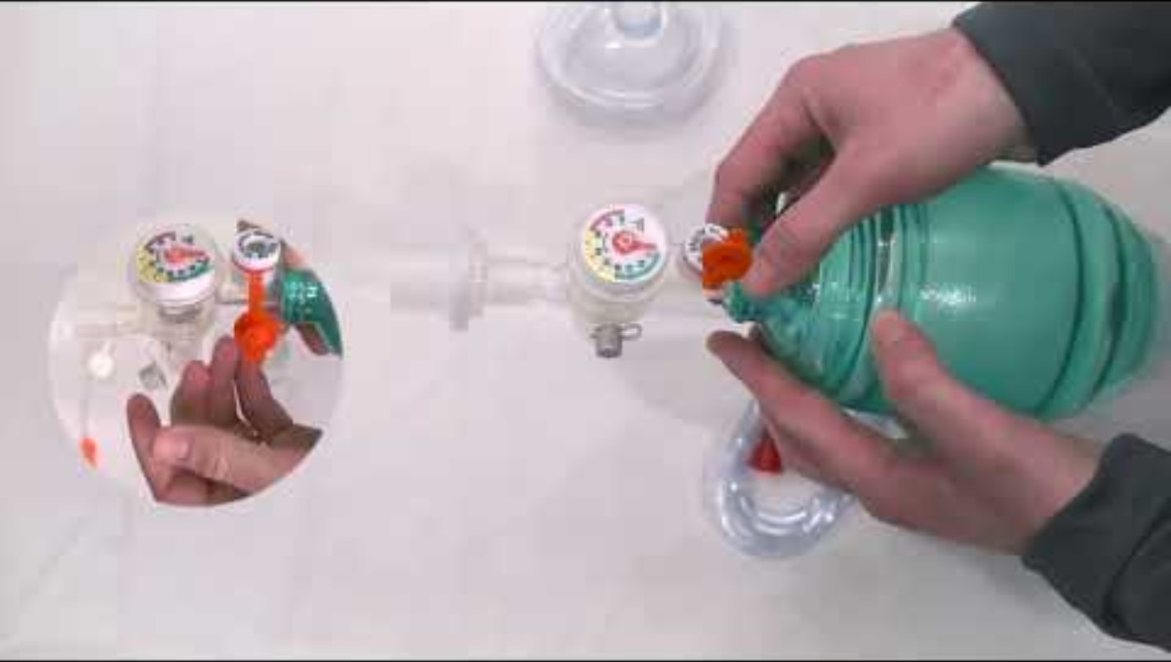
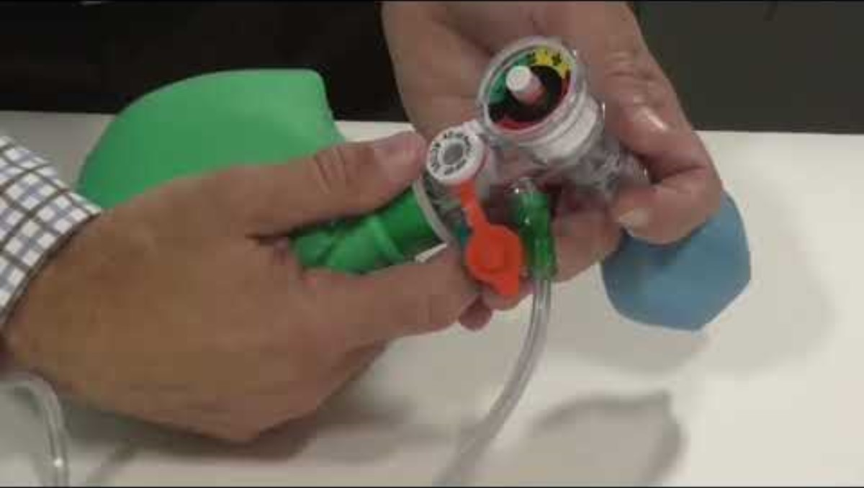
Resources
AirFlow™ Resources
AirFlow™ Resuscitator Landing Page
AirFlow™ Training Video
AirFlow™ Literature Sheet
Hyperinflation Resources
Hyperinflation Landing Page
Hyperinflation Training Video
Hyperinflation Literature sheet
6

Slide 7
Thank You
PPT-20022-C1 Rev1
7

