Slide 1


B&B Bubbler Training Guide

Slide 2
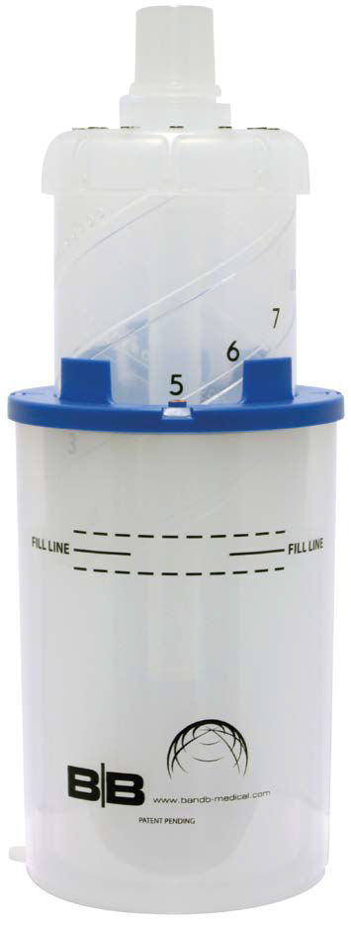
Featured Product
B&B Bubbler
Purpose – To deliver continuous positive airway pressure (CPAP) to infants < 10 kg.

Slide 3
Define Bubble CPAP
A spontaneous breathing mode in which flow is delivered through a breathing circuit to the patient
Patient exhalation is accomplished through the breathing circuit, through a water column, with a set PEEP
Bubble nasal CPAP uses a column of water to provide the positive airway pressure rather than a variable resistor valve

Slide 4
CPAP vs. PEEP
Continuous Positive Airway Pressure (CPAP)
  is a spontaneous breathing mode in which positive pressure is continuously delivered throughout the breathing cycle
Positive End Expiratory Pressure (PEEP)
  is the set measurement of pressure delivered to the airways; measured in cm H2O. Positive end expiratory pressure above atmospheric

Slide 5
Who benefits from
Bubble CPAP
Spontaneously breathing infant in respiratory distress
Infants with a marked increase in their work of breathing
  grunting, retracting, nasal flaring, cyanosis, and need for supplemental oxygen
Surfactant deficient premature newborn
Term infant, suspected TTN

Slide 6
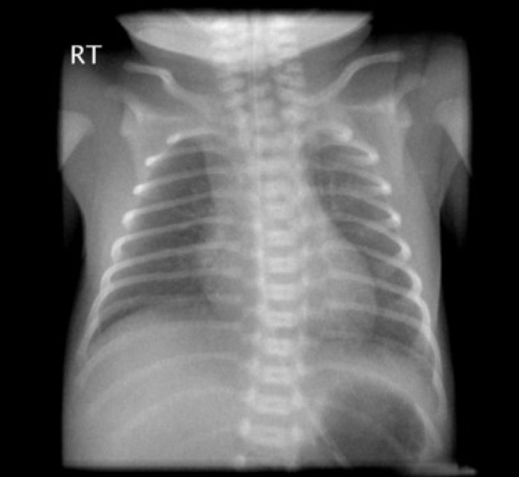
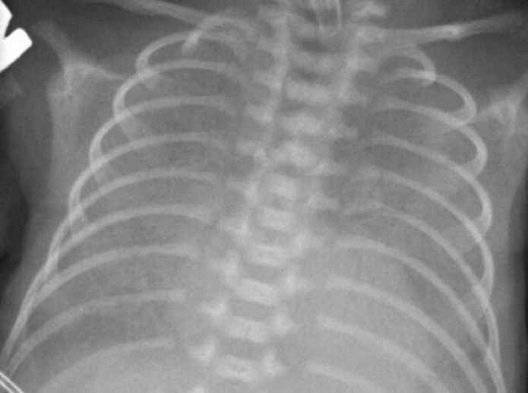
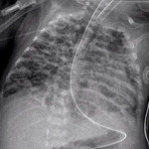
Goals of Bubble CPAP
Decrease work of breathing
Prevention of alveolar collapse
  atelectasis/pneumonia
Recruitment of alveoli
Prevention of barotrauma
Normal
Surfactant deficiency
Barotrama

Slide 7
Less = More
Less:
patient ventilator days
number of days on oxygen
need for sedation
need for surfactant administration
barotrauma – CLD/BPD
chance for VAP, trauma with intubation and complications that derive from long term mechanical ventilation

Slide 8
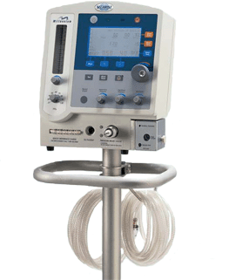

BCPAP vs. VCPAP
Less risk of ventilator associated complications
Less expensive
Additional Information
“Bubble CPAP versus Ventilator CPAP in Preterm Neonates with Early Onset Respiratory Distress — A Randomized Controlled Trial” - J Trop Pediatr (2013)
http://tropej.oxfordjournals.org/content/early/2013/01/09/tropej.fms061
“Bubble Continuous Positive Airway Pressure, A Potentially Better Practice, Reduces the Use of Mechanical Ventilation Among Very Low Birth Weight Infants With Respiratory Distress Syndrome” - Teresa Nowadzky, Alfonso Pantoja and John R. Britton (2009)
http://pediatrics.aappublications.org/content/123/6/1534.full.pdf+html
Thousands of $$$$$!!!!

Slide 9
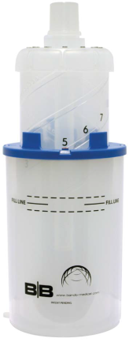
Features and Benefits
B&B Bubbler
Convenient method to deliver CPAP for infants < 10kg
CPAP level is easily adjustable from 1 to 10 cm H20
ISO equipment mount adapts to all commercially available pole clamps
Clearly marked settings for precise PEEP adjustment
Positive engagement, rotating CPAP dial and setting lock reduces risk of inadvertent setting changes

Slide 10
Features and Benefits
B&B Bubbler
360 degree swivel gas inlet reduces risk of inadvertent circuit disengagement
Dual-chambered wall allows water level to be observed without disrupting therapy
Internal, drainable overflow chamber limits fluid level to desired height
Accepts 15 mm OD and 22 mm ID circuits
Closed system minimizes risk of atmospheric fluid contamination

Slide 11
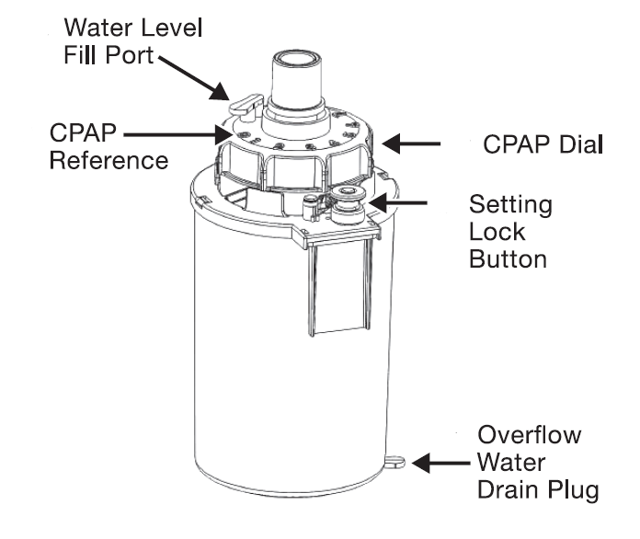
Features and Benefits

Slide 12
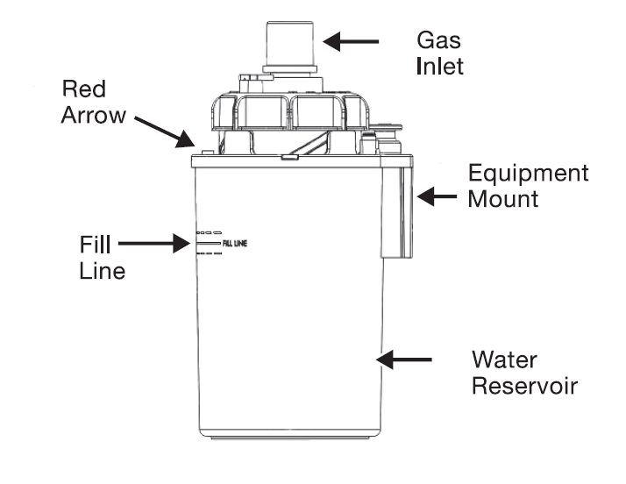
Features and Benefits

Slide 13
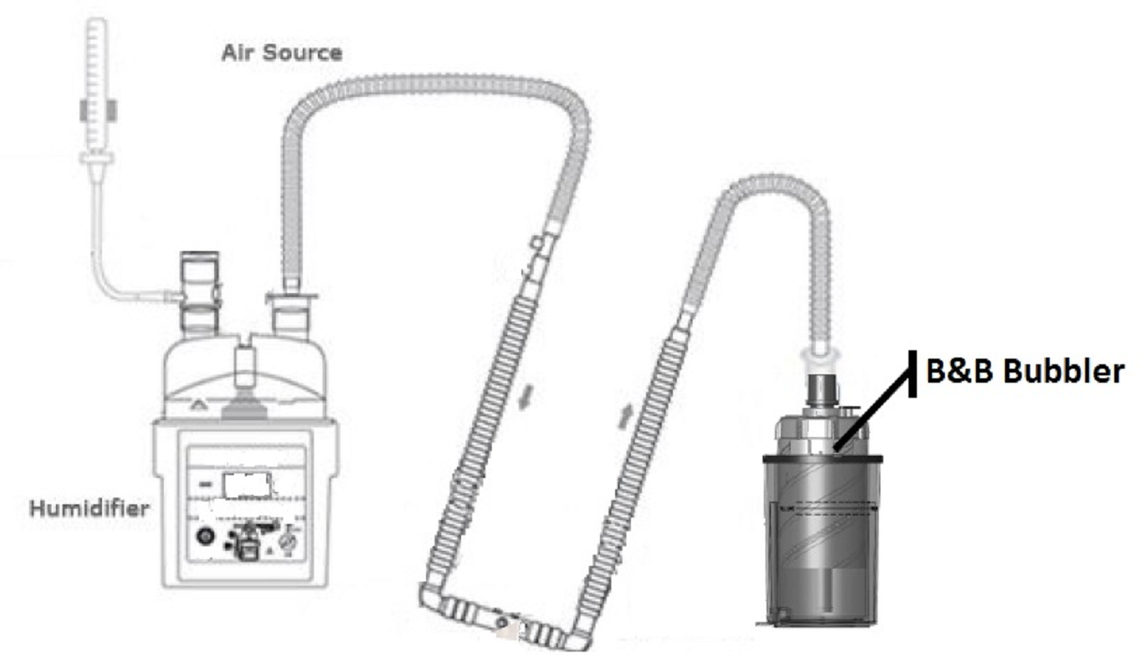
Bubble CPAP Circuit Diagram

Slide 14
Product Application – B&B Bubbler
1. Fill the water reservoir to the solid fill line with sterile water or 0.25% acetic acid solution by adding water through either the gas inlet adapter located in the center of the bubbler, or by instilling water through the water level fill port, adjacent to the inlet port.
2. Slide the B&B Bubbler into a 30 mm pole or rail-mount bracket to assure that the device remains in an upright position using the equipment mount located on the rear side of the B&B Bubbler.
3. While holding the CPAP dial, press the setting lock button and rotate the CPAP dial counterclockwise to align the red arrow with the prescribed correlating CPAP level on the B&B Bubbler. Release the setting lock button to lock the CPAP dial in place.
4. Adjust the air/oxygen blended gas flow to the desired level between 1 – 12 LPM.

Slide 15
Product Application – B&B Bubbler
5. Connect the expiratory end of the breathing circuit to the gas inlet connector of the B&B Bubbler.
6. Connect an airway pressure manometer to the circuit between the patient interface and the inspiratory side of the circuit.
7. Connect a pressure relief manifold between the blended gas supply and the inlet port of a humidifier. The pressure relief manifold will limit the delivered pressure in the event of an occlusion.
8. Before attaching the interface to a patient, occlude the patient interface connected to the circuit and confirm the desired pressure setting. Assure bubbling is visible and check the integrity of the breathing circuit.

Slide 16
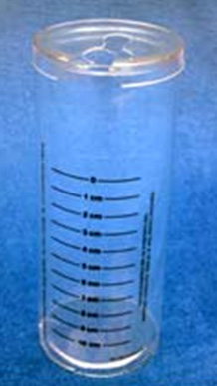
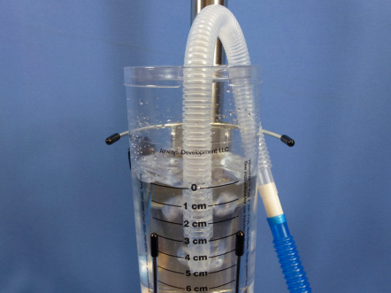
Competitive Comparison
Airways Development Water Seal Canister &
Pole Clamp
Features
The Canister has a custom tube supporting top
Water column displacement in the tube
Tube depth adjustment
Custom Bracket
The Bracket fits into the Pole Clamp
The Pole Clamp fits 1-1½ ” diameter poles
General use for 1-10 cm HO pressure verification
Comments
Difficult to maintain position of the expiratory tube in the canister
Difficult to maintain the fluid level & difficult to view fluid level in all positions
Infection Control concerns regarding open system and potential for contamination
of fluid
Canister not secure in bracket
No overflow chamber
Must disengage to read water level
www.airwaysdevelopment.com

Slide 17
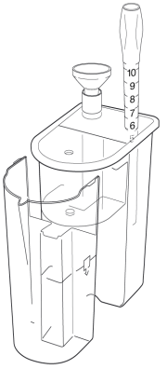
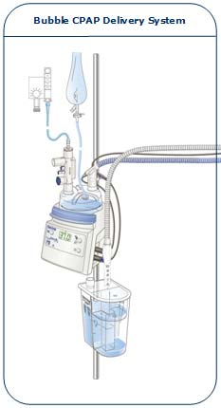
Competitive Comparison
Fisher & Paykel: Bubble CPAP
Delivery System
Features
Pressure settings from 3 to 10 cm H2O
Detachable overflow container allows continuous CPAP while removing excess water from condensate
Mountable using an F&P humidifier bracket
Warning: The use of the Bubble CPAP Delivery System with other than the recommended Fisher & Paykel humidifier may impair performance or compromise safety.
Comments
Open System
Must manually reposition tube depth to change PEEP level
Must purchase entire Bubble CPAP System
Must disengage to read water level
www.fphcare.com

Slide 18
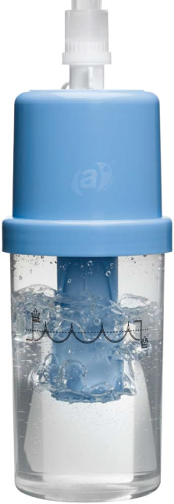
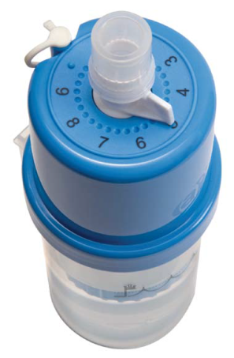
Competitive Comparison
Babi.Plus Bubble PAP Valve
Features
360° Swivel inlet connector accepts 15 O.D. and 22mm I.D. expiratory
circuit connectors
Rotating pressure adjustment lever
Marked settings
Water level adjustment port to add or remove water
Equipment mount
Minimum and maximum lines
Comments
No overflow chamber
Must disengage to read water level
www.babi-plus.com

